Slide 1

“China
Seismological
Reference Model”
Institute of Geology and Geophysics, CAS
Walter Mooney
USGS
June 27, 2016

Slide 2

Special Thanks to:
Prof. Wen Lianxing
Prof. Zhao Lian-Feng
and
Organizing Committee

Slide 3

Earthquake
Science Center
Walter D. Mooney
U.S. Geological Survey
Menlo Park, California USA
mooney@usgs.gov

Slide 4
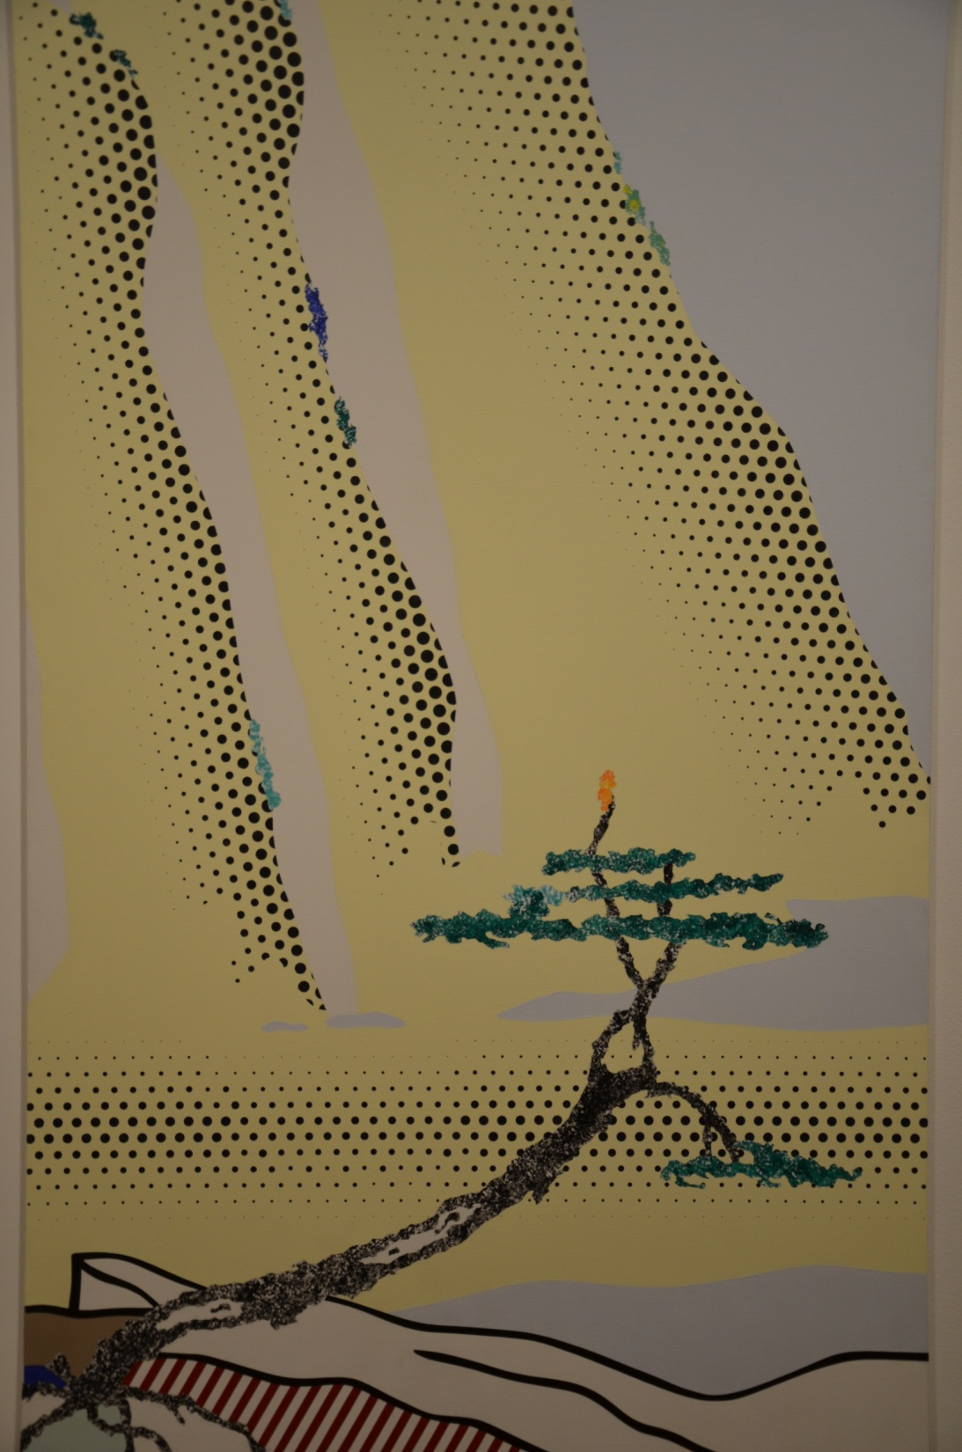
Global
Crustal
and
Lithospheric
Models:
A Synthesis

Slide 5
THE
CRUST

Slide 6
Global Geological Provinces
Mooney et al., 2007

Slide 7
OCEAN
SHIELD
PLATFORM
OROGEN
SEDIMENTARY BASIN
LARGE IGNEOUS
PROVINCE
EXTENDED CRUST

Slide 8
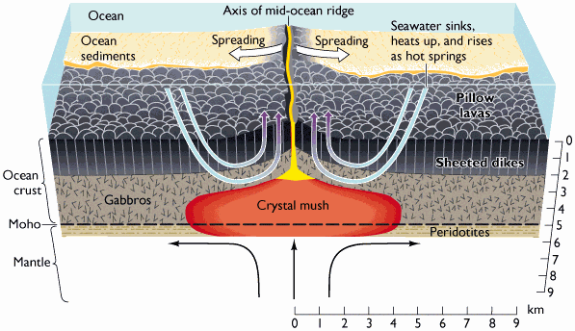
Generation of Earth’s Oceanic Crust
Oceanic
Intrusion and differentiation of mantle-derived basalt
From Press & Siever

Slide 9
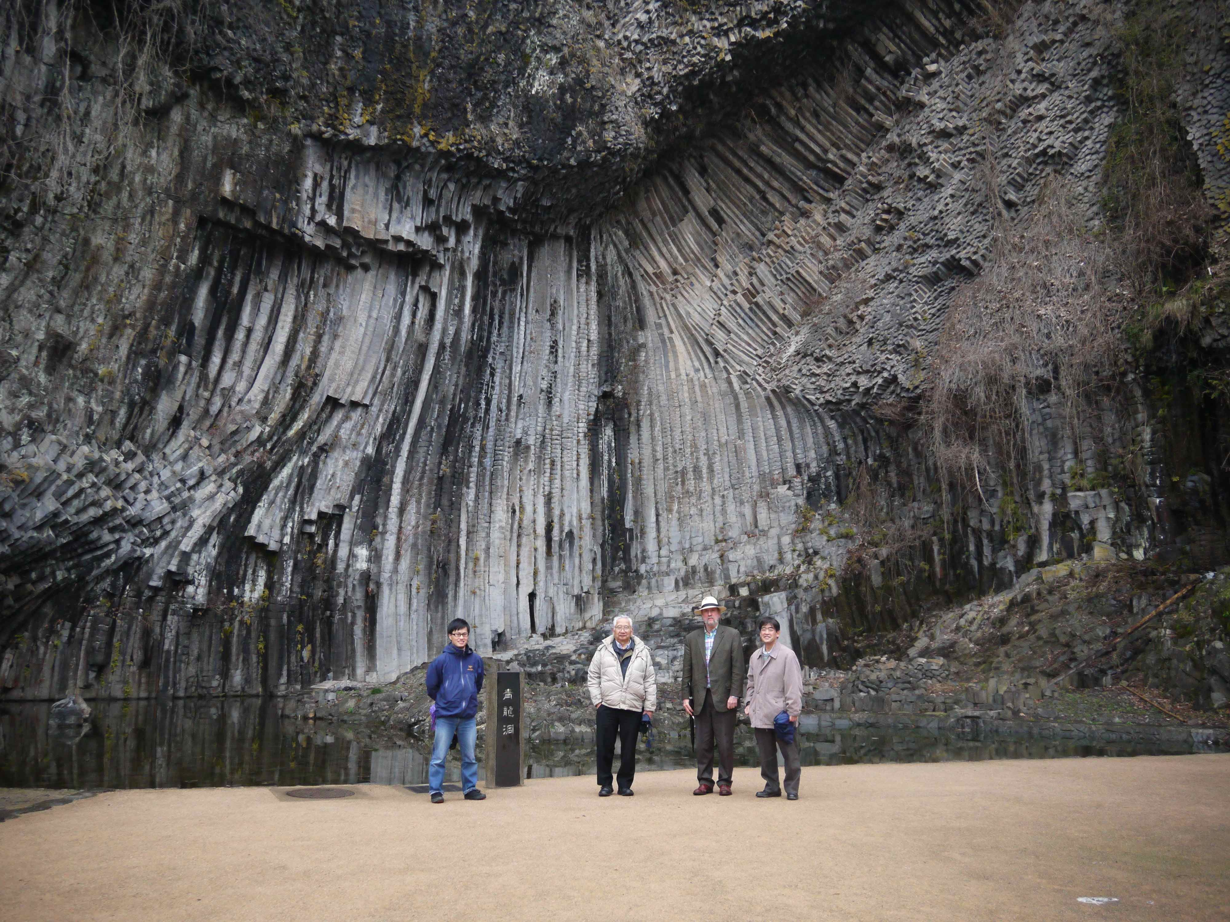
Sheeted Dikes, Japan (2014)

Slide 10
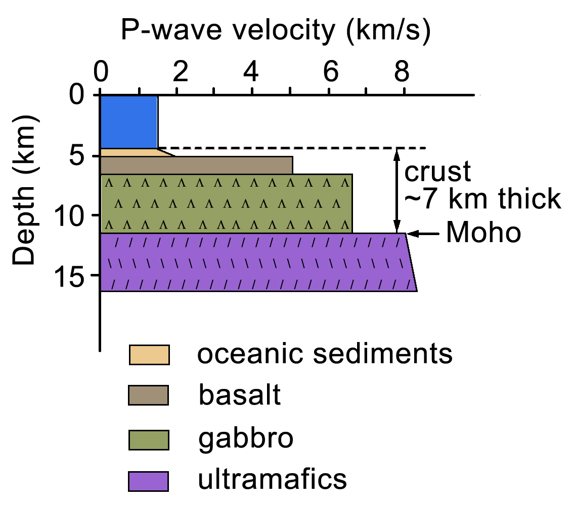
Oceanic Crust

Slide 11


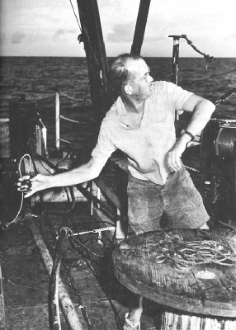
Marine Geophysicists in 1960’s
George Shor, Maurice Ewing and Russell W. Raitt

Slide 12
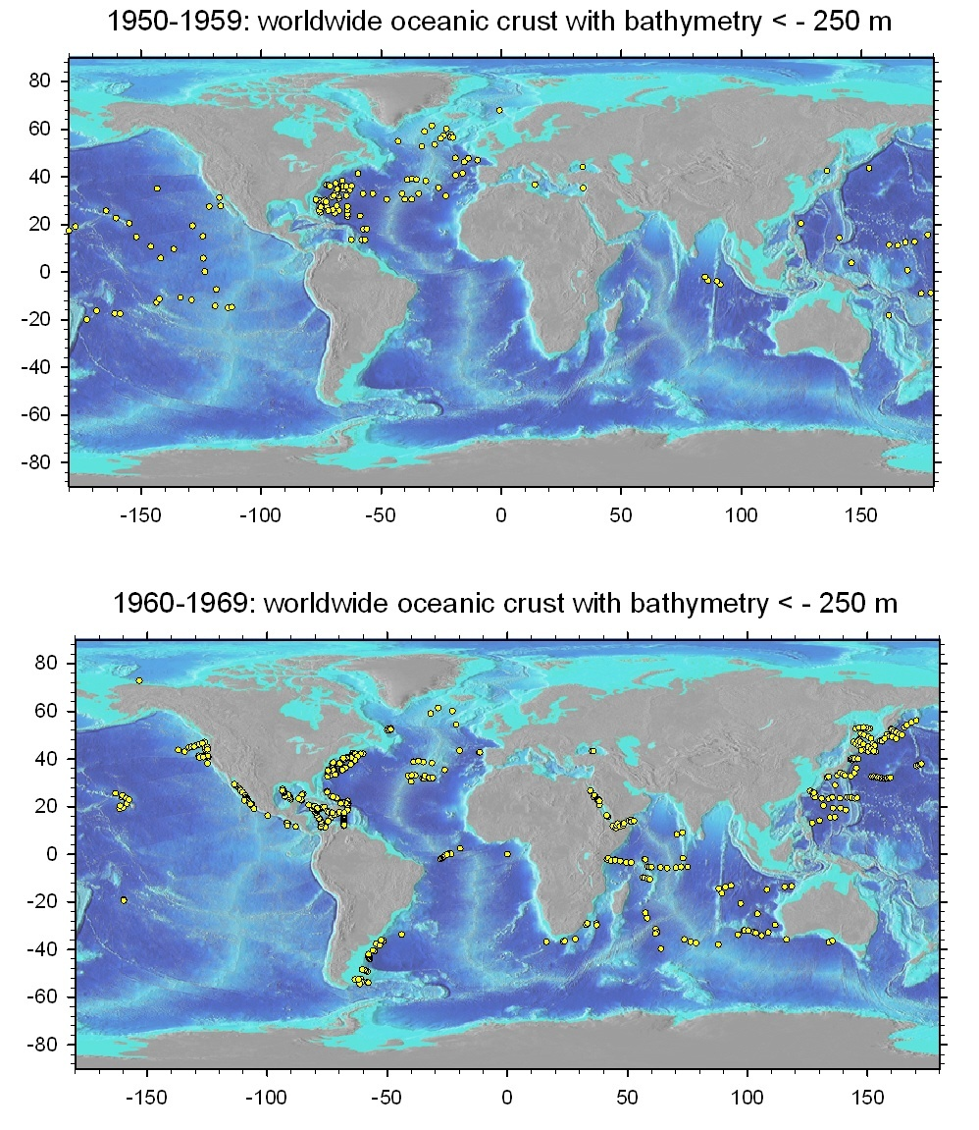

Slide 13
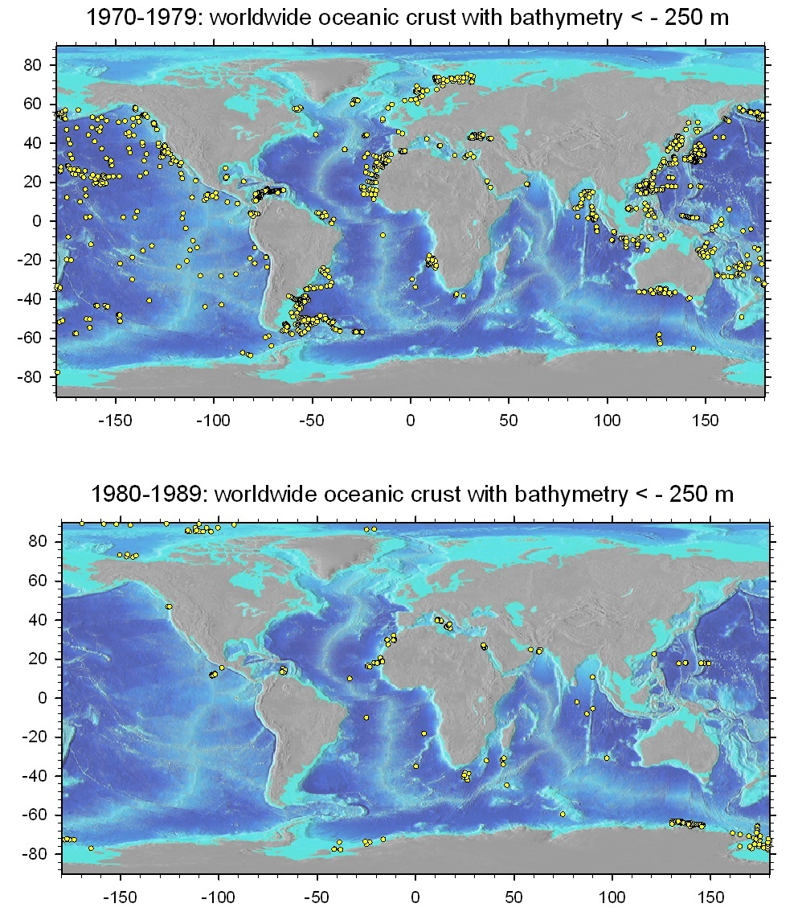

Slide 14
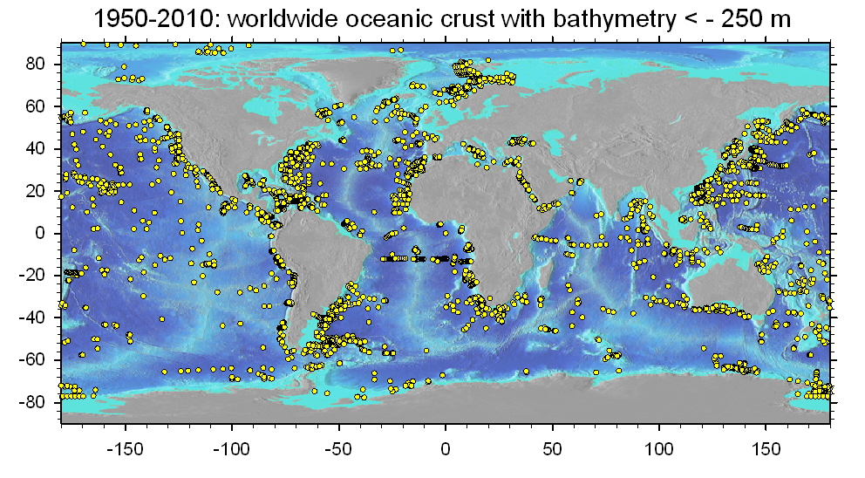

Slide 15
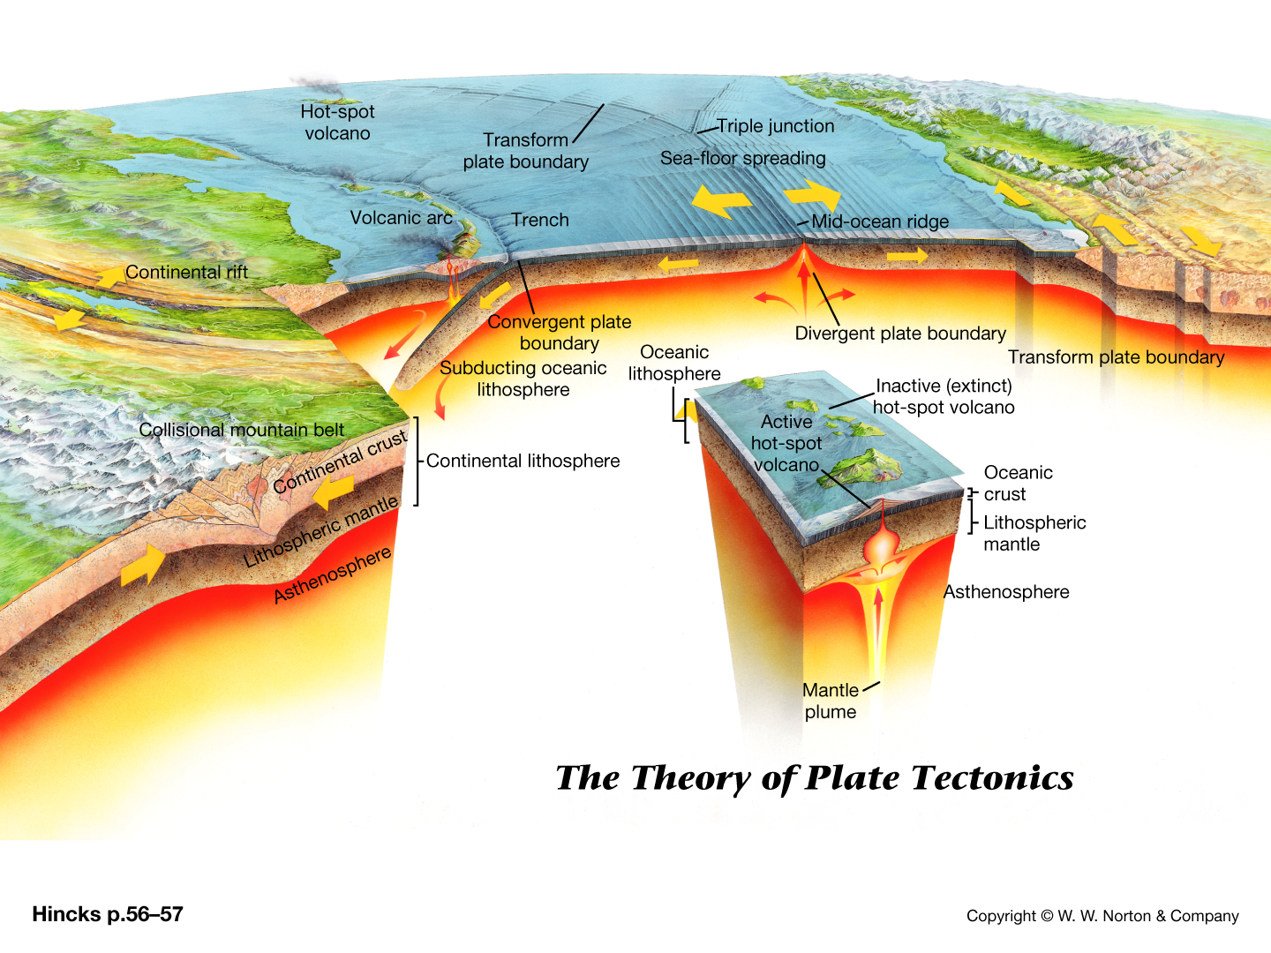
Continental Crust
Notes:
Establishing the composition of continental crust provides important insight into the processes of its formation.

Slide 16
Continental Crust
Variable Crustal and
Lithospheric Properties
Notes:
Establishing the composition of continental crust provides important insight into the processes of its formation.

Slide 18
Geochemistry
Laboratory and Field
Seismology

Slide 19

Gao Shan, 1962-2016
Gao Shan,

Slide 20
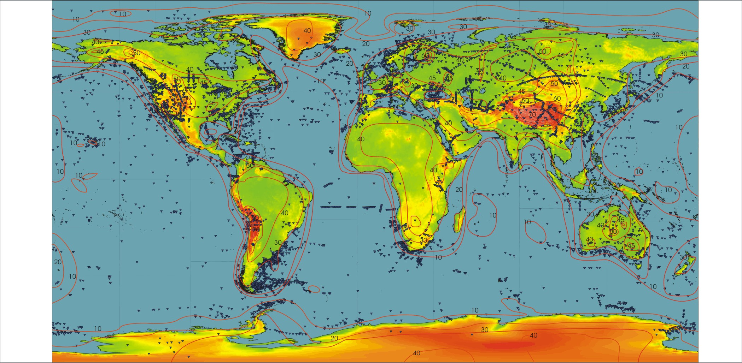
Global Active-Source Seismology
(Mooney, 2007, Treatise on Geophysics
Prodehl and Mooney, 2012, GSA Memoir)

Slide 21
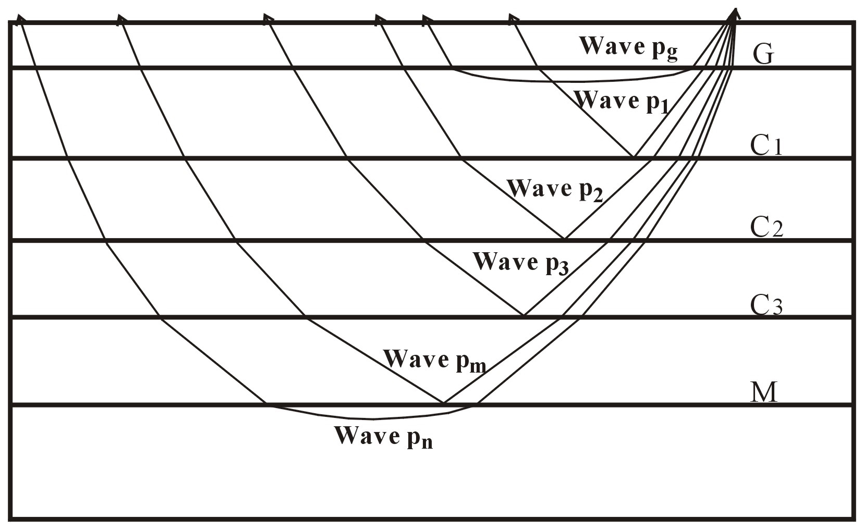
Notes:
Schematic diagram illustrating the ray paths of the wave groups Pg, P1, P2, P3, Pm, and Pn identified in the record sections. Pg is a refracted (diving) wave from the crystalline basement; P1, P2 and P3 are wide-angle reflected waves from intracrustal interfaces; Pm is a wide-angle reflected wave from the top of the mantle (the Moho); Pn is a refracted (diving) wave from the uppermost mantle. Letters indicate the following: G–base of the sedimentary cover, C1, C2, C3–intracrustal interfaces, M–Moho.

Slide 22
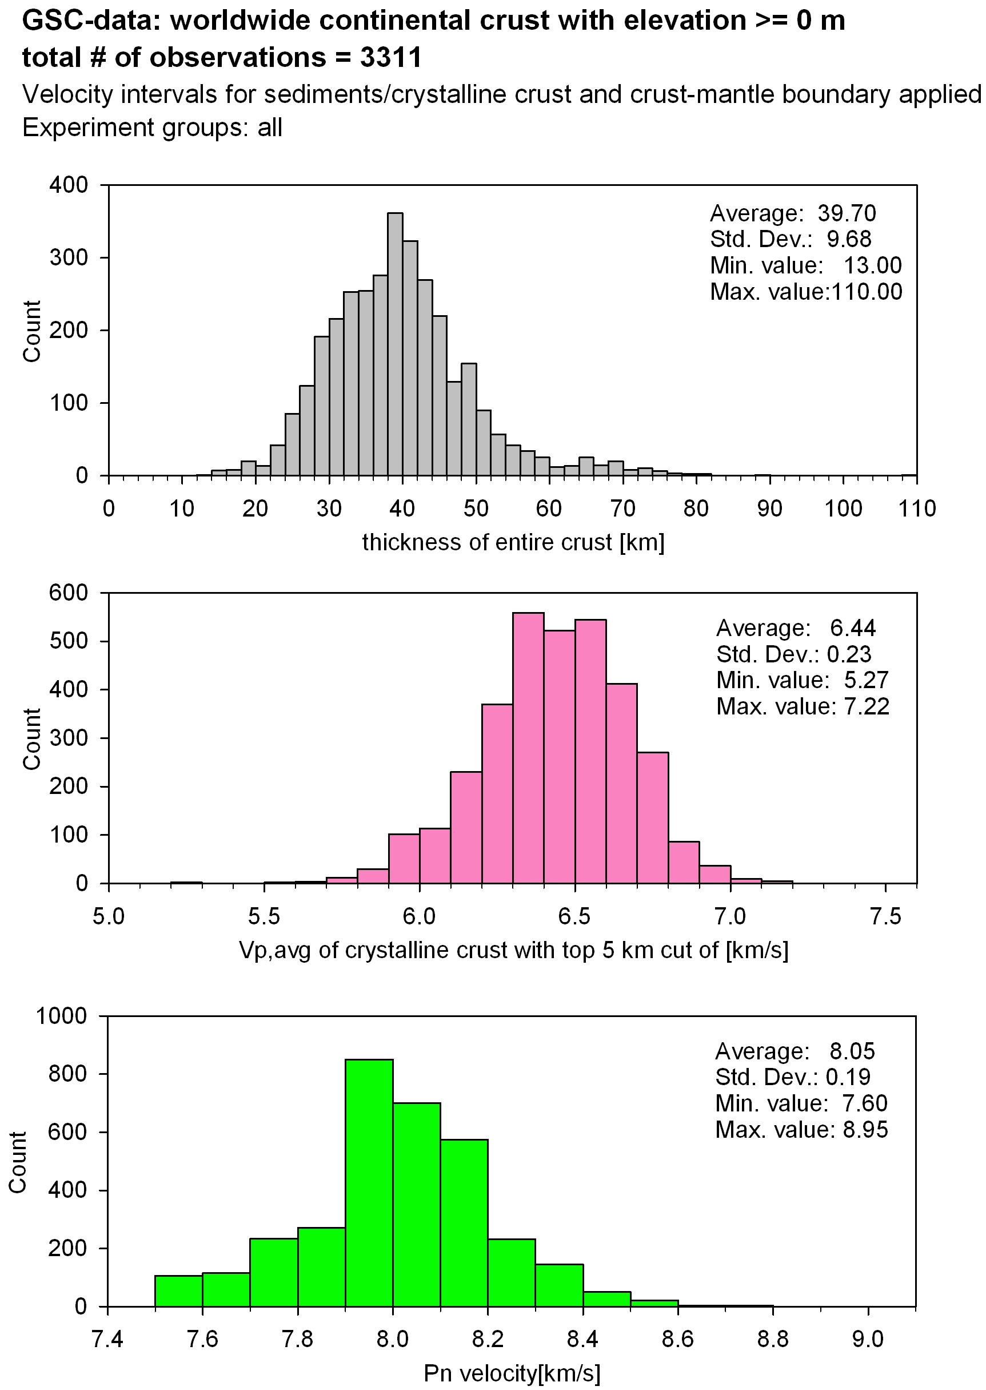
82 km

Slide 27
Christensen
and
Mooney, 1995

Slide 28
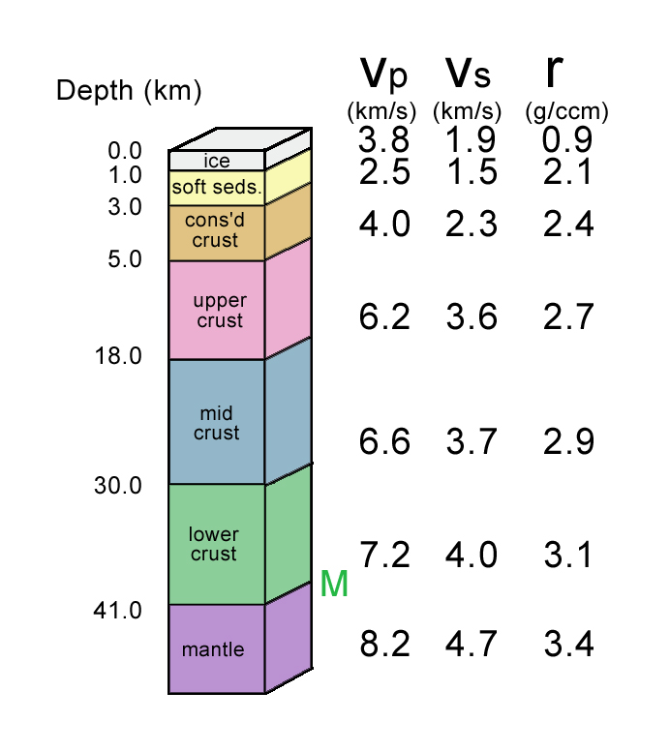
Continental Crust: Platform

Slide 29
Global Crustal Types (Crust 5.1)
Mooney et al., 1998

Slide 31
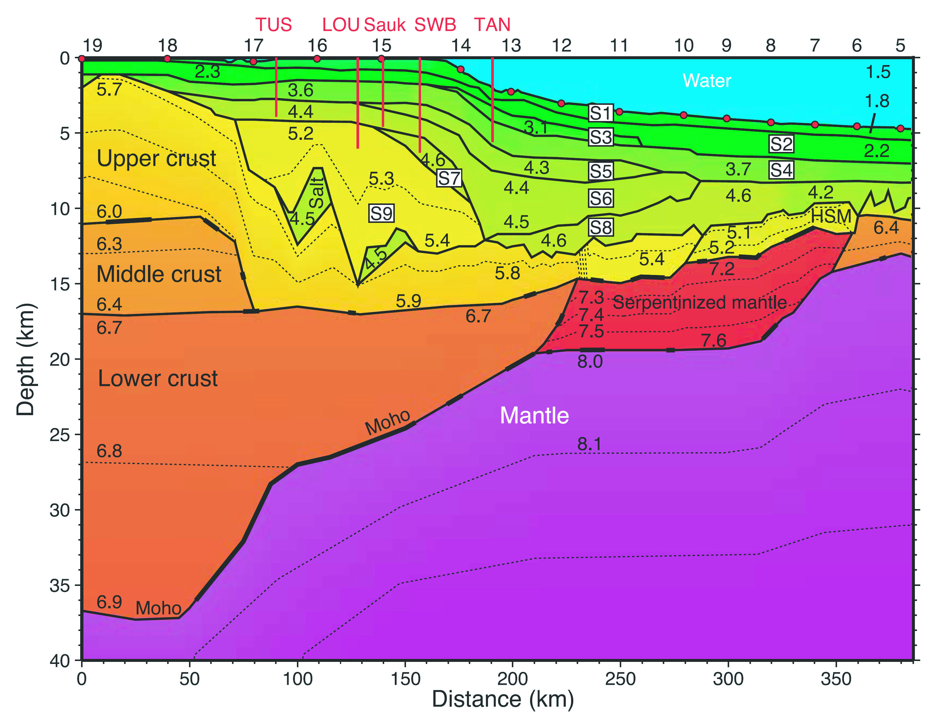
North America- Atlantic Coast
North America – Atlantic Coast
Funck et al. (2004, JGR)

Slide 32
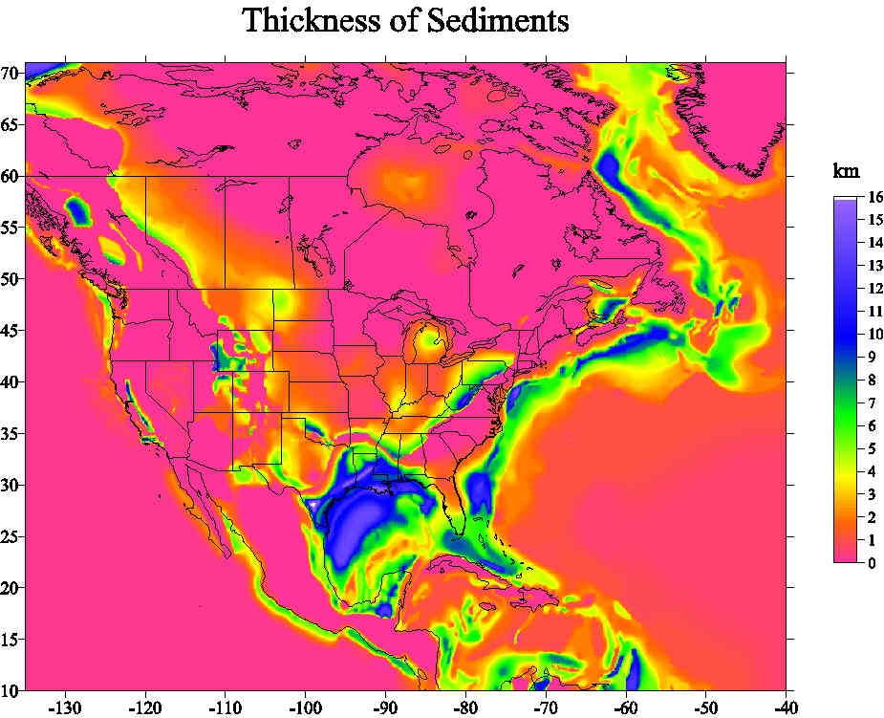
Thickness of Sediments, Mooney and Kaban, JGR, 2010

Slide 33
Mooney
and
Kaban,
JGR, 2010

Slide 34
Archean
Early-Mid Proterozoic
Late Proterozoic
Phanerozoic
Platform
Extended Crust
Orogenic Crust

Slide 35
Mooney et al., 1998

Slide 36
Forearc
Continental Arc
Submarine Plateau
Shelf
Continental Margin
Oceanic Crust

Slide 37
Mooney et al., 1998

Slide 38
Global Crustal Types (Crust 5.1)
Mooney et al., 1998

Slide 39
Global Sediment Thickness
5 by 5 Degree (Crust 5.1)

Slide 40
Global Crustal Thickness
Mooney et al., 1998

Slide 41
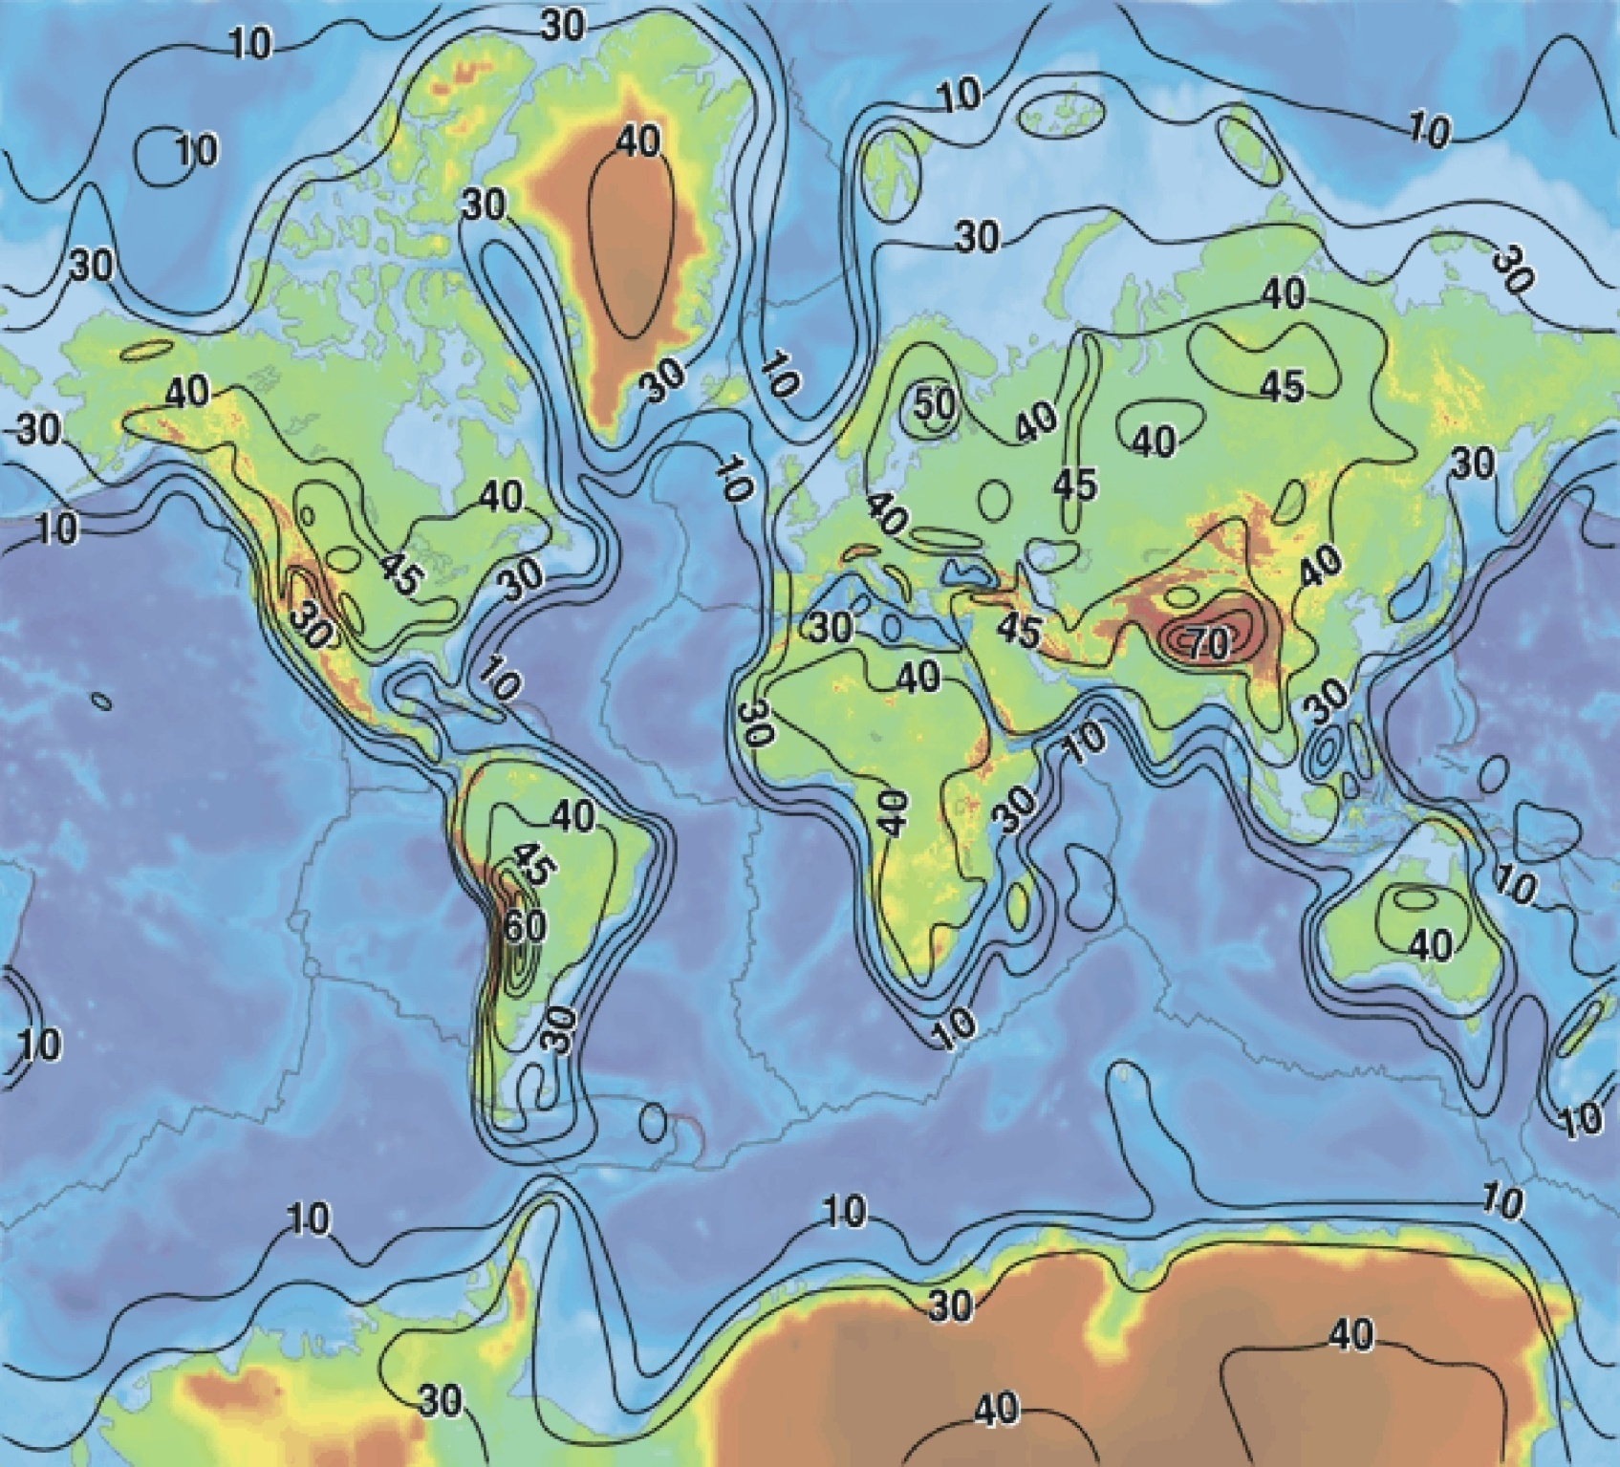
Source: Mooney et al., 1998

Slide 42
5° X 5° Resolution
(Crust 5.1; Mooney et al, 1998)

Slide 44
40 s Love Waves

Slide 45
40 s Love Waves
Mooney et al., 1998

Slide 46
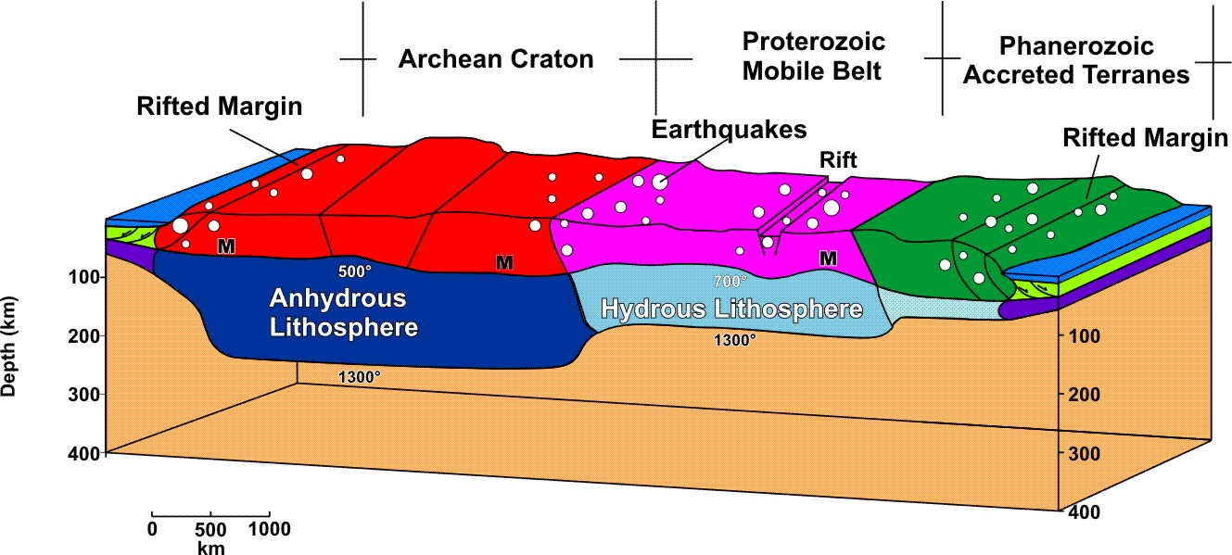
The Lithosphere
Mooney et al., 2013, EPSL

Slide 47

What is the
Lithosphere?

Slide 48
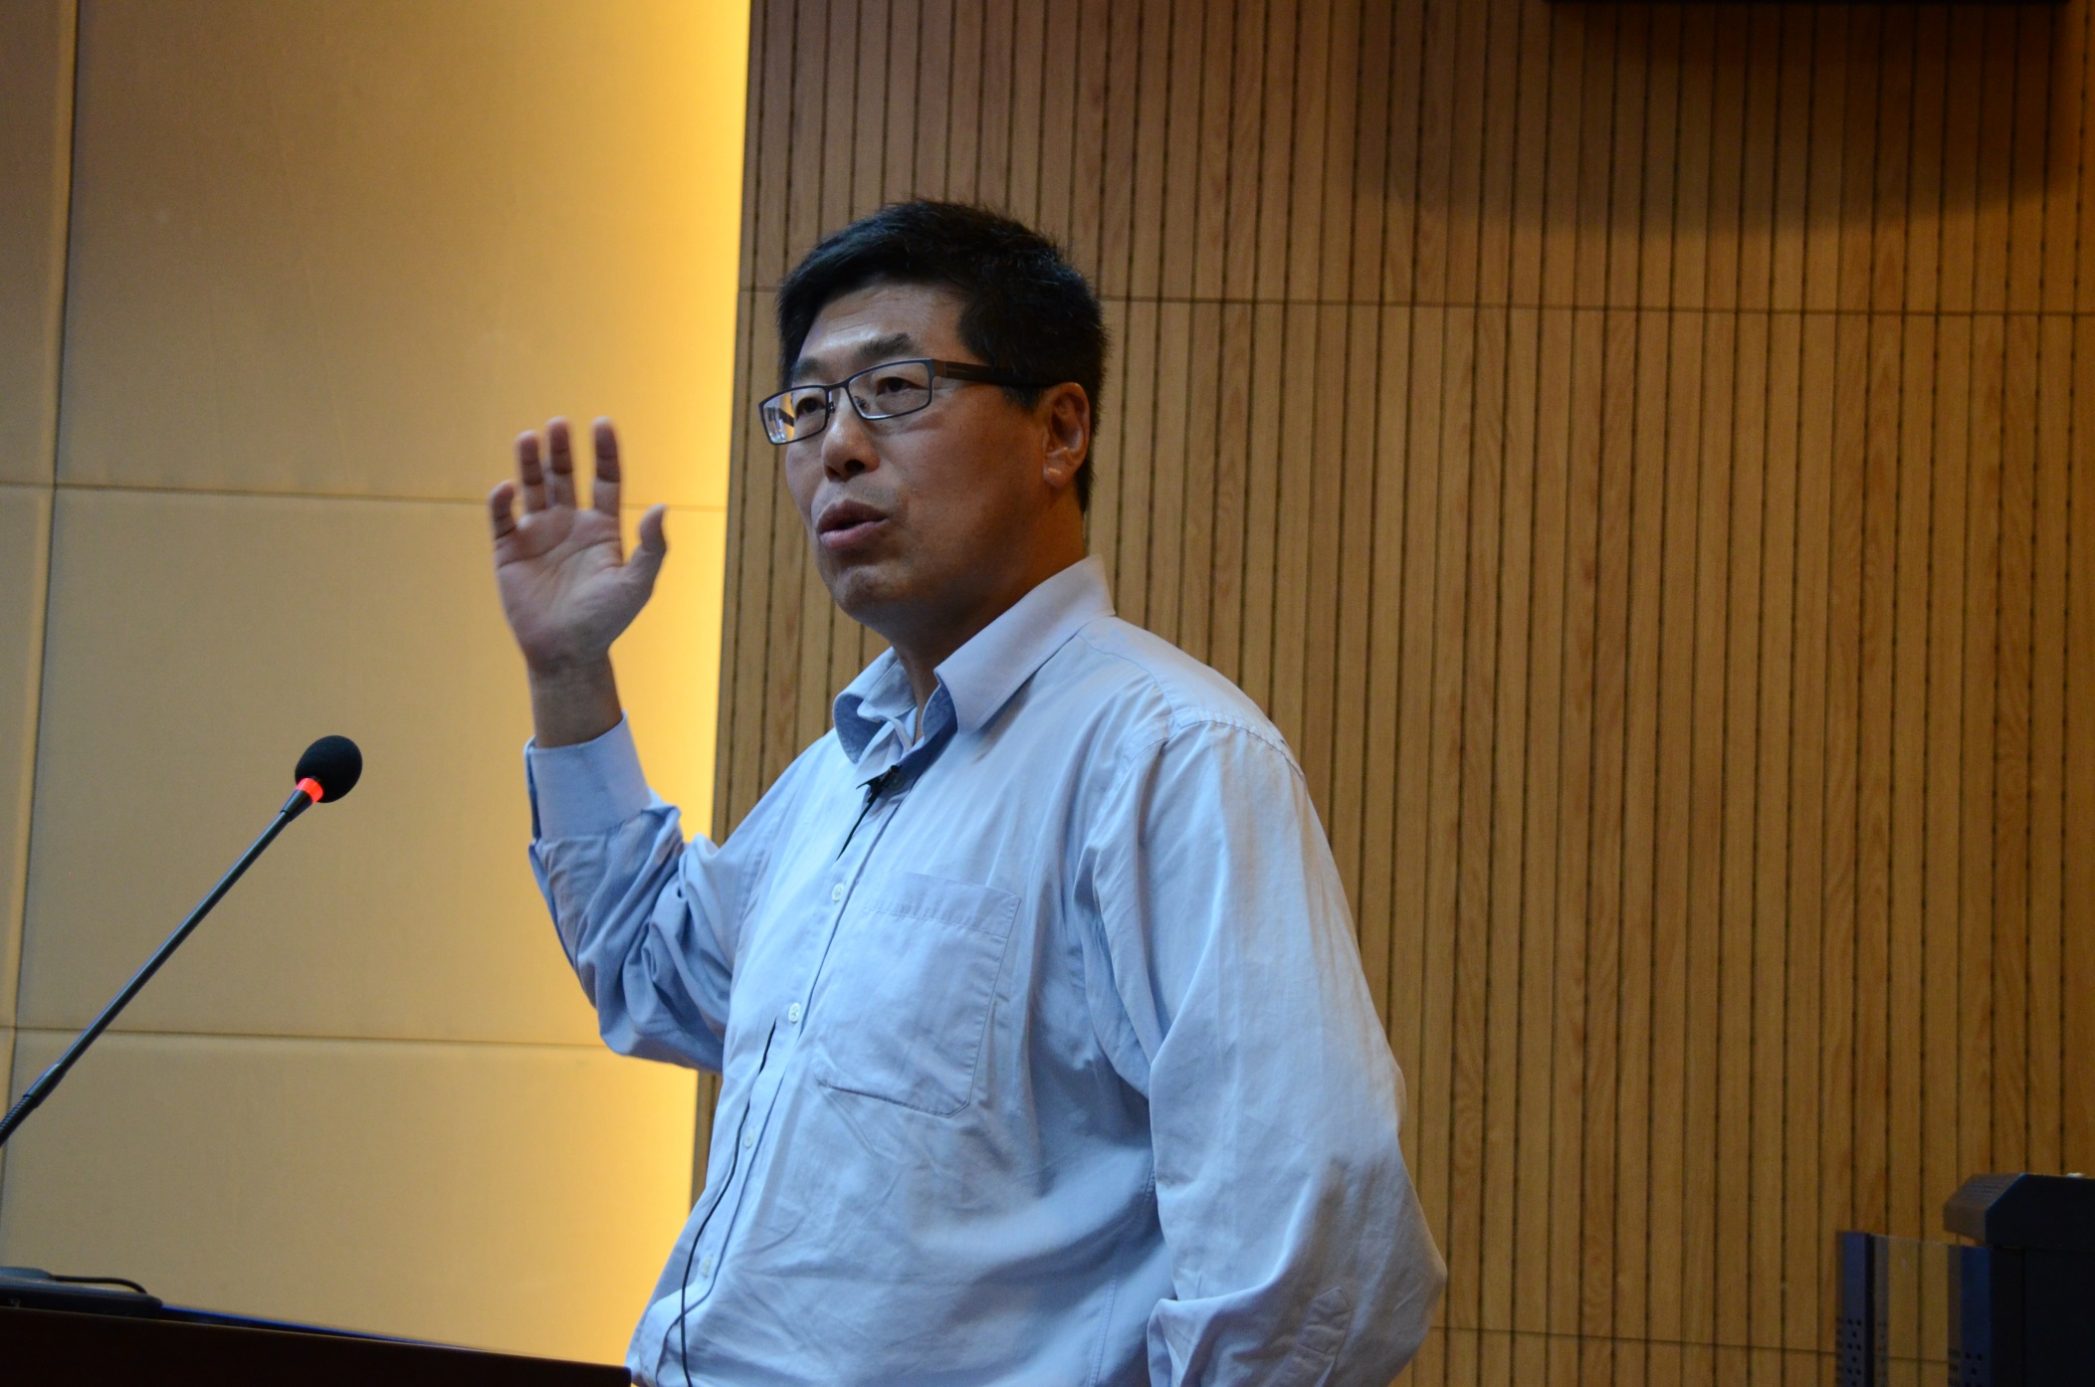
Lithosphere:
“The Tectonic
Plates”

Slide 49
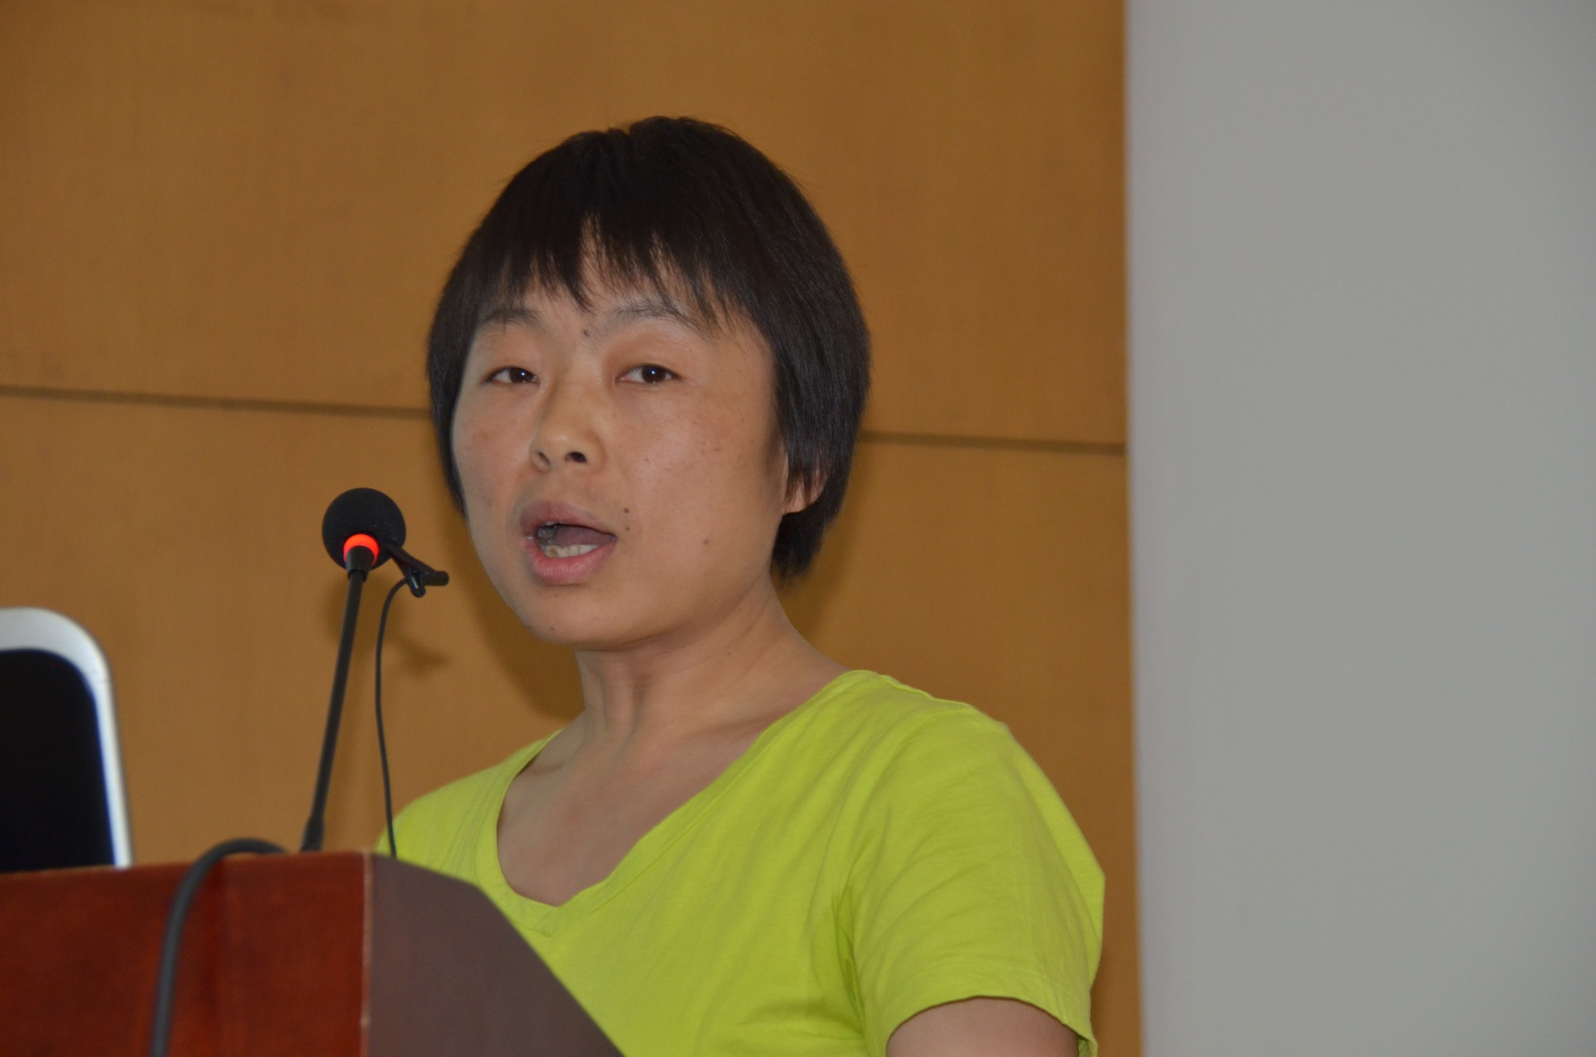
Lithosphere:
“Based on
Seismology”

Slide 50
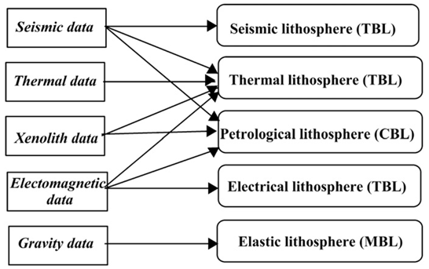

Slide 52
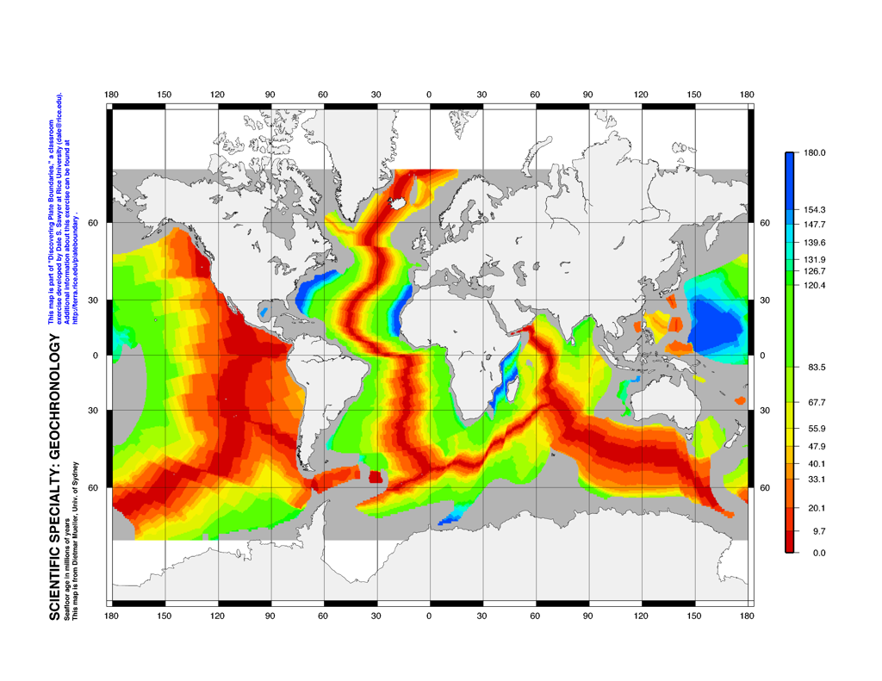
http://terra.rice.edu/plateboundary/index.html

Slide 53
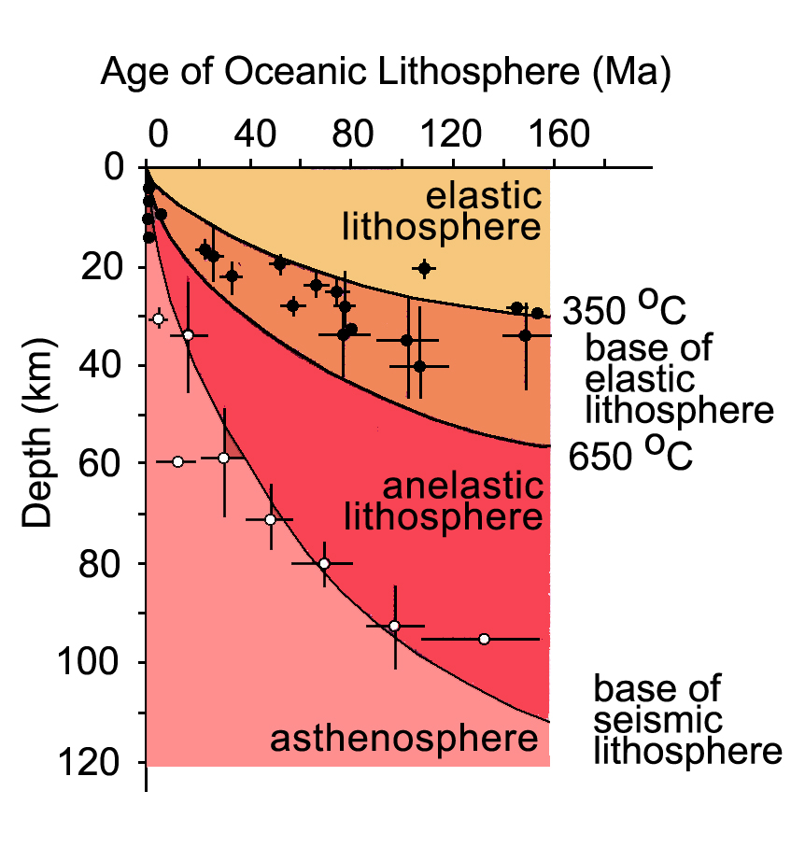
Oceanic Lithosphere Thickens by Cooling

Slide 54
The Seismological Lithosphere

Slide 55
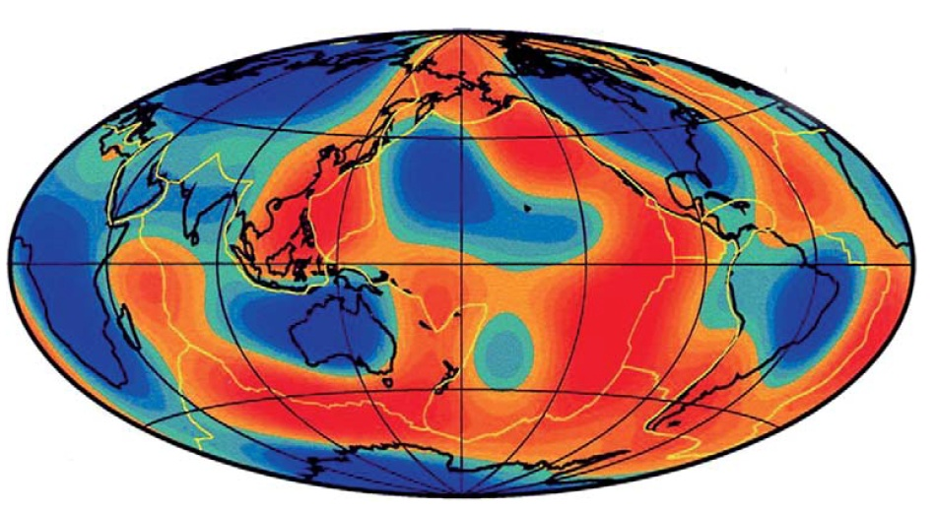
Woodhouse and Dziewonski, 1984
Vs at 100 km; blue is positive, red is negative

Slide 56
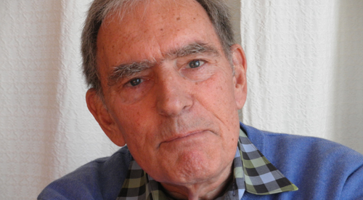
Adam Dwiewonski, Harvard University
1936 to 1/3/2016

Slide 57
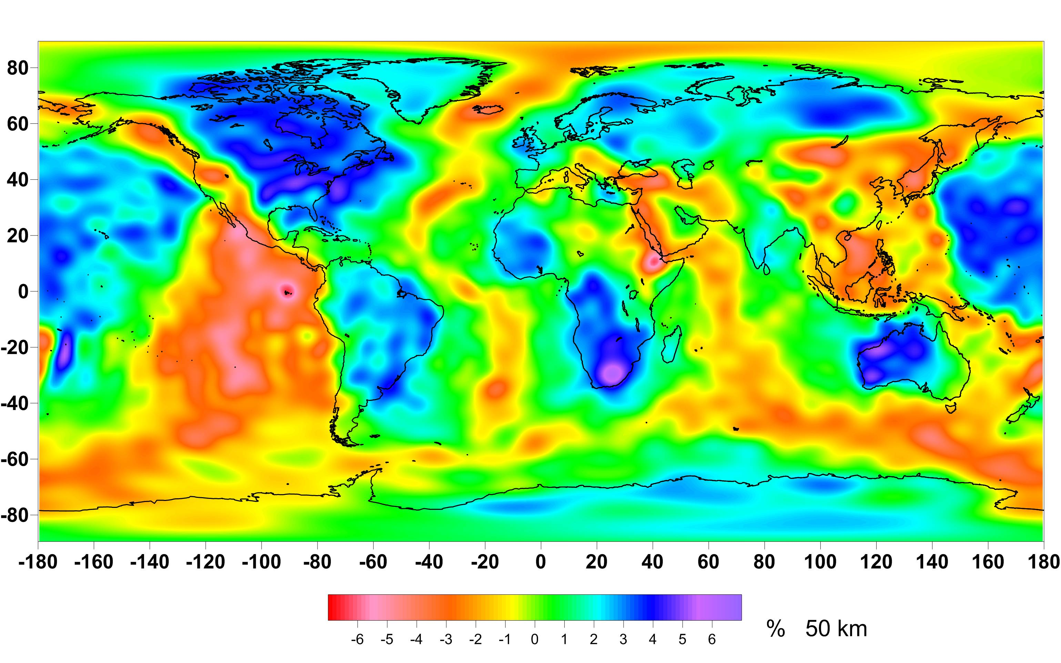
S-wave Anomaly 50 Km
Ritsema et al., GJI, 2011

Slide 58
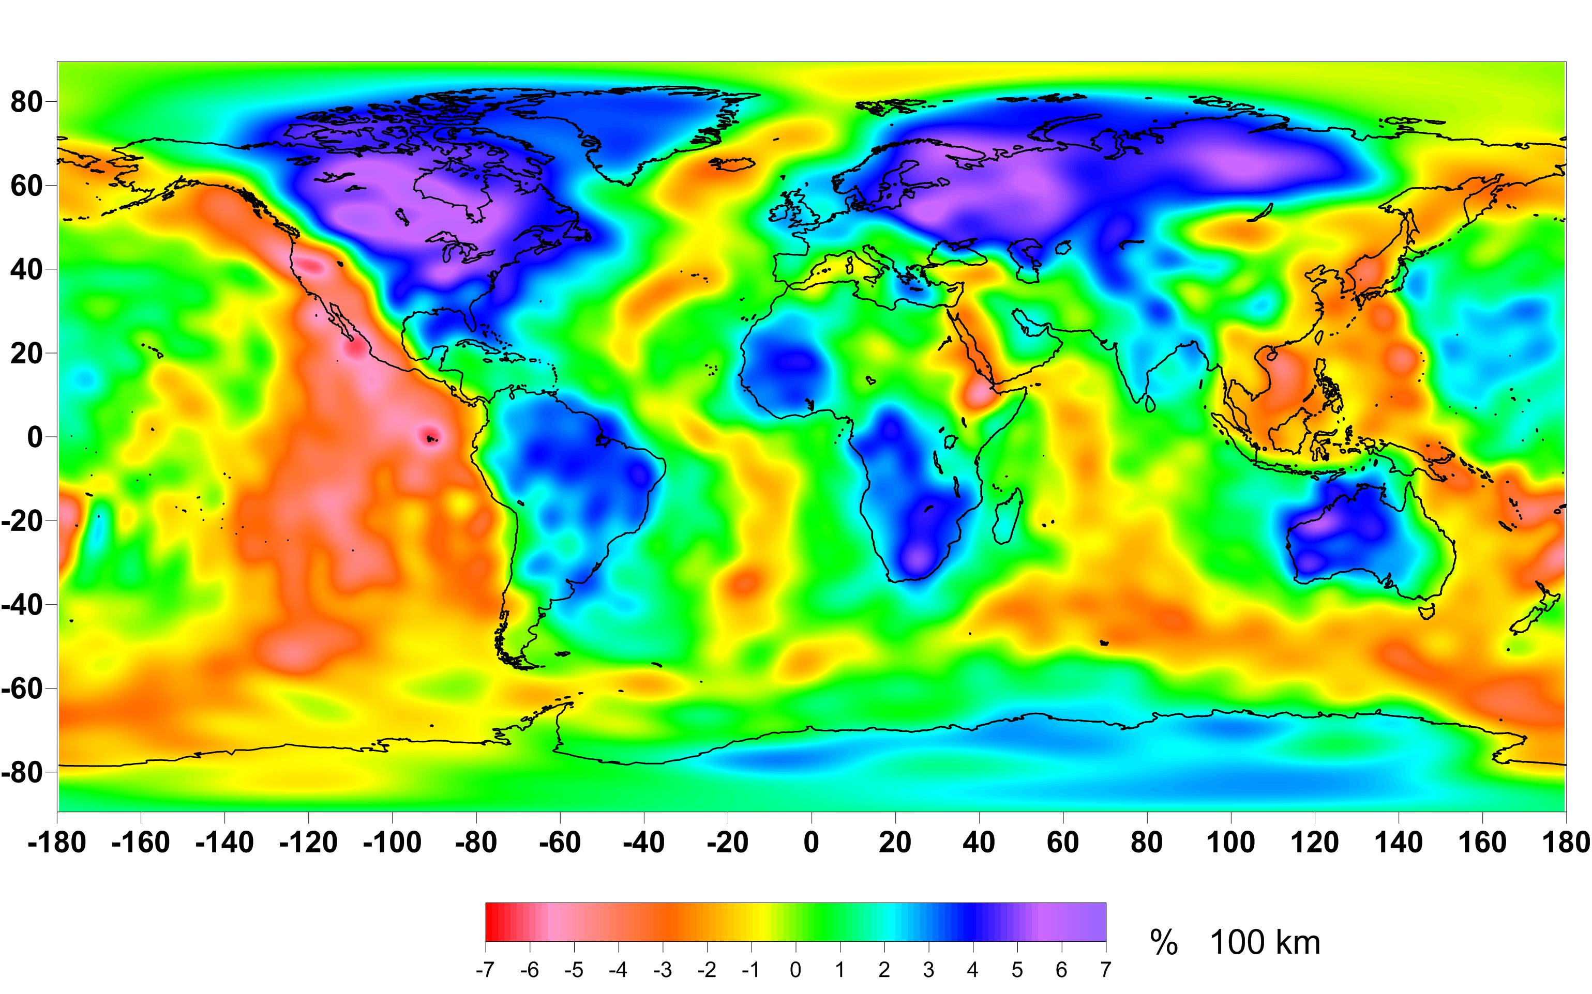
S-wave Anomaly 100 km

Slide 59
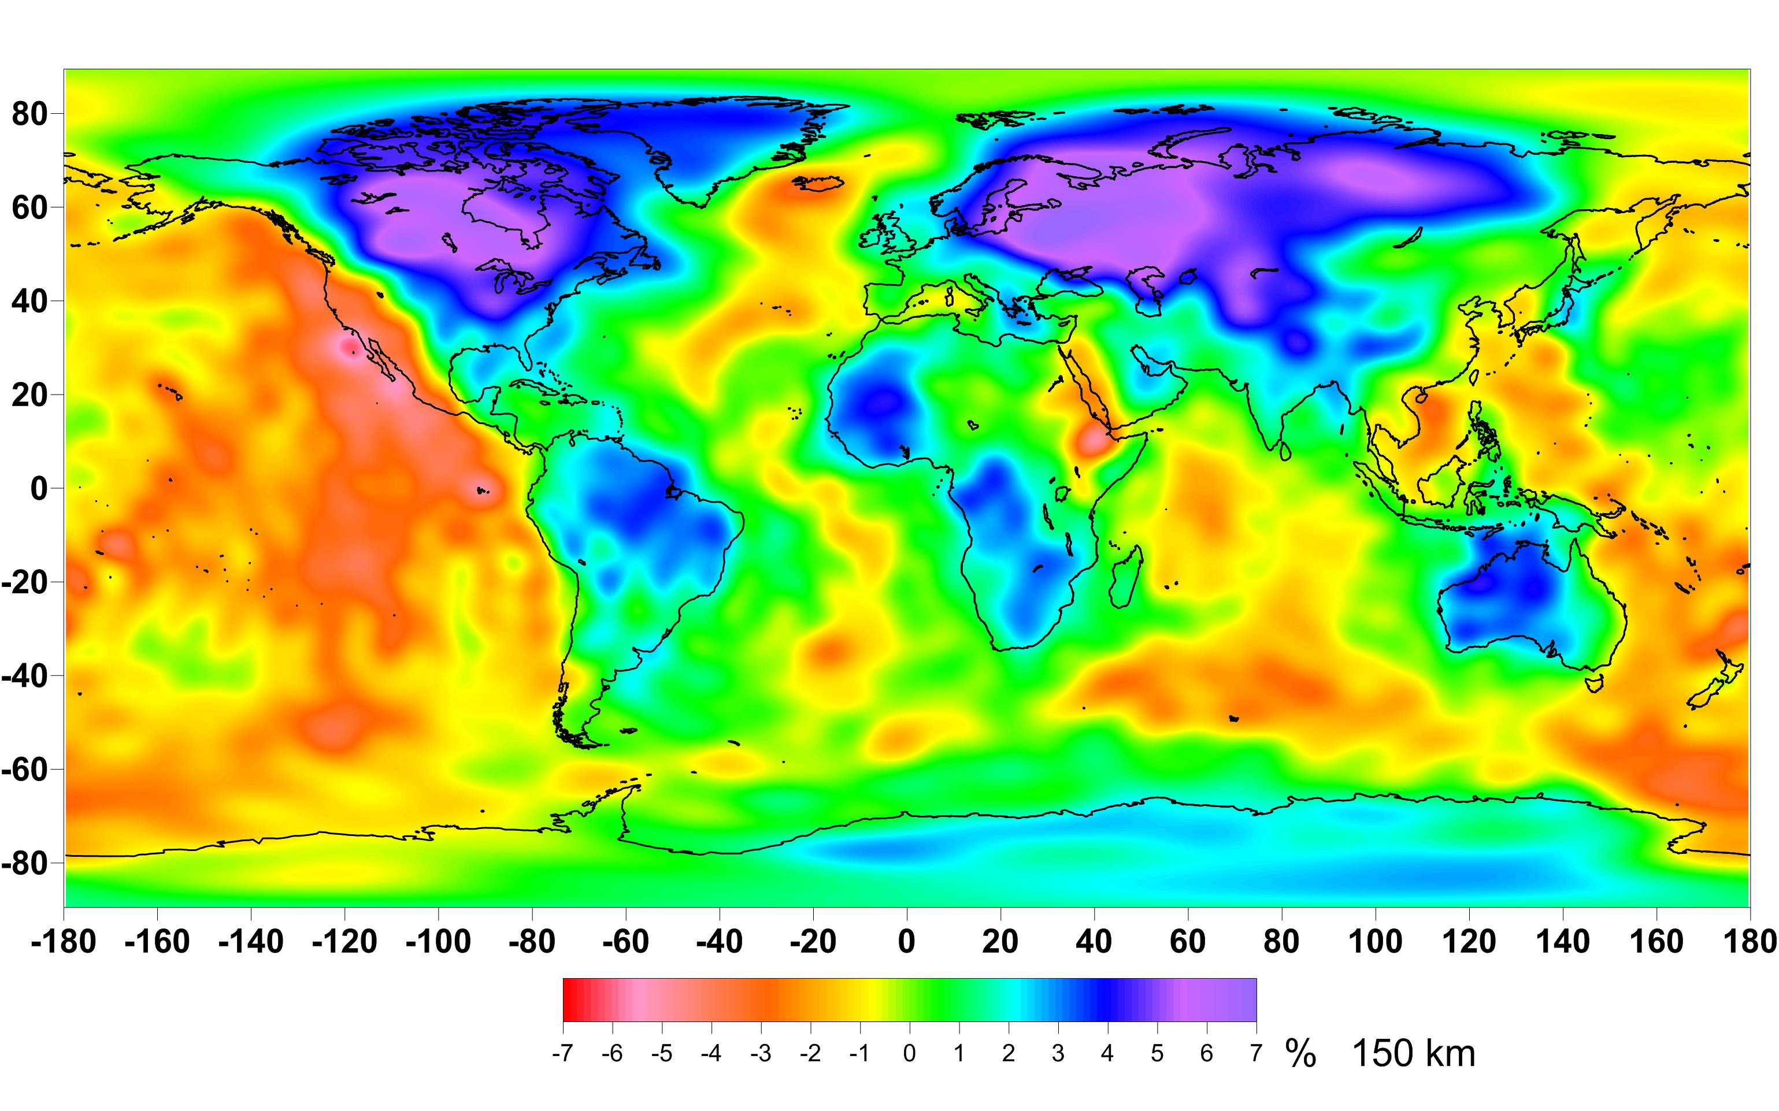
S-wave Anomaly, 150 km

Slide 60
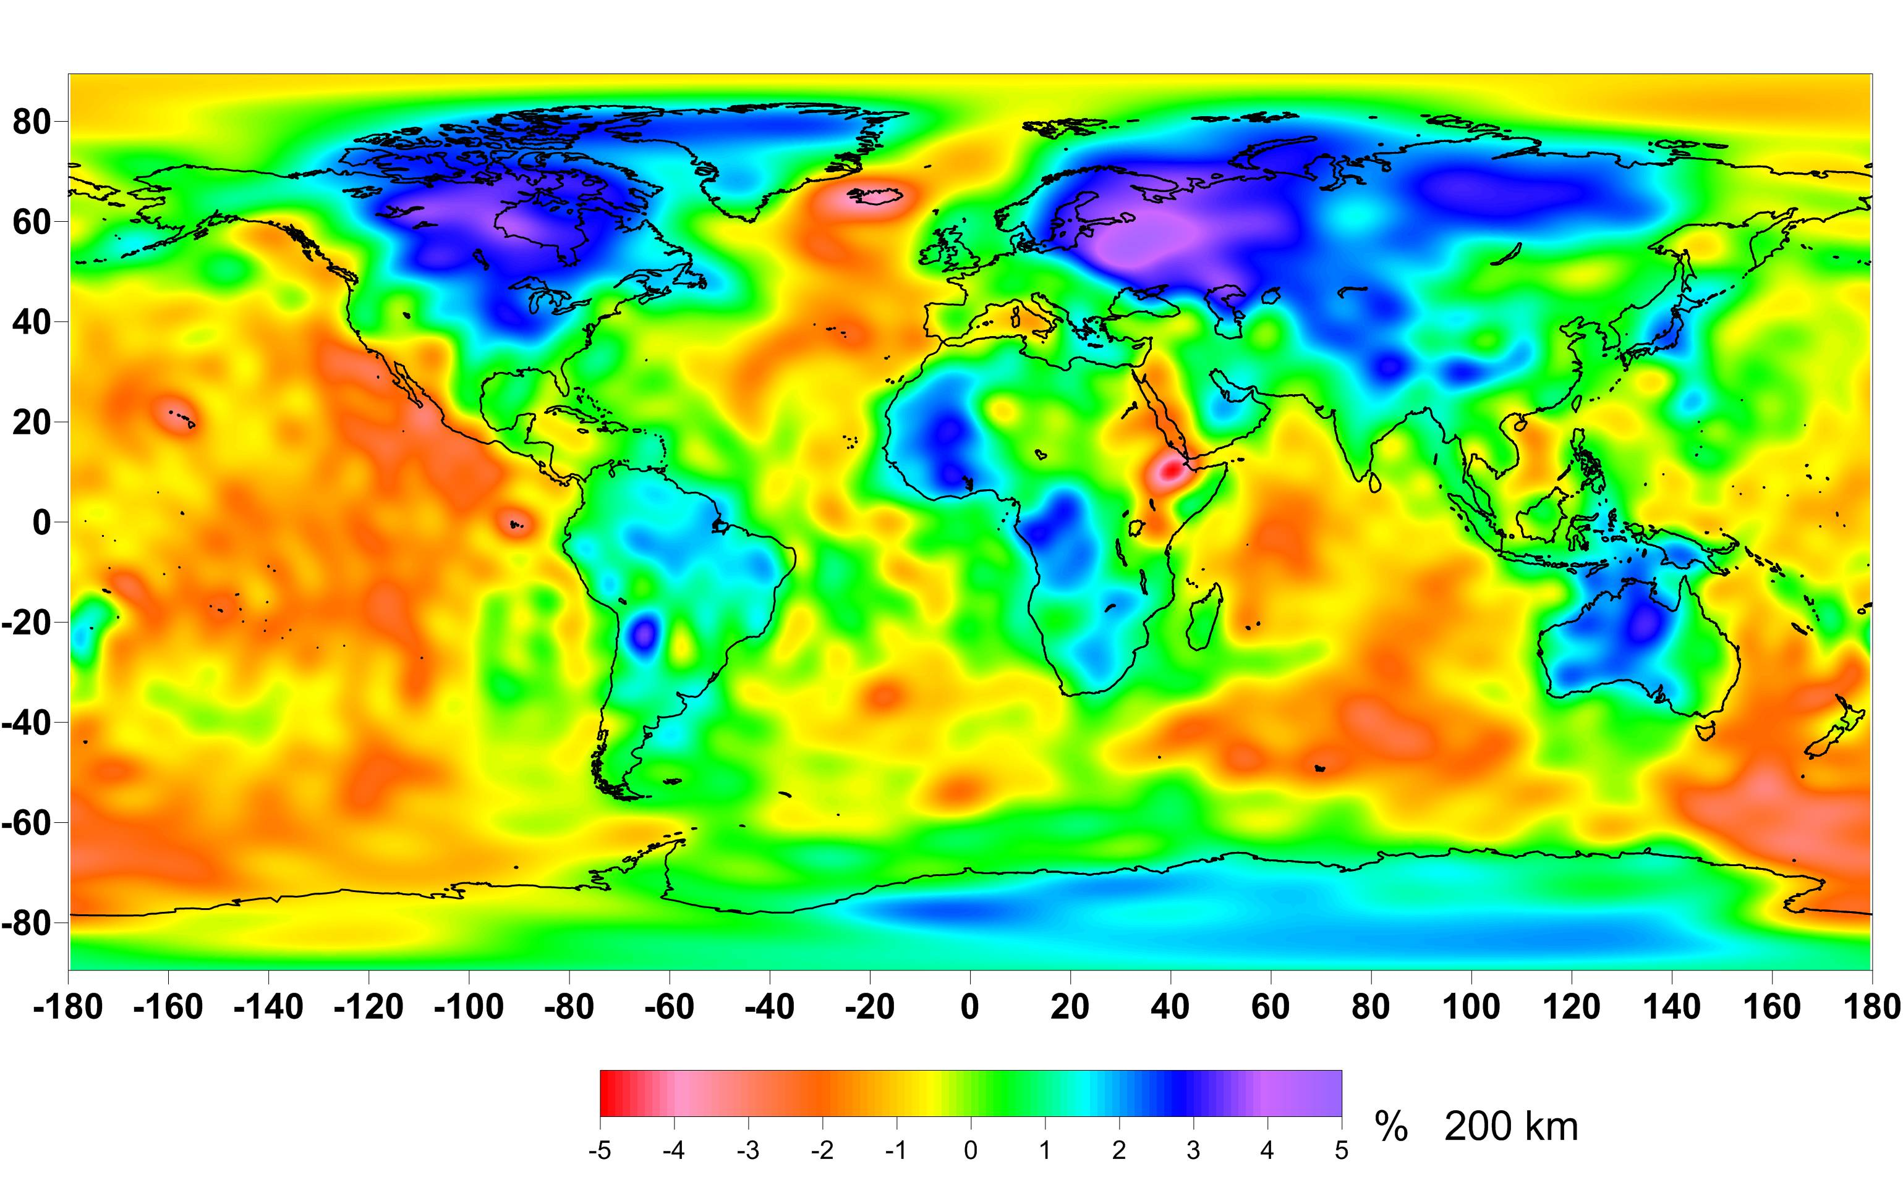
S-wave Anomaly 200 km

Slide 61
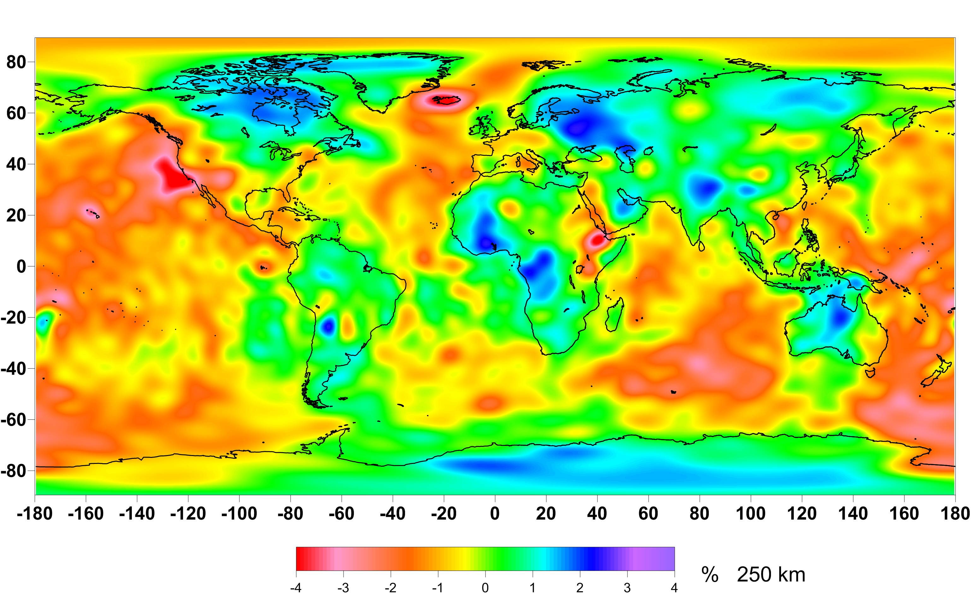
S-wave Anomaly 250 km

Slide 62
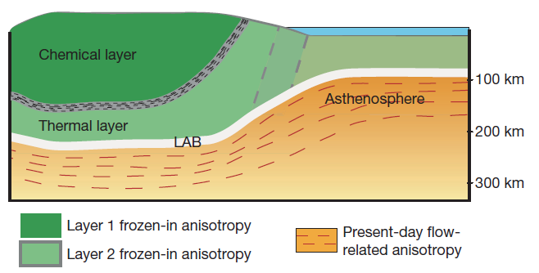
Lithospheric Structure:
Seismic Anisotropy
Yuan and Romanowicz, Nature, 466, 1063-1068, 2010

Slide 64
Lithospheric Thermal Thickness
Steady State Thermal Conductivity
∂² T / ∂z² = - A / k
at z = 0: T = 0
Q₀ = - k · ∂T / ∂z
+ Assumption
A(z) = A₀ · exp(-z / D)
Q₀ = q + A₀ · D
A₀ – surface radioactivity k- thermal conductivity
Q₀ - surface heat flow T- temperature
q - reduced (mantle)heat flow D – characteristic depth

Slide 65
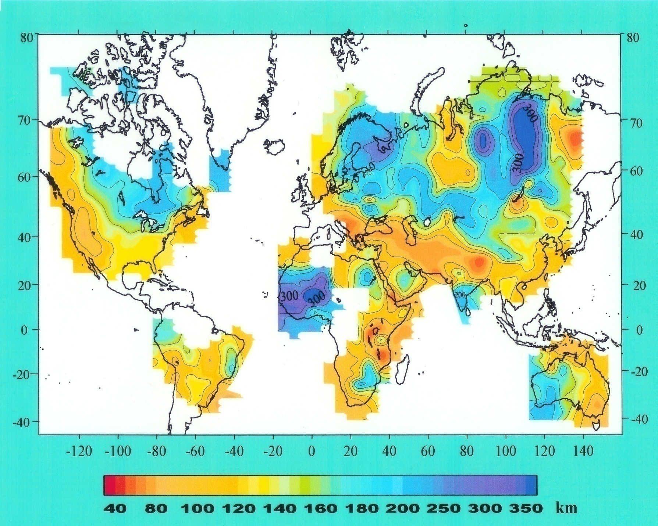
Lithosphere Thermal Thickness as the Depth to 1300 °C
Source: Artemieva and Mooney, JGR, 2001

Slide 66
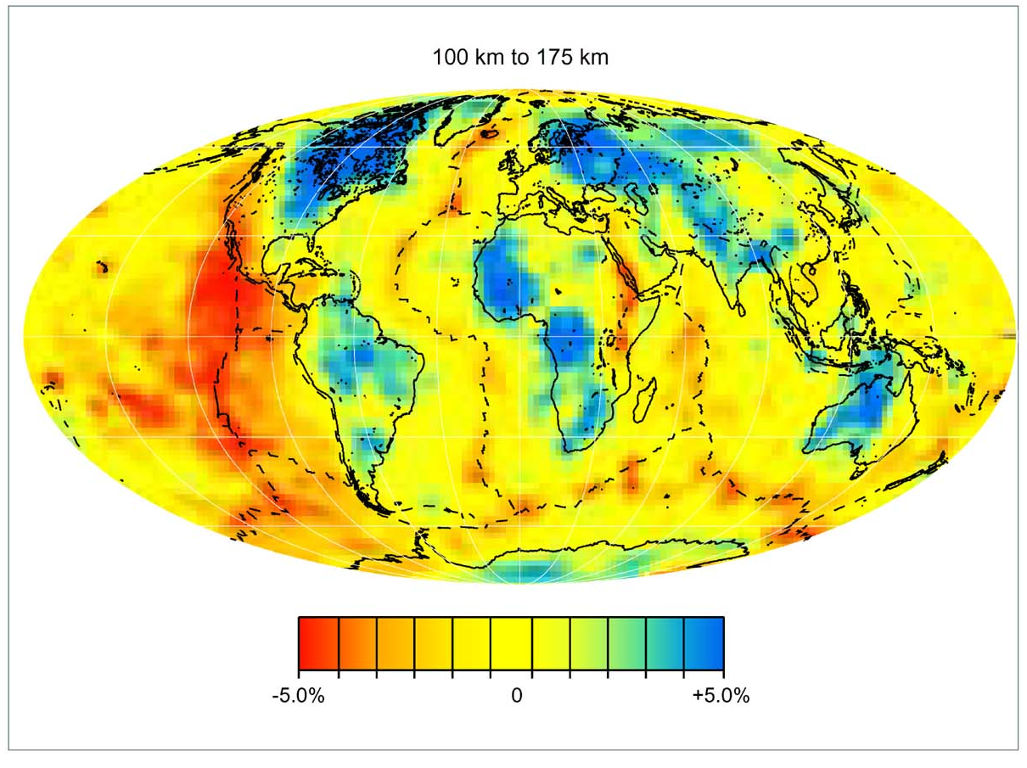

Slide 67

Source: Mooney et al., 1998

Slide 68
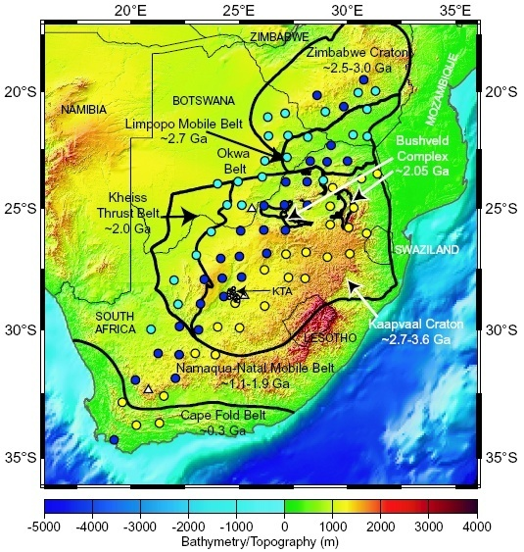
Southern African (or Kaapvaal)
Seismic
Experiment

Slide 69
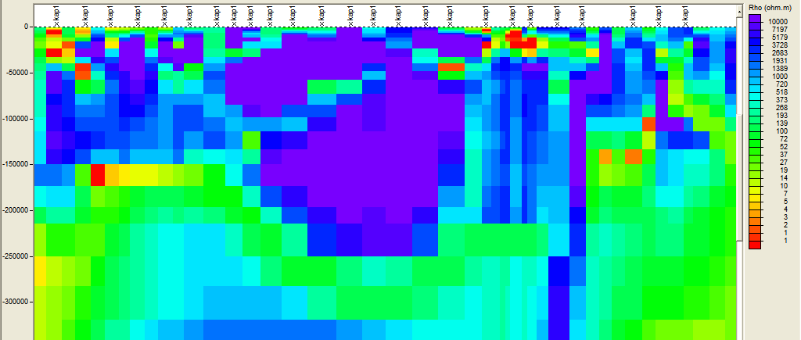
Electrical Lithosphere: South Africa
S
N
100
200
?
300
Lithospheric thickness varies along the profile, with the thickest part from just south of Kimberley -> north of Pretoria
Alan Jones et al., 2004

Slide 70
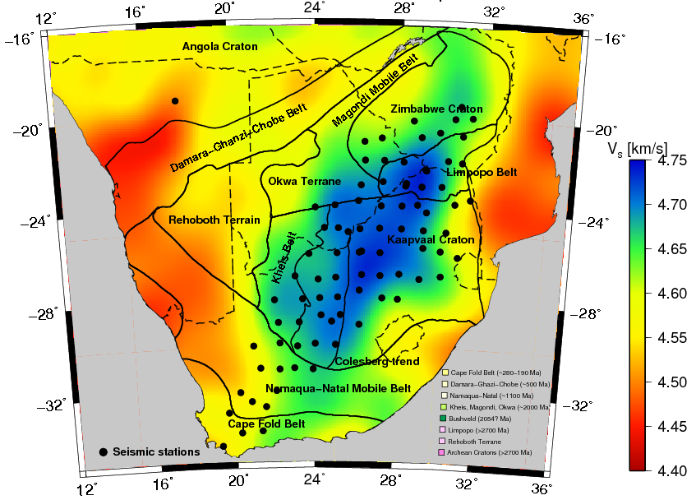
New velocity model VsF1.5d at 100 km
Low velocity “notch” in southern extension of Angola Craton

Slide 71
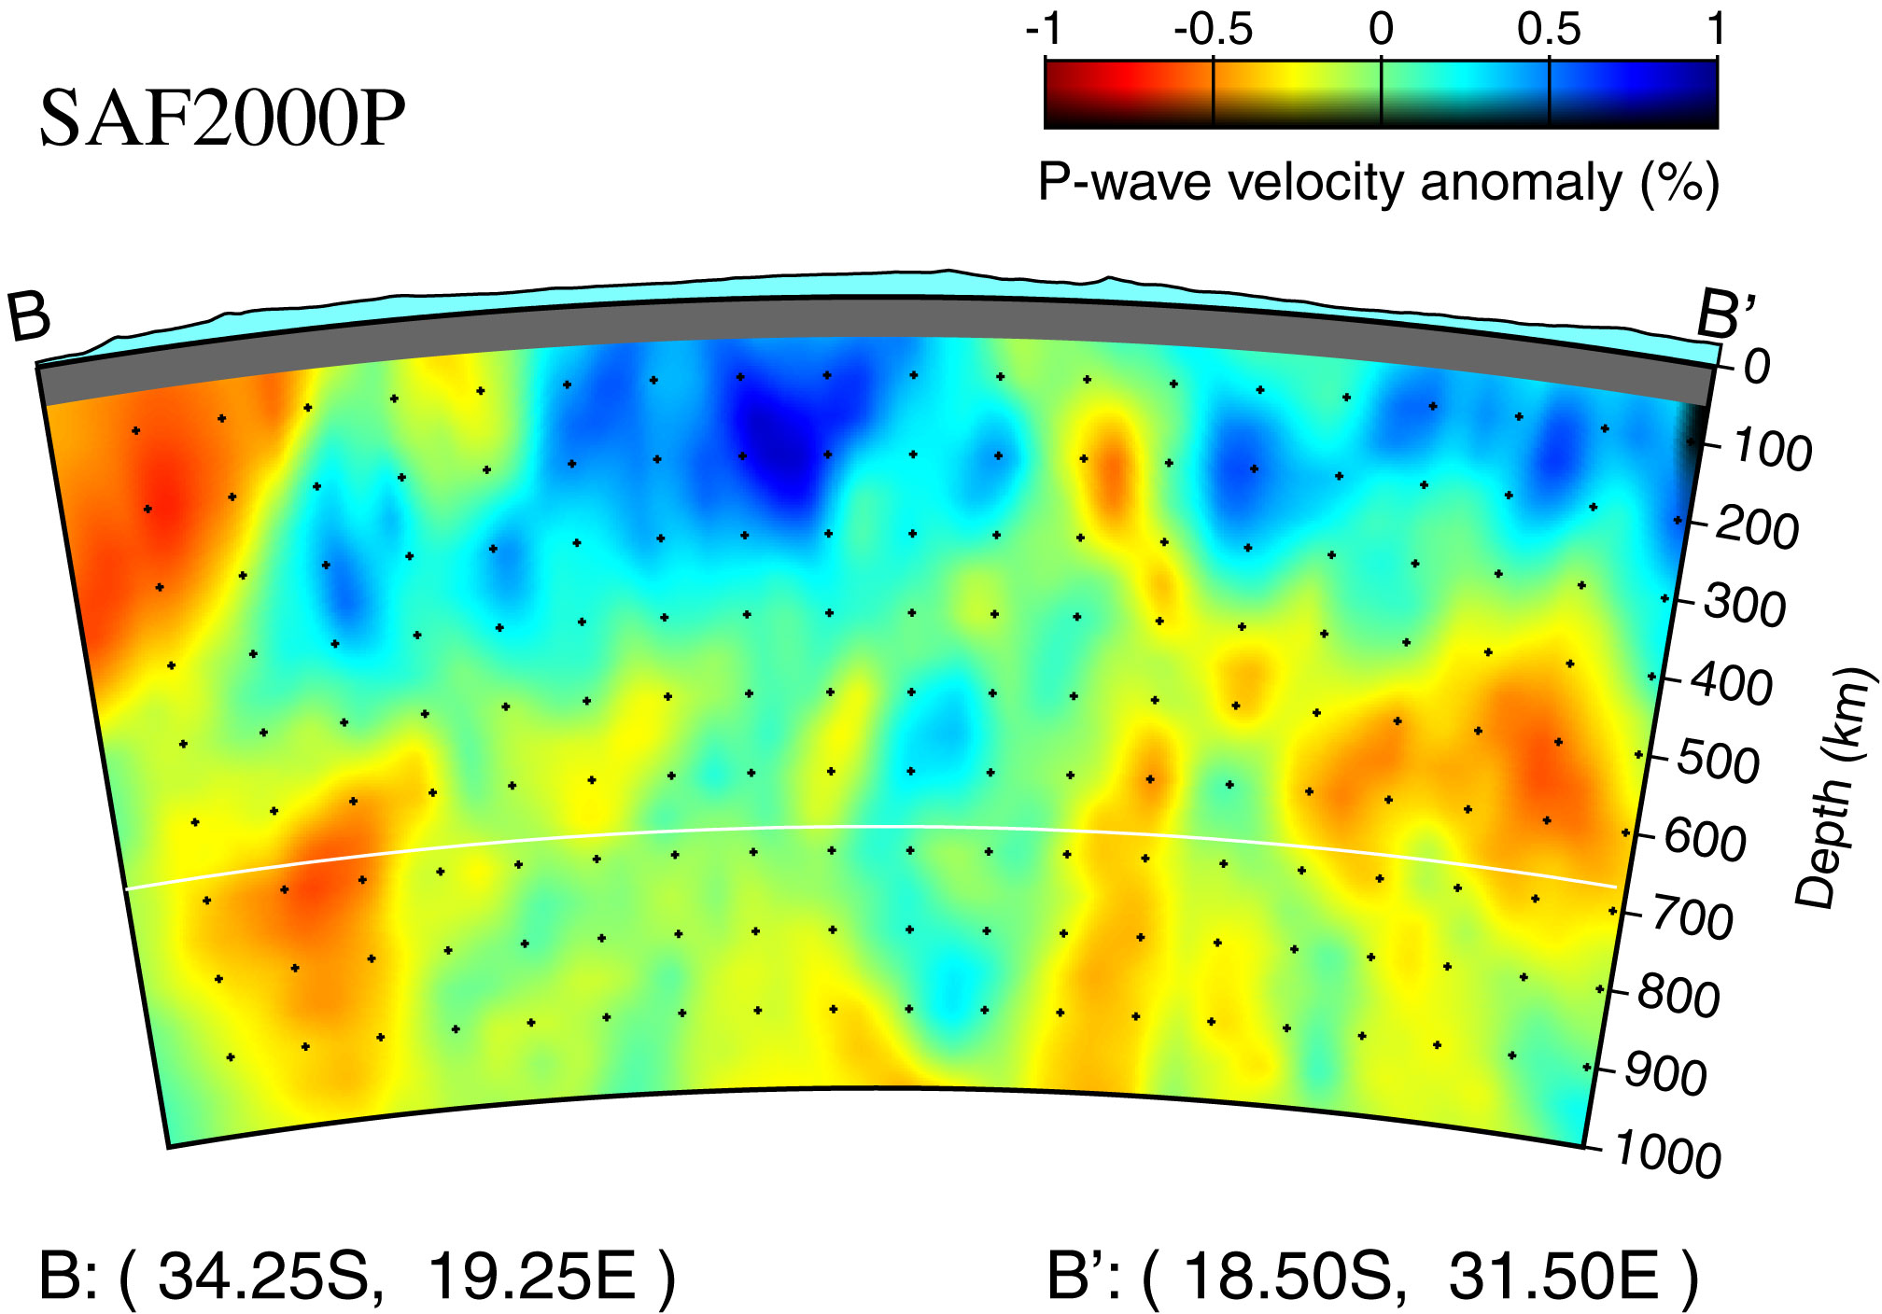
Fishwick et al, 2013

Slide 72
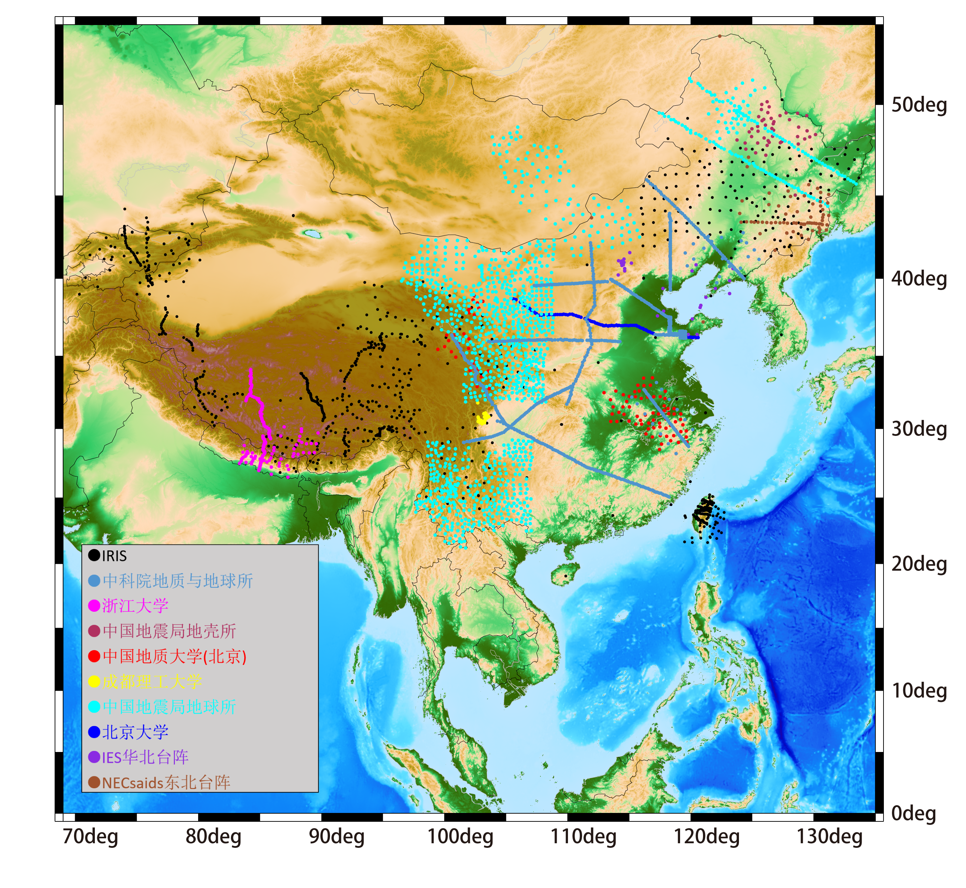

Slide 73
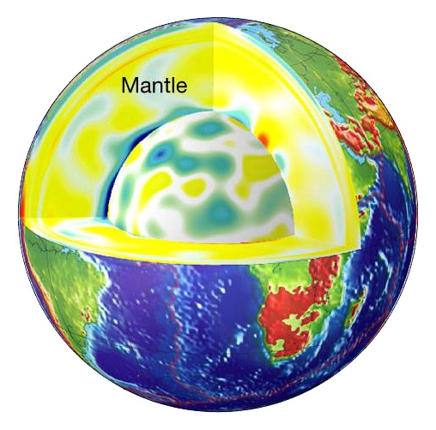

Slide 74

THANK
YOU!

Slide 75
Source: Mooney et al., 1998

Slide 76
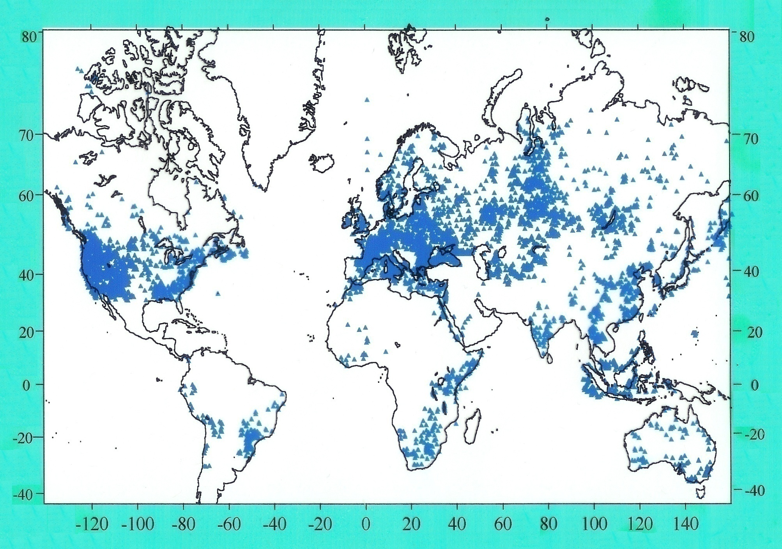
Heat Flow Data for Continents
Source: Artemieva and Mooney, 2000

Slide 77
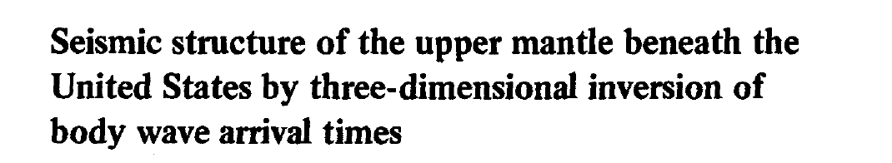
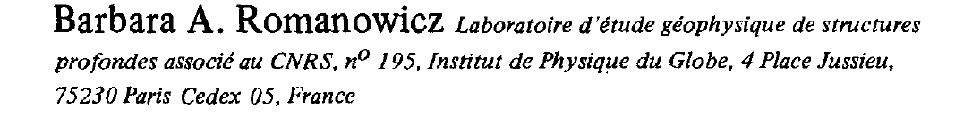

Slide 78
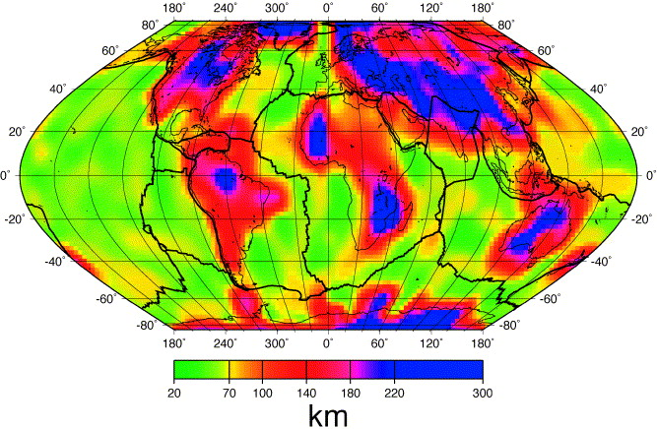
Global lithosphere thickness from seismic anisotropy
Pattern of anisotropy (rock fabric) change across the LAB
Plomerová, et al. Tectonophysics, 358, 175-185, 2002

Slide 79
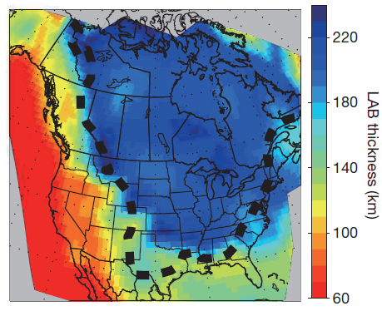
lithosphere thickness from azimuthal anisotropy
Depth dependent azimuthal anisotropy
Fast axis direction parallel to current plate motion
Multiple episode of continent formation
Applicable to the globe
Yuan and Romanowicz, Nature, 466, 1063-1068, 2010

Slide 80
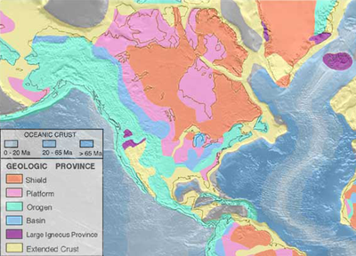

Slide 81
What is the lithosphere?
The rigid outer shell of the Earth that moves as tectonic plates is called the lithosphere.
However, there are several ways to define the lithosphere.

Slide 82
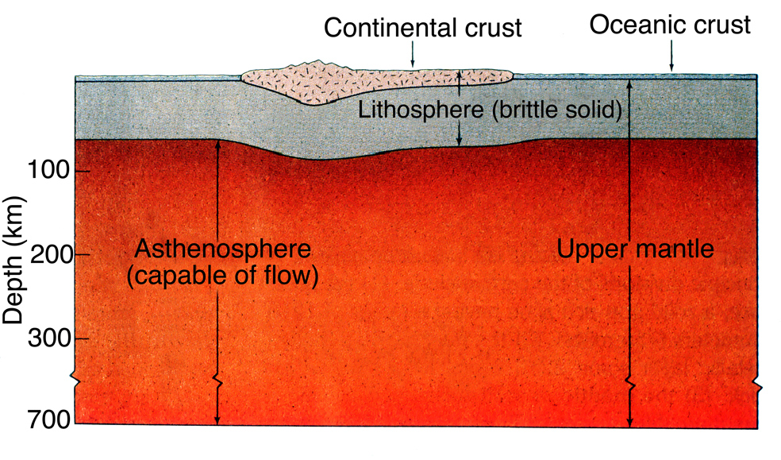

Slide 83
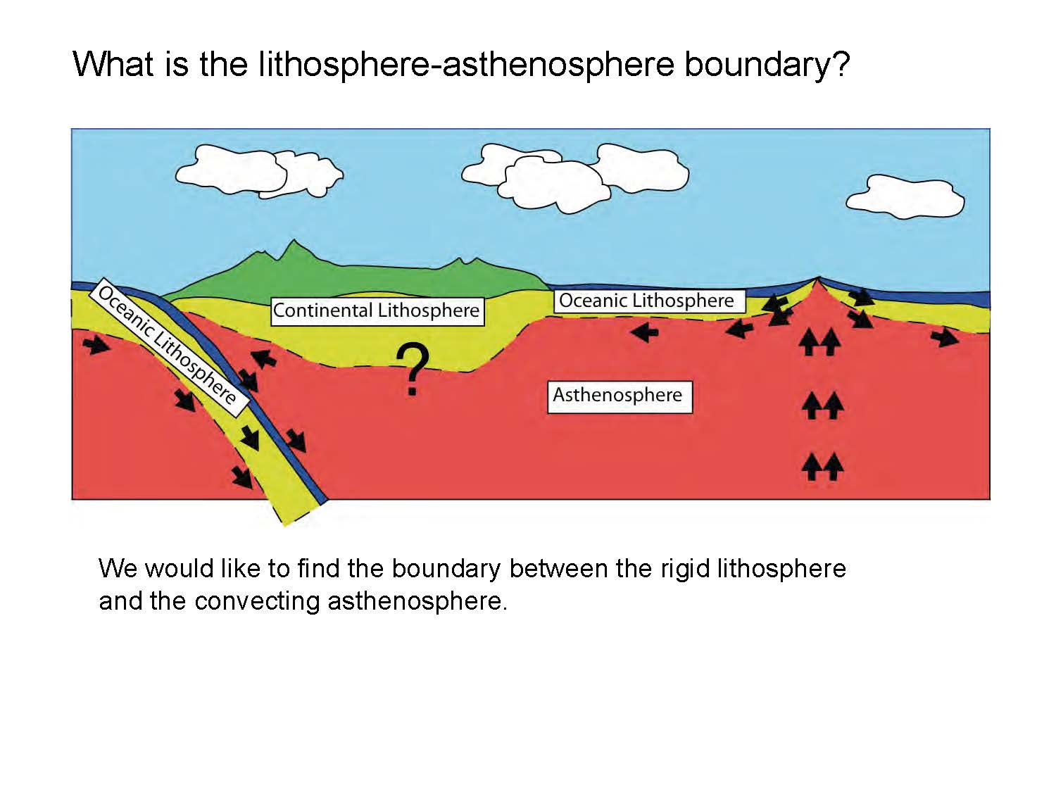

Slide 84
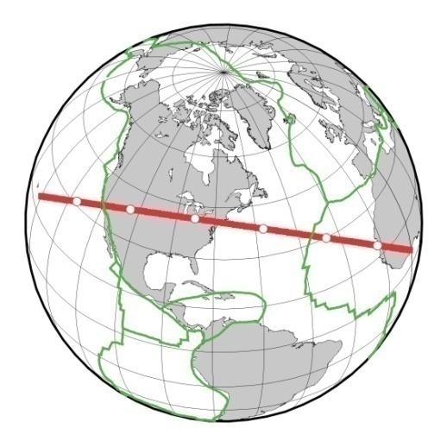
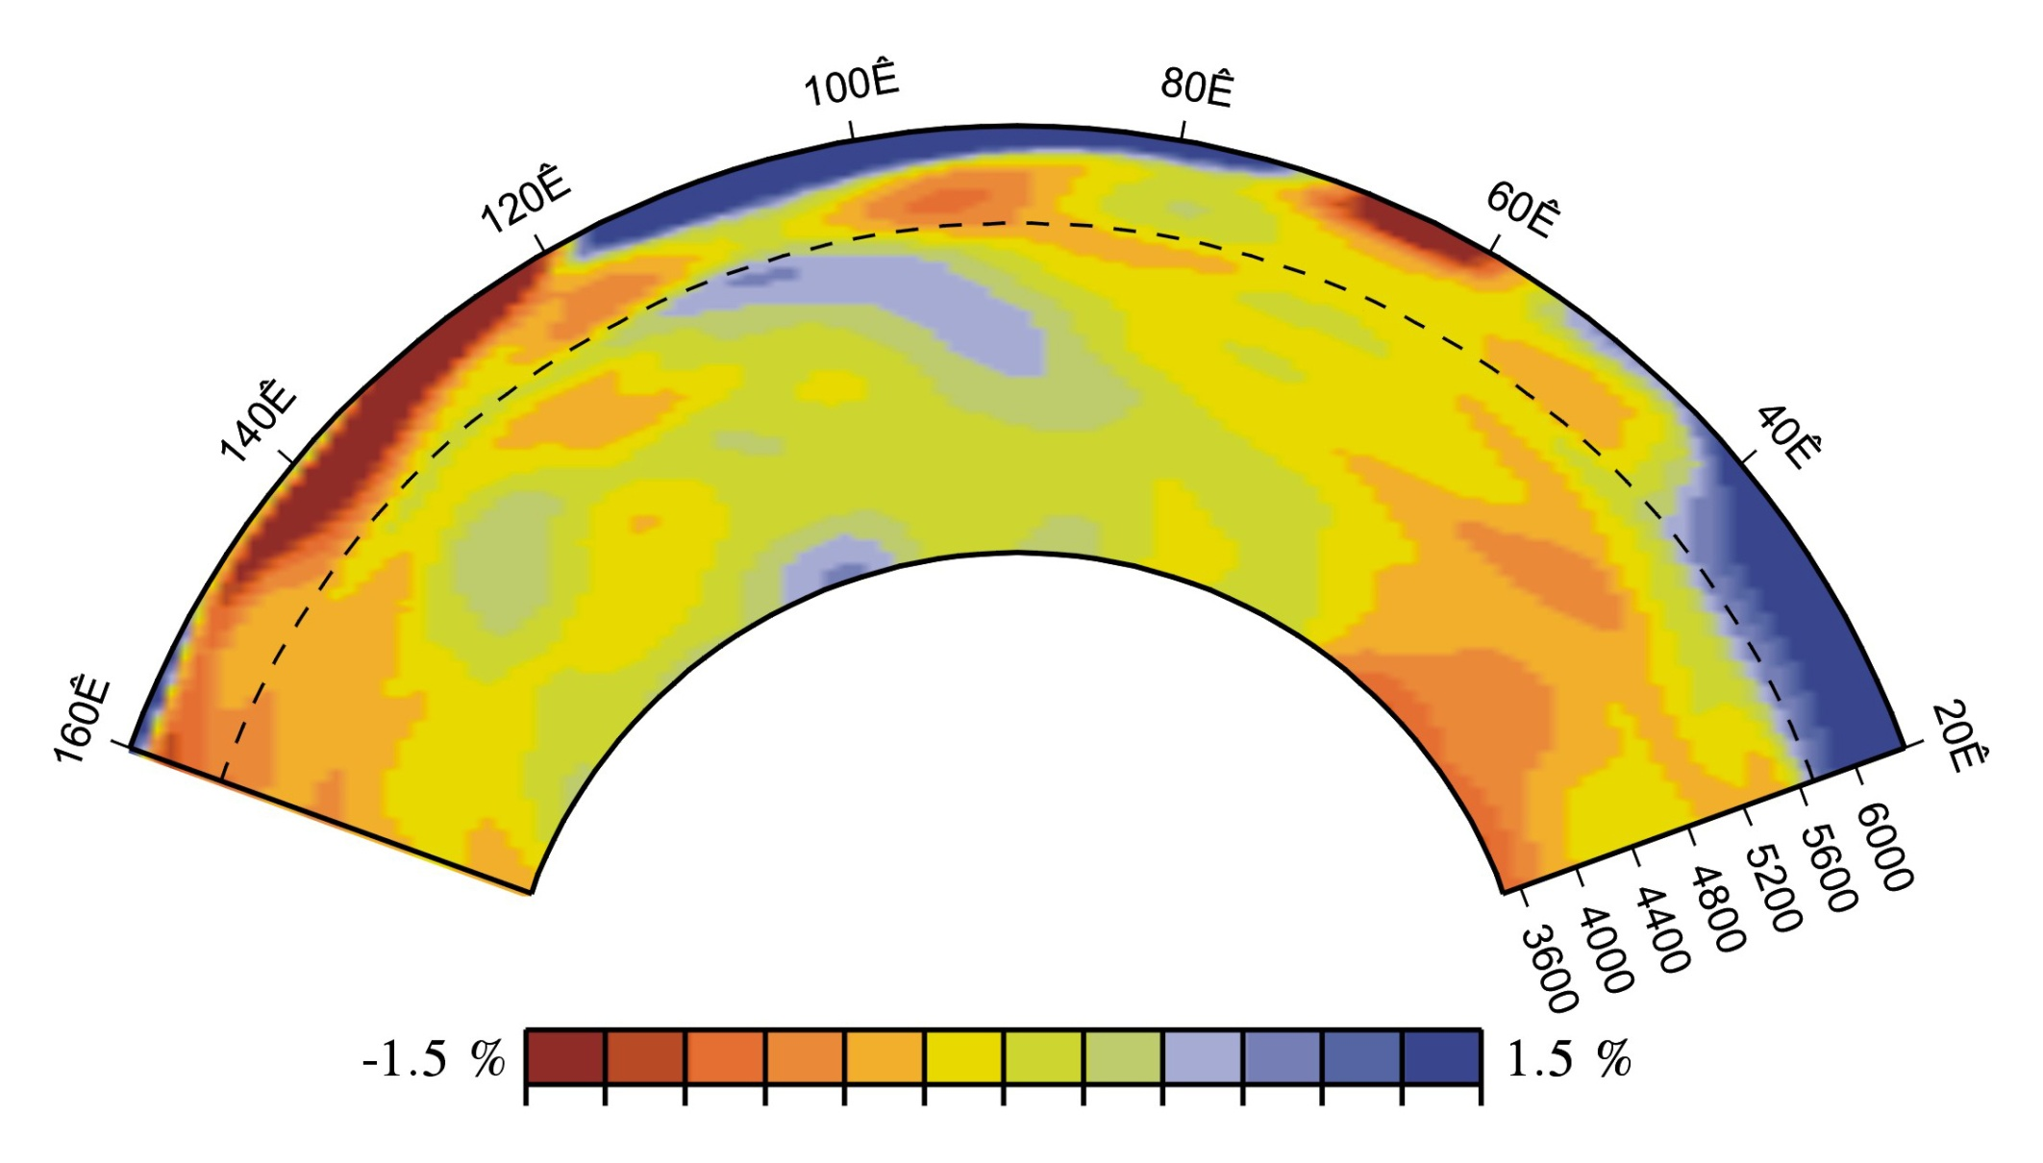
Tomographic Model
Van Heijst, Ritsema,
and Woodhouse, 1999

Slide 85
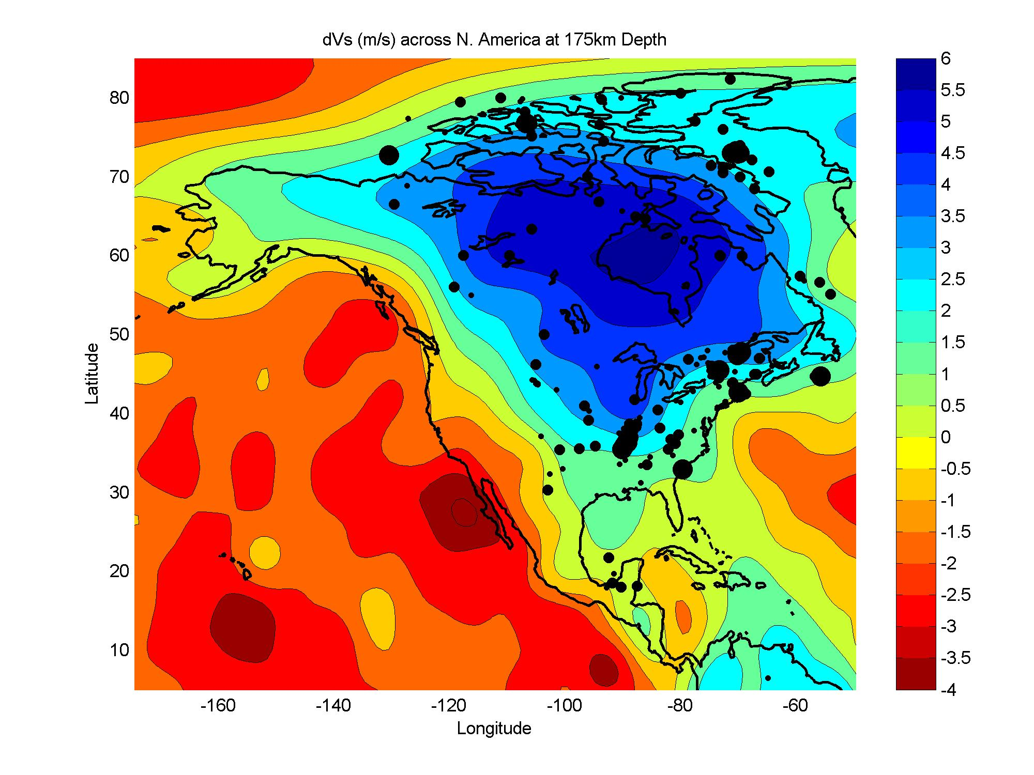

Slide 86
Seismic hazard map for PGA – firm rock: 2% probability of exceedance in 50 years
SEATTLE
Yellowstone
Charlevoix
Ottawa-
Adirondacks
SALT LAKE CITY
MEMPHIS
Meers
Alaska
Walker
Rio Grande
Charleston
San Andreas
New Madrid
Wasatch
Wabash
Valley
Eastern
Tennessee
Cascadia
Hawaii

Slide 87
S-wave Anomaly, 150 km

Slide 88
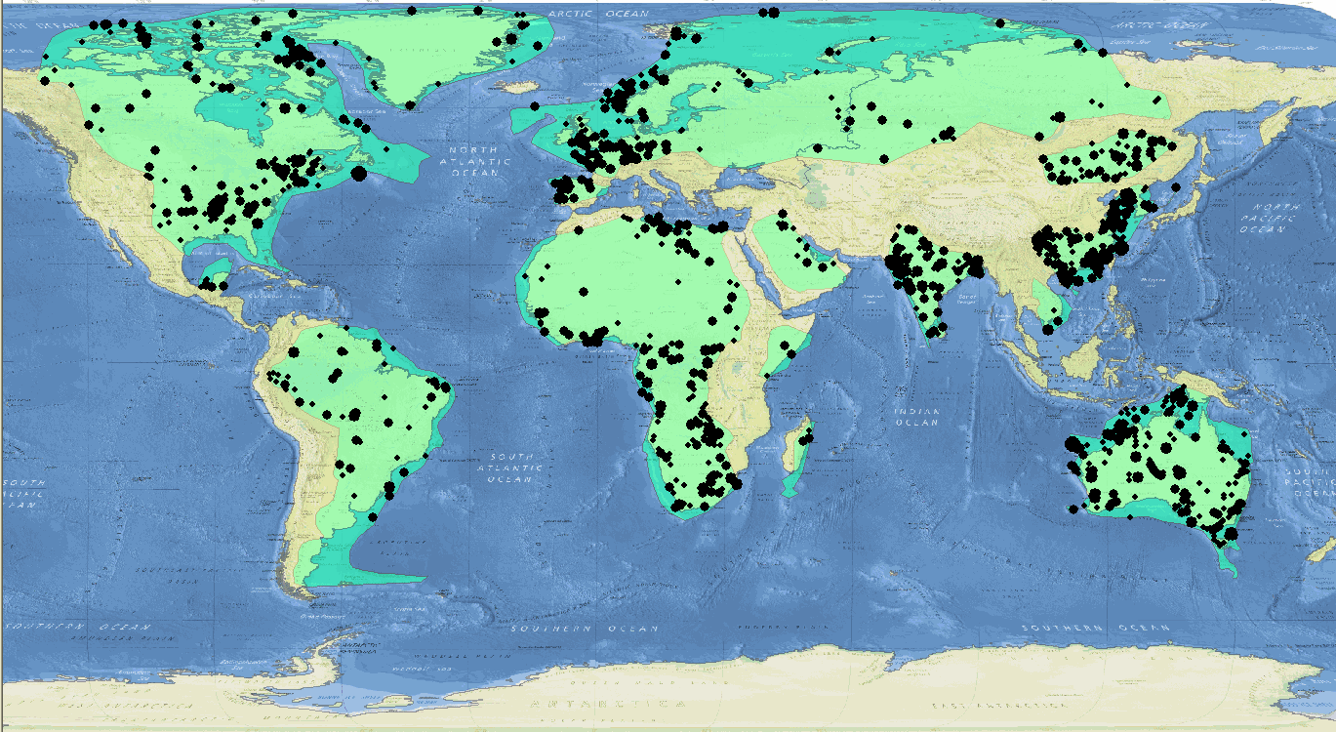
Intraplate Earthquake Catalog
Updated Catalog

Slide 89
Intraplate EQ and the Lithosphere
Mooney et al., 2012

Slide 90

Paleoseismology: 500 yr
From Tuttle and others, 2002
Notes:
Based on age dating of sand blows, paleoseismologists have found that there have been several large earthquake clusters occurring at least three times over the last 1500 years. The average recurrence interval for the most recent, well studied events is about 500 years.

Slide 91

From Calais and Stein, 2009
Notes:
A recent controversy stems from the work of Calais and Stein in which they state “…the recent cluster of large magnitude events does not reflect long-term fault behavior, and may be ending.” This is based on geodetic measurements made over the last 10 years which suggest very little deformation across the New Madrid fault system. Most people agree that the cluster of large magnitude events occurring on average every 500 years does not represent long-term fault behavior. Besides the geodetic data, other researchers have pointed out the lack of significant topography, which would be required if these events had been occurring at this rate for tens of thousands of years. The controversy has to do with whether the 500-year return period of large magnitude events has ended. One of the big assumptions Calais and Stein make is that all of the stress is relieved in an earthquake. This may be a reasonable assumption for some faults at the edges of plates, but it may not hold on faults within plates. Another recent finding is that the 1450 event may have happened on a different part of the New Madrid fault system. This may mean that if each cluster occurs on a different part of the fault system, when taken as a whole, strain across the region may be low and satisfy the geodetic data.

Slide 92


Current strain rate in the NMSZ is less than 0.2 mm/yr over 100 km
The longer we measure, the smaller the uncertainties, the smaller the signal.

Slide 93
Paleoseismology: 500 yr
From Tuttle and others, 2002
Notes:
Based on age dating of sand blows, paleoseismologists have found that there have been several large earthquake clusters occurring at least three times over the last 1500 years. The average recurrence interval for the most recent, well studied events is about 500 years.

Slide 95


April 2008 magnitude-5.2 earthquake in Illinois
Over 36,000 Did You Feel It? reports on the USGS web site
Felt reports from 16 states plus Ontario, Canada
Reminder that earthquakes are a national issue

Slide 96

National seismic hazard maps
M4.7
M6.0
M2.2
M5.2
M5.4
Update released April 2008

Slide 97
Thank you!

Slide 100


Slide 101


Station Distribution: Continuous Real-time
~1,300 station ~5,000 channels *2,000 stations; on-demand
(Effectively respond to all Mw5+ events world-wide)
Notes:
PAGER will fill in the gap between knowing magnitude and location and damage information by estimating impact as soon as possible. We want these estimtes to be based on the best possible
science and hazard input information.

Slide 102


Slide 103
S-wave Anomaly, 150 km

Slide 104


Slide 105
Walter
Mooney
USGS

Slide 106
OCEAN
SHIELD
PLATFORM
OROGEN
SEDIMENTARY BASIN
LARGE IGNEOUS PROVINCE
EXTENDED CRUST

Slide 107

Mid-ocean ridge

Slide 109
Global Geological Provinces
Mooney et al., 2007

