Slide 1
Crustal and mantle seismic anisotropy beneath the Tibetan Plateau and adjacent areas from shear-wave splitting analyses
Stephen S. Gao （高尚行）
Missouri University of Science and Technology
http://www.mst.edu/~sgao
sgao@mst.edu

Slide 2
Collaborators
Dr. Jing WU, Institute of Geology and Geophysics, CAS
Dr. Kelly LIU, Missouri University of Science & Technology
Dr. Fansheng KONG, Missouri University of Science & Technology
Dr. Solomon CHERIE, Missouri University of Science & Technology
Others involved in the studies:
Cory REED, Bin YANG, Youqiang YU, Dr. Yuan GAO

Slide 3
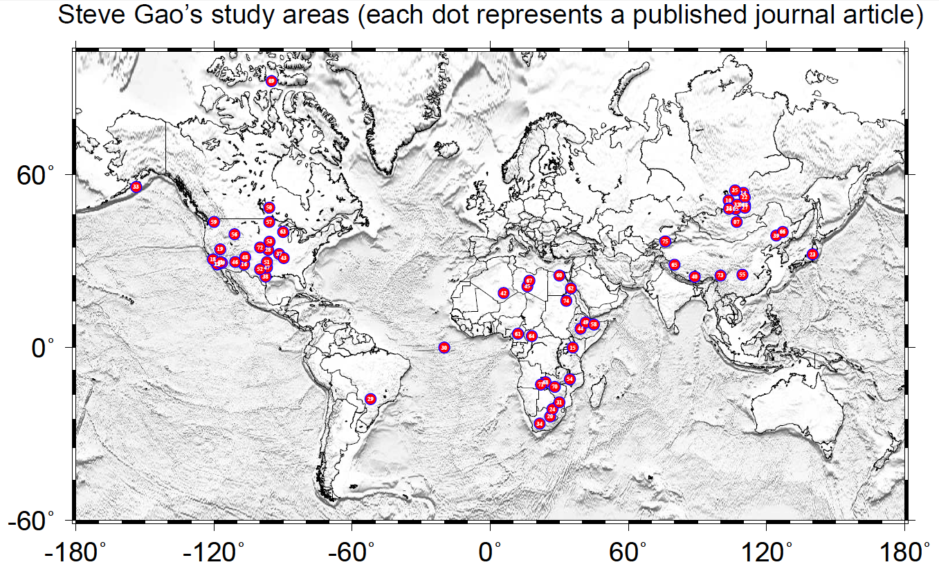

Slide 4
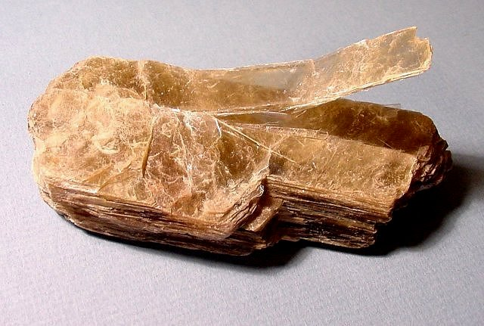
Anisotropy and Seismic Anisotropy
Anisotropy – the property of a material is directionally dependent
Seismic anisotropy – seismic property (i.e., traveling velocity of waves) is directionally dependent
Mica (云母）is a typical anisotropic mineral

Slide 5
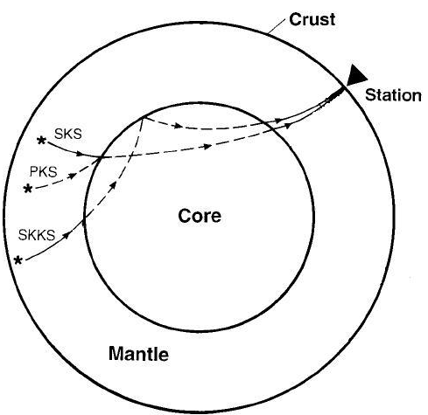
P-to-S converted waves at core-mantle boundary including SKS, PKS, SKKS are commonly used to qualify seismic anisotropy.
The three phases are collectively called XKS hereinafter.
Savage, 1999

Slide 6
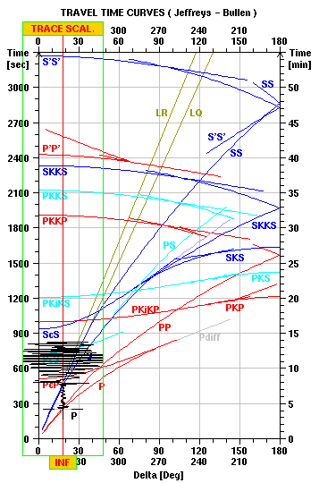
SKS is usable at the distance range of 83 to 180 degrees. SKKS is 95-180 deg. PKS is the best for distance 120-180 deg.

Slide 7
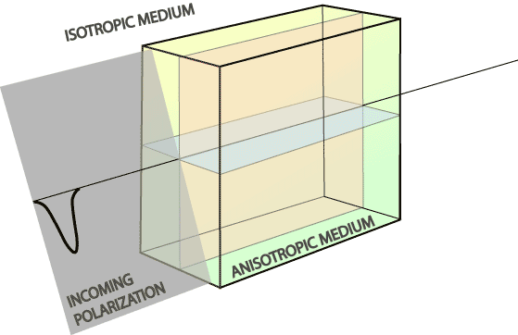
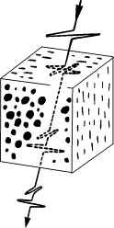
A shear-wave traveling through an anisotropic object will split, and this is called shear wave splitting
The two splitting parameters:
Fast direction: the polarization direction of the fast wave; measurement of the orientation of mantle deformation
Splitting time: the arrival time difference between the fast and slow waves; measurement of the magnitude of mantle deformation
Global average is 1 s.
http://www.victoria.ac.nz/geo/research/tectonics/seismic-anisotropy/figures/splits.gif

Slide 8
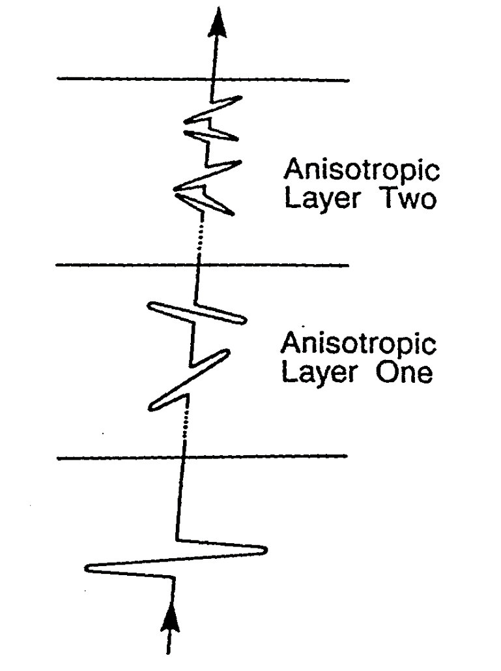
Simple and complex anisotropy
For a “simple” anisotropic model (e.g., a single layer with horizontal axis of symmetry), the splitting parameters should not change with the back azimuth (BAZ).
For a double layer model, which is the simplest form of complex anisotropy, the splitting parameters change with BAZ and the period is 90-degree
Silver and Savage, 1994

Slide 9
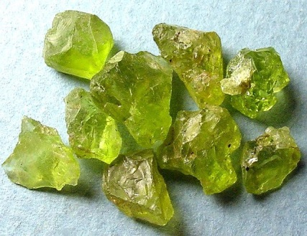
Upper Mantle Seismic Anisotropy
Earth’s upper mantle contributes to the bulk of observed seismic anisotropy from XKS.
~70% of the Earth’s upper mantle is composed of olivine.
The preferred orientation of olivine in strain field is the main cause of seismic anisotropy.
The highly anisotropic property of olivine and the development of LPO provide a macroscopic anisotropy in the upper mantle that may be examined using seismic waves [Conrad et al., 2007].
Shear wave splitting analysis can be used to measure fabrics formed by mantle flow or past tectonic events in the mantle.
Notes:
Seismic anisotropy is a common property of mantle and crust rocks of the earth.

Slide 10
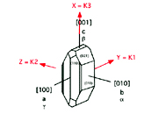
Olivine is highly anisotropic
For a seismic P-wave travelling in the direction of the a-axis, the P-wave velocity is 9.87 km/s, which is 27.7% faster than a P-wave traveling along the b-axis, and 14.1% faster than that along the c-axis. For a shear-wave, what matters is the polarization direction.
Olivine has 3 crystal axes (a, b, and c). Axis “a” is also called axis [100], “b” is [010], and “C” is [001]

Slide 11
What SWS measures is transverse isotropy
TI is the simplest form of anisotropy. It has only two axes, the fast and slow axes.
Many studies have proven that under compression or shear, some of the olivine crystals have their a-axis point to the same direction, but the b and c axes will distribute randomly in the plane that is perpendicular to the a-axis. This type of preferred orientation of axes collectively produces a transversely isotropic media. The a-axis is the axis of symmetry
b and c axes
a-axis

Slide 12
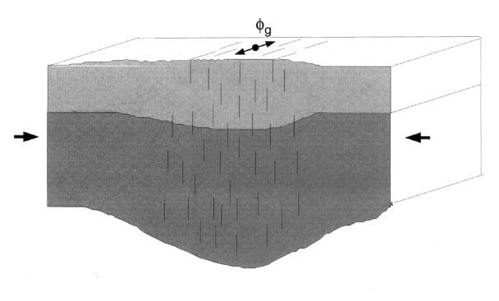
Under horizontal compression, the olivine a-axis turns to the direction that is orthogonal to the shortening direction, forming a transversely isotropic medium.
XKS waves arrive at a steep angle (near-vertical). Thus the fast direction is parallel to mountain belts, and slow direction is parallel to direction of maximum shortening.
Old mountain belts can also preserve this fabric (e.g., the Limpopo belt in southern Africa – Silver et al., 2001)

Slide 13
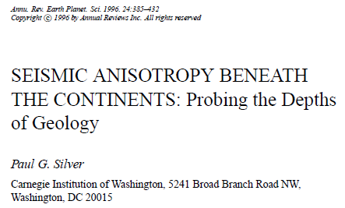
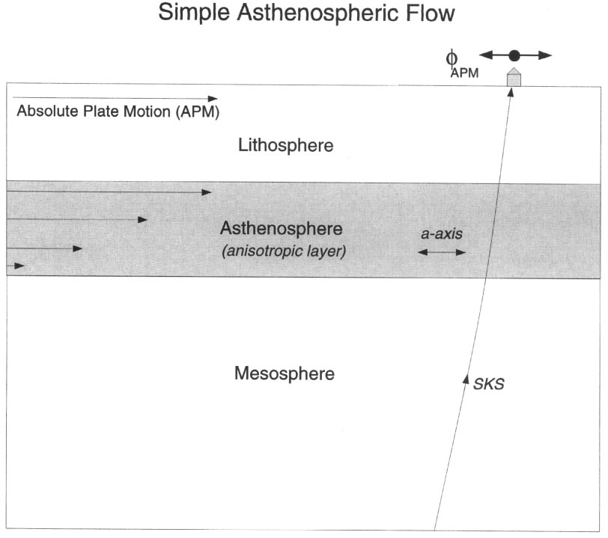
Anisotropy and mantle flow
The a-axis of olivine turns to the direction of plastic flow in the asthenosphere, forming a transversely isotropic medium with the fast direction parallel to the flow direction, and the slow direction orthogonal to the flow direction.
In many areas, the flow direction is parallel to the absolute plate motion direction
Note: vertical flow also aligns a-axis vertically, but this anisotropy cannot be detected using XKS. So in areas with vertical flow (and no other sources of anisotropy), the observations are dominantly Null

Slide 14
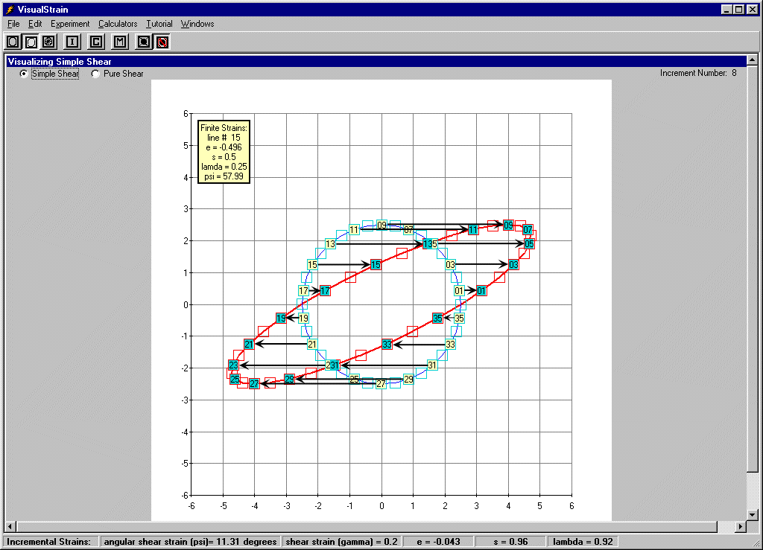
Simple shear (deformation in mantle flow)
Simple shear is a three-dimensional constant-volume strain.
It is analogous to the process that occurs when you place a deck of cards on a table and then gently press down on the top of the deck and move your hands to the right or left. As you move your hand the top of the deck slides over the lower part, with each successively intervening card sliding over its lower neighbor.
http://www.geology.sdsu.edu/visualstructure/vss/htm_hlp/simpl_s.htm

Slide 15
Processes that can lead to flow of the asthenosphere (note: Red arrows are arranged on a vertical plane, and “passive mantle” refers to sub-asthenospheric mantle)

Slide 16
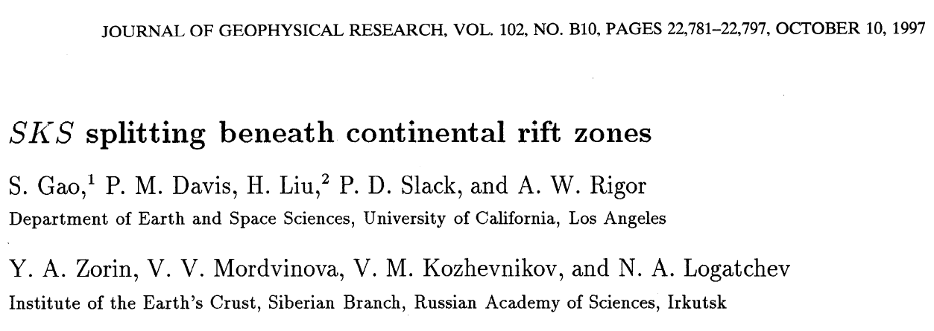
Densely-spaced vertical dikes can also form a transversely isotropic medium. Dikes have lower seismic velocity than surrounding areas. Vertical fractures have the same effect, but they can only exist in the crust, not the mantle. Note – this has nothing to do with olivine. It is “shape-preferred orientation” (SPO) rather than LPO. For vertically propagating shear-waves, the fast direction is parallel to the dikes, and the slow direction is orthogonal to it. This mechanism has been proposed to explain rift-parallel fast orientations observed in the Baikal Rift Zone (Gao et al., 1997)

Slide 17
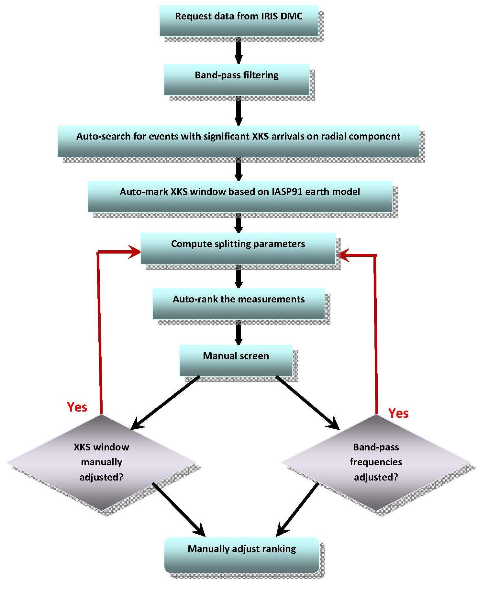
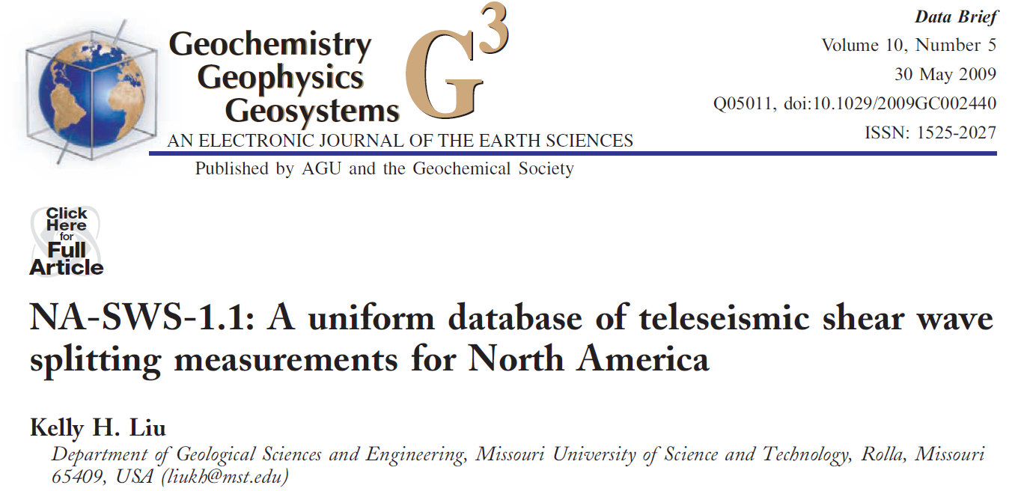
Method and Procedure
An automatic program was used to reject seismograms with low signal/noise ratio.
The method of Silver and Chan (1991) was used to measure the splitting parameters by minimizing the energy on the corrected transverse component.
Manual checking is essential
Figure 4 in Liu, G-cubed, 2009

Slide 18
A few notes on obtaining reliable shear-wave splitting measurements (based on Liu and Gao, 2013 BSSA)
Identification and minimization of noise and non-XKS signals in the XKS window
Correction for XKS signals recorded by mis-oriented sensors
Avoiding excessive use of “null” measurements
Identification and characterization of complex anisotropy

Slide 19
Some remarks on the multiple event stacking procedure (Kong et al., 2015)
The procedure (Wolfe and Silver, 1998; Restivo and Helffrich, 1999) should be used only for areas with confirmed simple anisotropy
A good azimuthal coverage is required to judge simple or complex anisotropy
For stations beneath which the anisotropy is multi-layered, the resulting ‘station-averaged’ splitting parameters are heavily biased toward those of the top layer

Slide 20
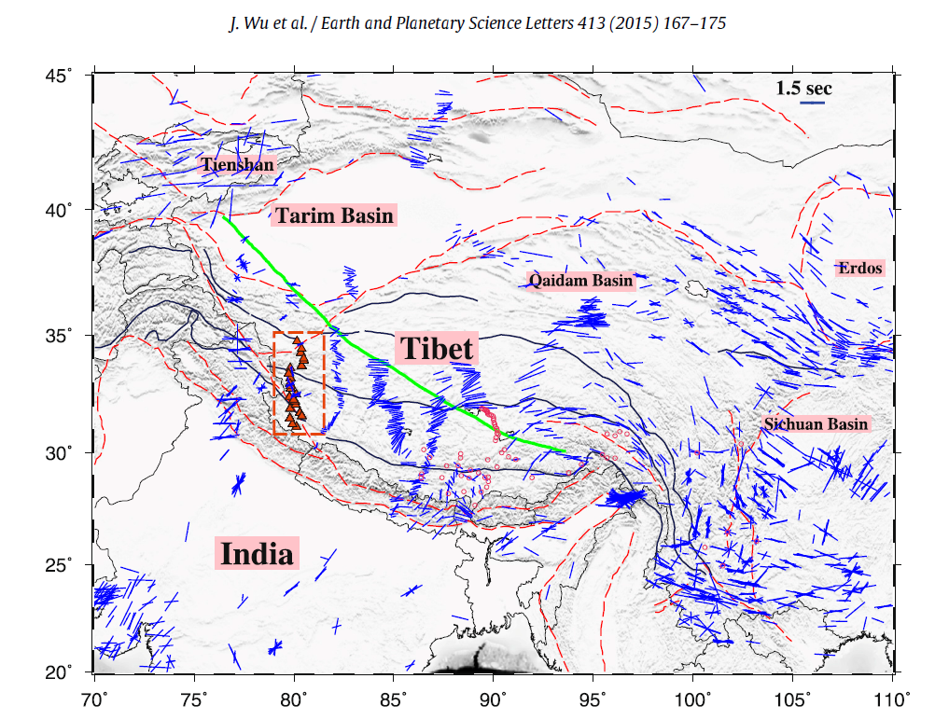
Some major features of SWS measurements in Tibet and adjacent areas:
1). Generally follow tectonic trends
2). Main exceptions in Tian Shan and Yunnan
3). “Null” measurements in southeastern Tibet
4). “Messy” measurements in western Tibet
Wu et al. (2015, EPSL)

Slide 21
Scientific implications and some questions on SWS measurements in Tibet
Implications: The general agreement between fast directions and tectonic features suggests coherent “flow” of the crust, sub-crustal lithosphere, and the asthenosphere, except for a few areas affected by current subduction (Yunnan, Tian Shan)
Questions to be discussed today:
1). What is the contribution of the crust and the proposed mid/lower crustal flow on the observed anisotropy?
2). What causes the exceptions in the Tian Shan area?
3). Why was significant anisotropy not observed in southern Tibet?

Slide 22
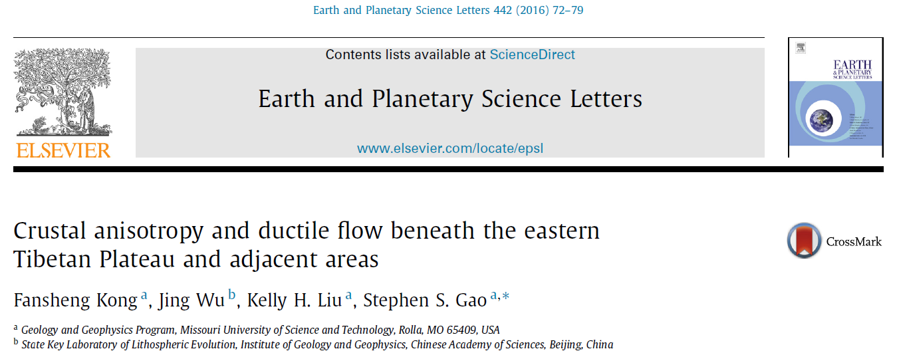
1. Crustal anisotropy in the vicinity of the eastern edge of the Tibetan Plateau (Kong et al., 2016)
Dr. Fansheng Kong, received PhD from Missouri Univ. of Sci & Tech (2016).

Slide 23
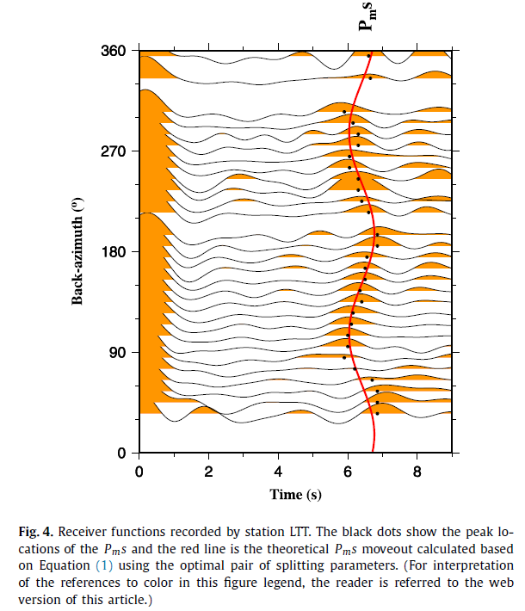
Method: Azimuthal variation of the arrival time of the P-to-S converted phase from the Moho:

Slide 24
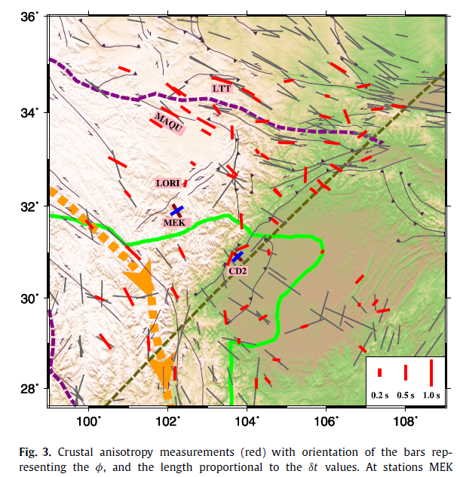
The fast directions observed at 71 stations are generally parallel to the strike-slip faults.
They are also mostly parallel to fast directions from SKS splitting
A couple of stations show two-layered anisotropy, with the upper layer anisotropy being parallel to fault strike.

Slide 25
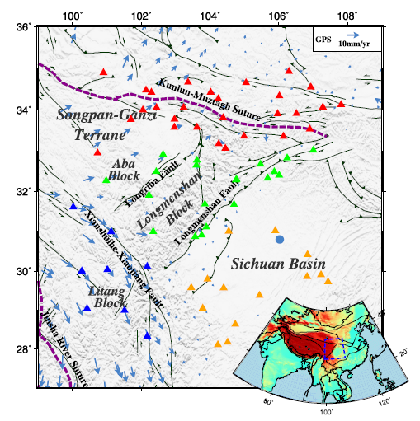
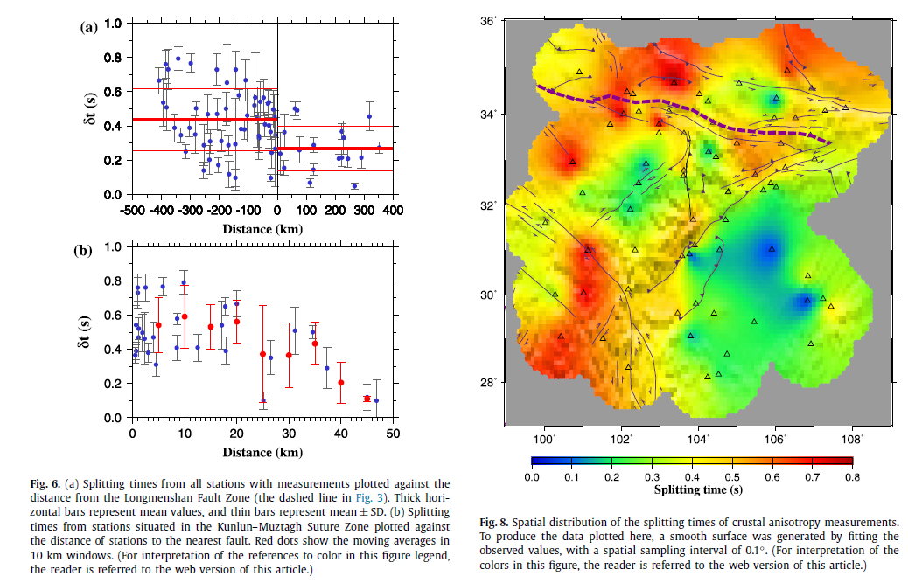
Major fault zones show high splitting times, while the Sichuan Basin and the Longmenshan/Aba blocks show low splitting times
Sudden drop of dt across the Longmenshan fault
Splitting times increase gradually toward the Kunlun suture

Slide 26
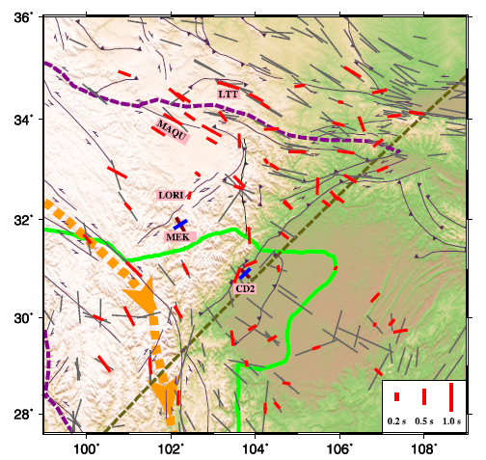
Some tectonic implications
1). Crust beneath the Litang Block has large Vp/Vs (Wang et al., 2010) and large splitting times: indications of mid/lower crustal flow
2). No active crustal flow beneath the Aba and Longmenshan blocks. So the flow system is likely “channelized” (Bai et al., 2010)
3). Fault-orthogonal fast orientations along the Longmenshan fault zone indicate fault-orthogonal compression, while upper-most crustal anisotropy (e.g., Y. Gao et al., 2014) shows fault parallel fast orientations and reflects fluid-filled fractures.

Slide 27
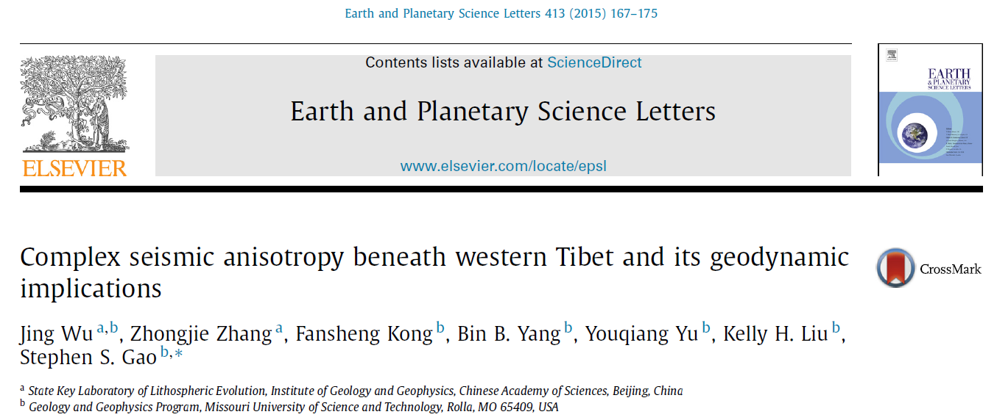
2. Crustal and mantle anisotropy beneath western Tibet (Wu et al., 2015)
Dr. Jing Wu, IGG/CAS

Slide 28
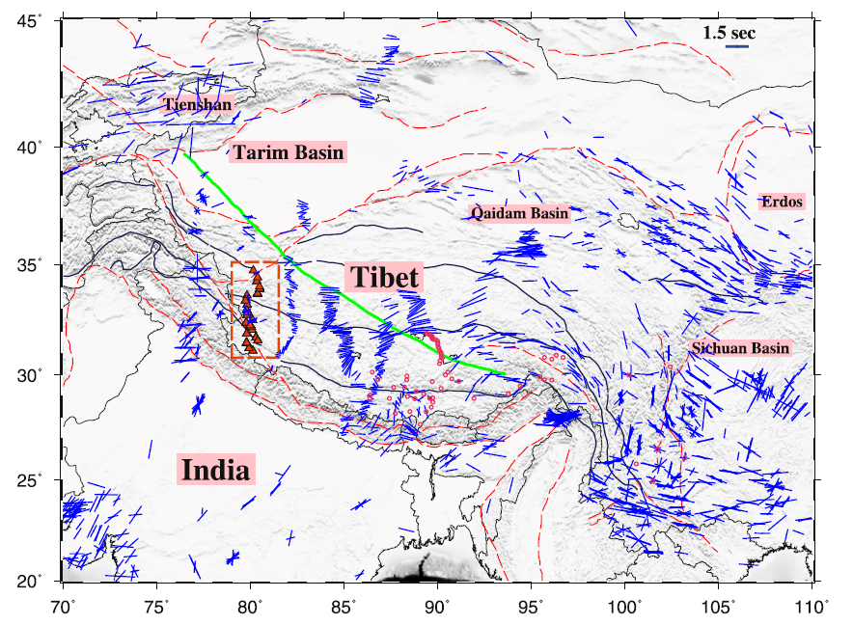
The study area. The profile is along 80 East

Slide 29
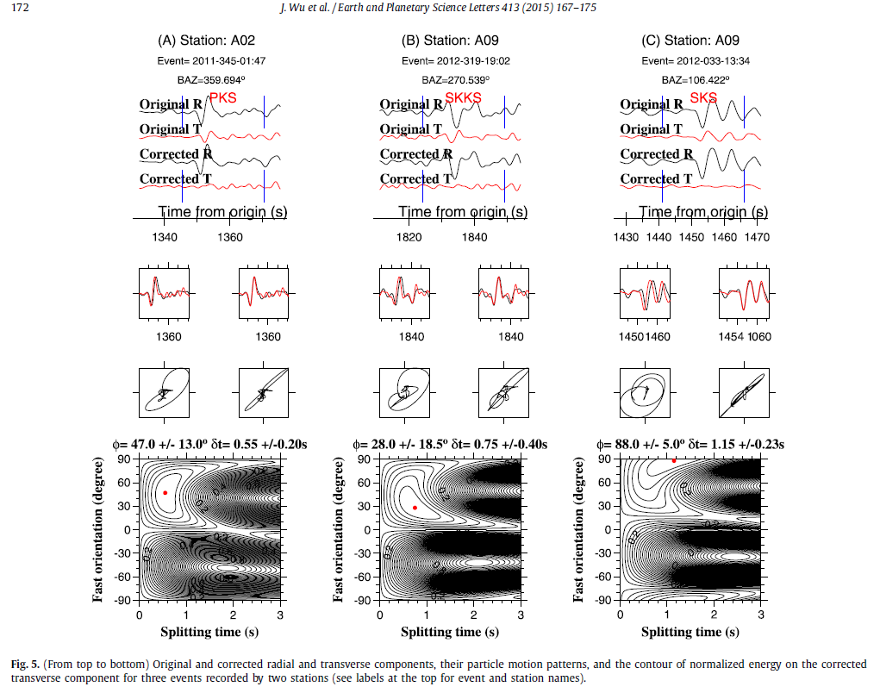
Outstanding data quality
for all the 3 phases

Slide 30
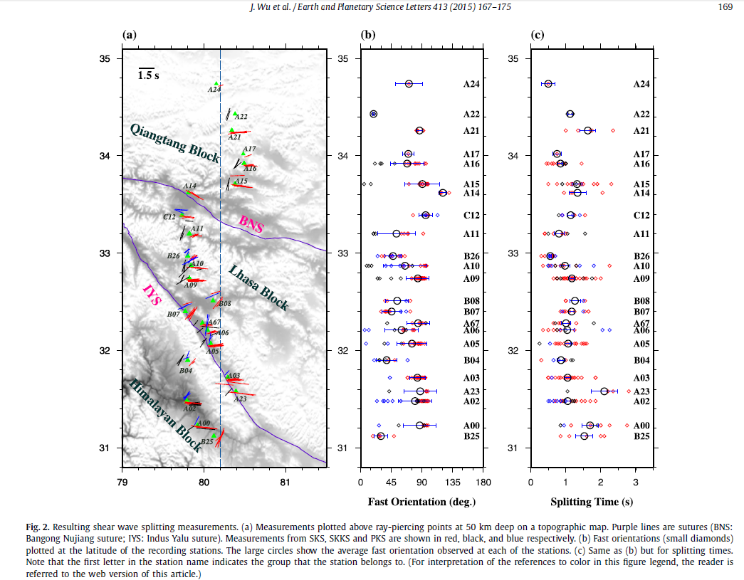
Resulting PKS, SKKS, and SKS splitting parameters.
Clear azimuthal dependence is found at most of the stations, indicating pervasive complex anisotropy

Slide 31
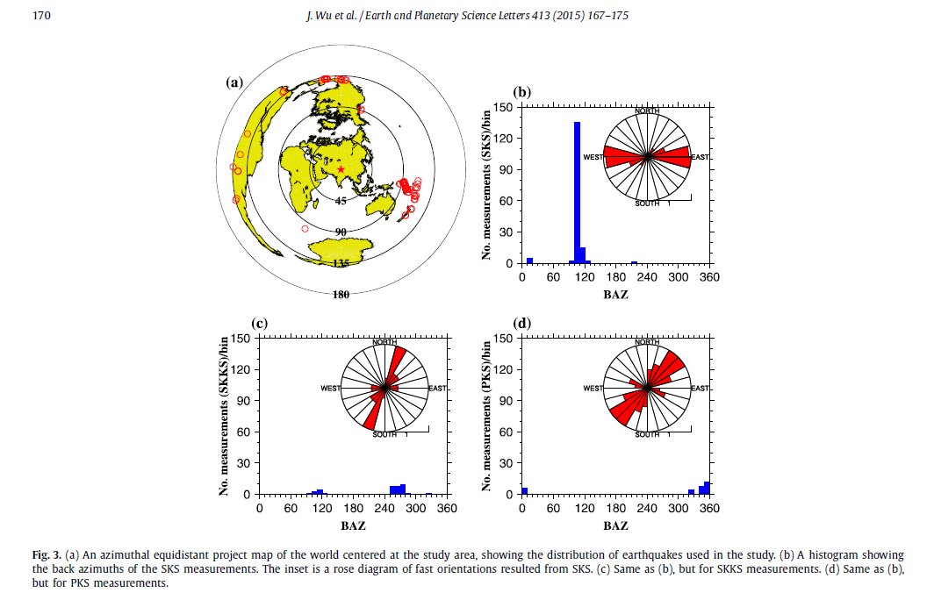
The 3 phases are from different azimuths.
The resulting fast orientations from the 3 phases are very different, indicating complex anisotropy.
If only the SKS phase were used, the resulting fast orientations would be E-W (panel b).

Slide 32
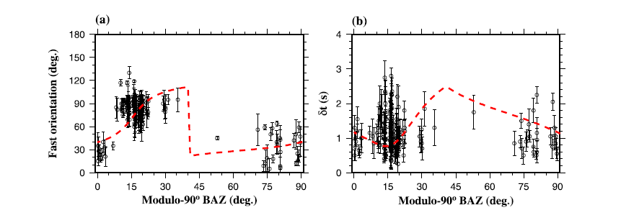
The azimuthal variations can be fitted by a two-layered model:
The lower layer has a N-S fast orientation with a splitting time of 1.2 s, and the upper layer has a NE-SW fast orientation, with splitting time of about 1 s.

Slide 33
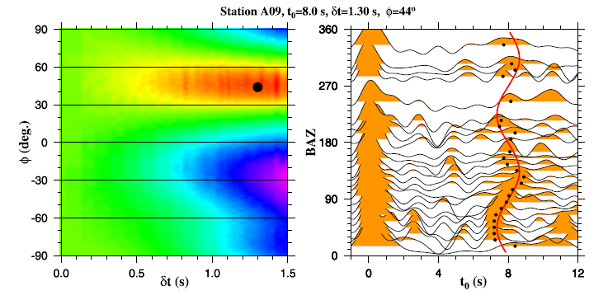
A few stations demonstrate strong crustal anisotropy with a NE-SW fast orientation and a dt of about 1 s. Both are consistent with the parameters of the upper layer from XKS

Slide 34
Tectonic implications
No significant changes in the characteristics of the splitting pattern across the entire profile: the Indian lithosphere extends beneath the entire array?
The N-S oriented fast directions for the lower layer may reflect flow induced by the subduction
The NE-SW oriented upper layer anisotropy may be caused by strong lower/mid crustal flow

Slide 35
3. Anisotropy beneath the Tian Shan area (Cherie et al., 2016)
Dr. Solomon Cherie (received PhD from Missouri S&T in 2015)

Slide 36
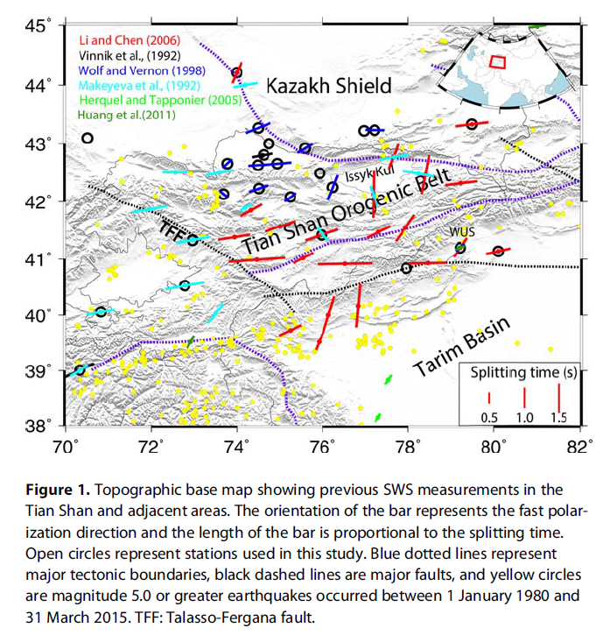
Previous studies all reported station-averaged results, except for Yonghua Li et al. (2010) and Vinnik et al. (2007) for station WUS
A band of NE-SW fast orientations was identified, and was perceived to be the results of a mantle plume (Makeyeva et al., 1992, Nature) or NE-ward dragging of the lithosphere relative to the asthenosphere (Li and Chen, 2006, GRL)

Slide 37
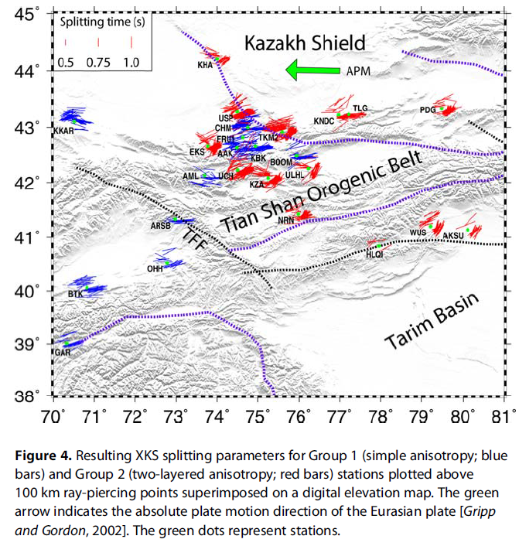
25 stations with adequate azimuthal coverage for identifying the existence of simple or complex anisotropy
10 of the stations show no significant azimuthal variations (group 1, single layered anisotropy)
15 shows significant variations with a 90-degree periodicity (group 2, two-layered anisotropy)

Slide 38
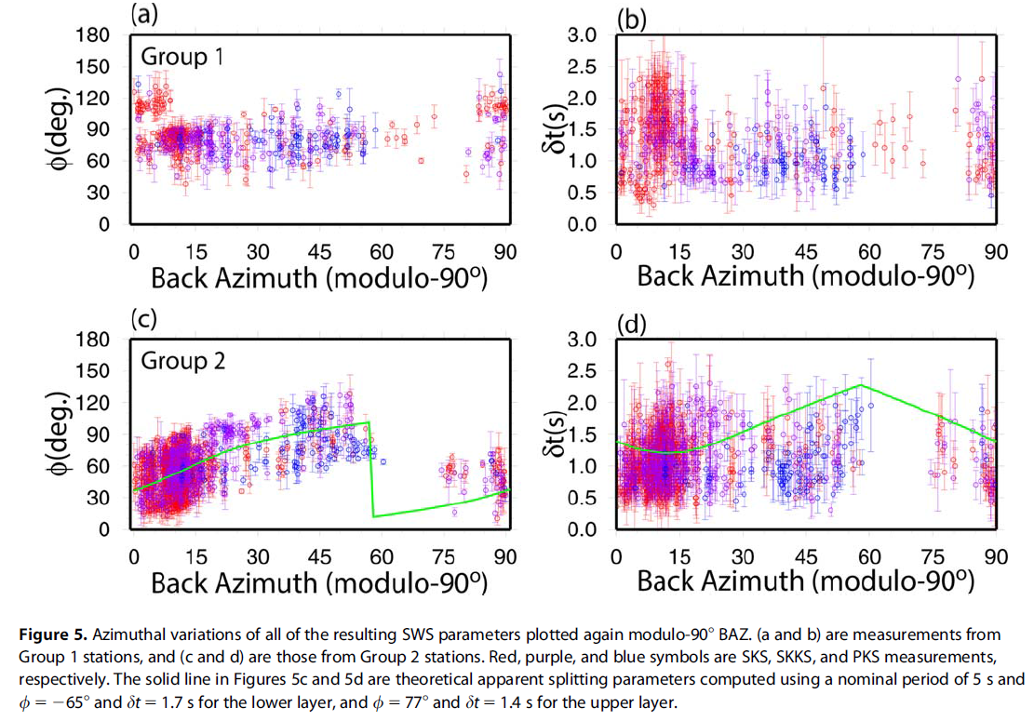

Slide 39
The SKS events are in a narrow azimuthal range of 90-110 deg. (or 0-10 degrees in the modulo-90 degree domain)
In this range the fast orientations are about 30-40º clockwise from the North
This explains the “anomalous” fast orientations reported by some of the studies which used only the SKS phase

Slide 40
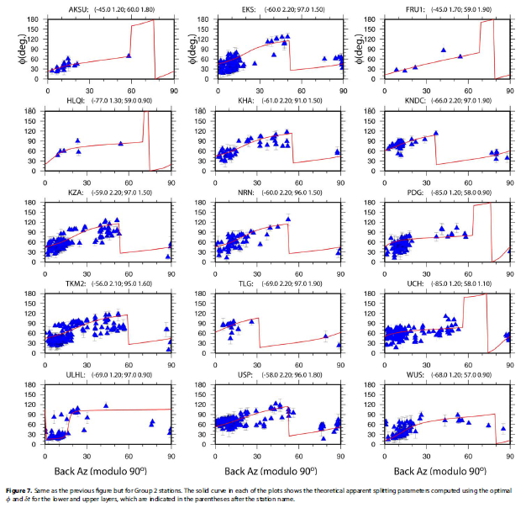
Searching for the two pairs of splitting parameters for each of the stations

Slide 41
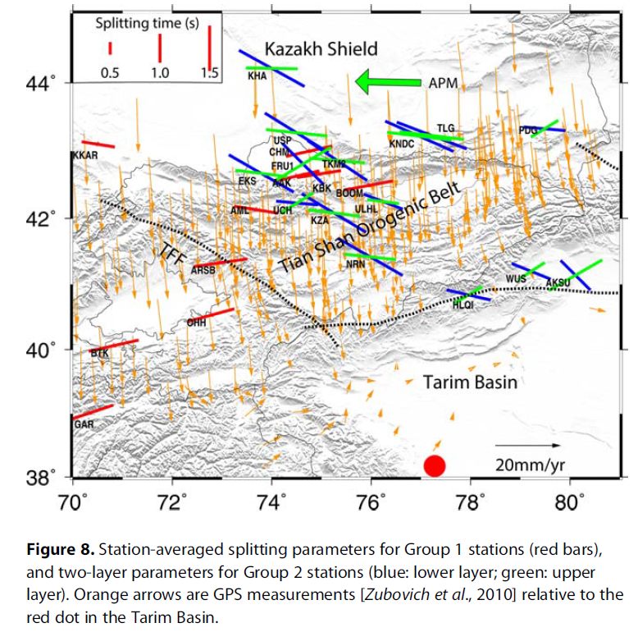
For the 15 two-layered stations, the resulting fast orientation of lower layer (blue) is mostly NW-SE, and that of the upper layer (green) is mostly parallel to the orogenic belt.

Slide 42
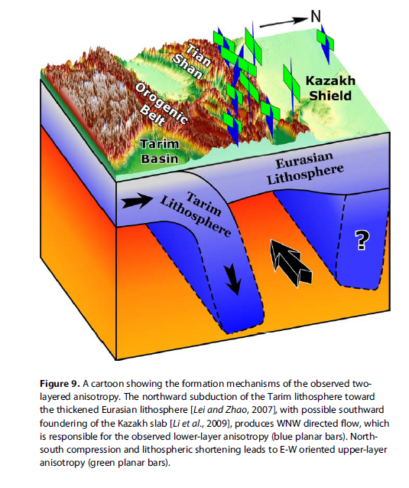
The model
Upper layer anisotropy reflects lithospheric shortening-induced olivine LPO.
Lower layer anisotropy is associated with mantle flow sandwiched between the subducting Tarim lithosphere and the thick lithospheric root of the Kazakh shield (both are revealed by seismic tomography, e.g., Lei and Zhao 2007; Li et al., 2009).

Slide 43
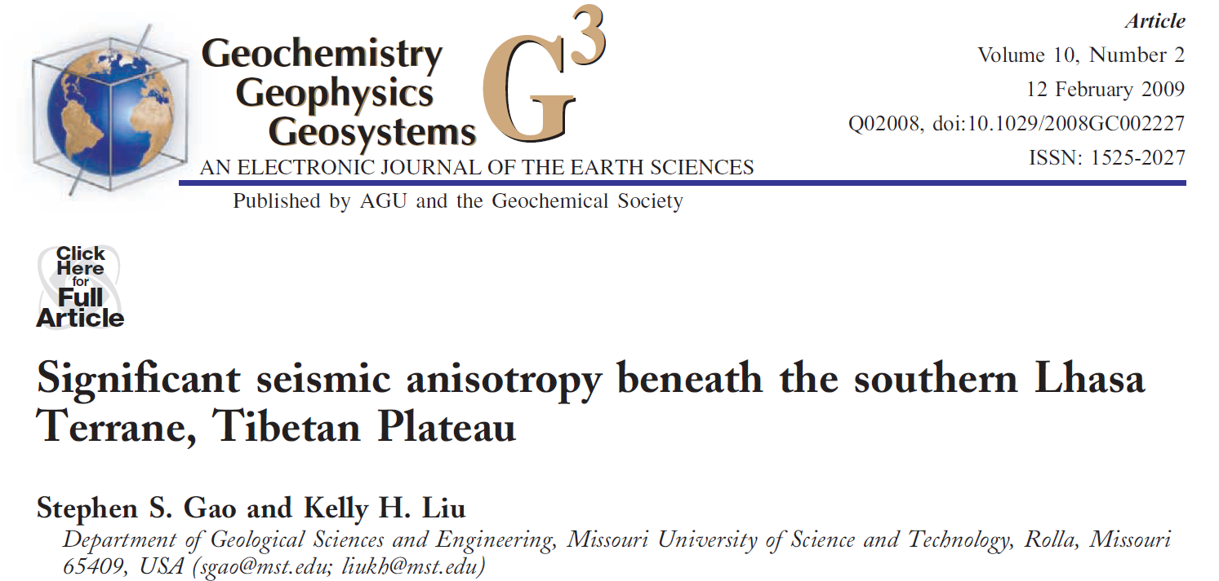
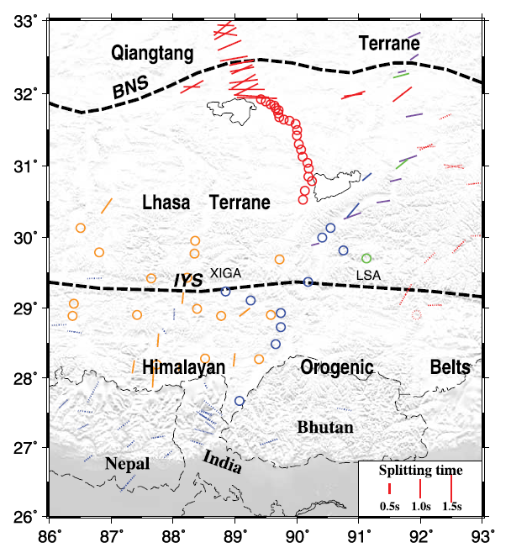
4. Why was significant anisotropy not observed in southern Tibet (Gao and Liu, 2009)?
Previous SKS splitting results. Circles are null measurements.
(Figure 1 of Gao and Liu, 2009)
Most previous SKS splitting studies reported “Null” measurements at stations south of the Bangong-Nujiang suture in eastern Tibet.
Several geodynamic models were proposed.

Slide 44
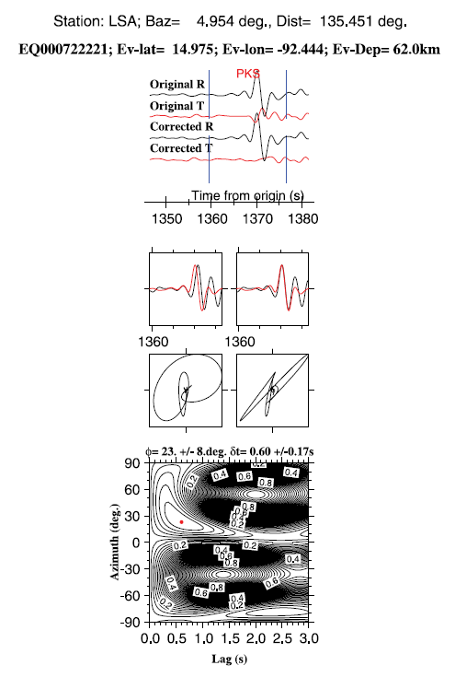
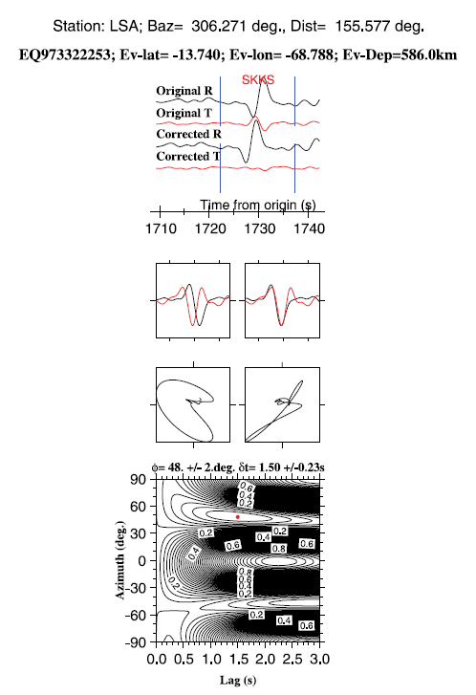
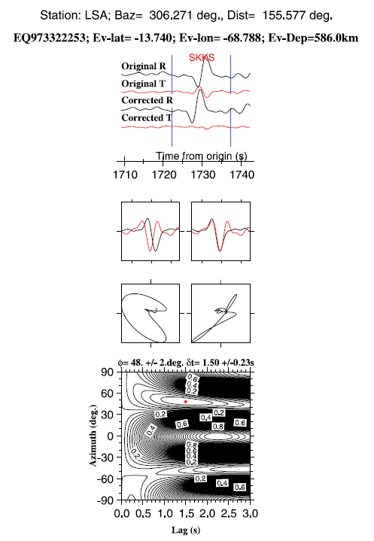
Strong evidence of significant anisotropy is found at the Lhasa station.
The splitting parameters are azimuthally dependent: complex anisotropy

Slide 45
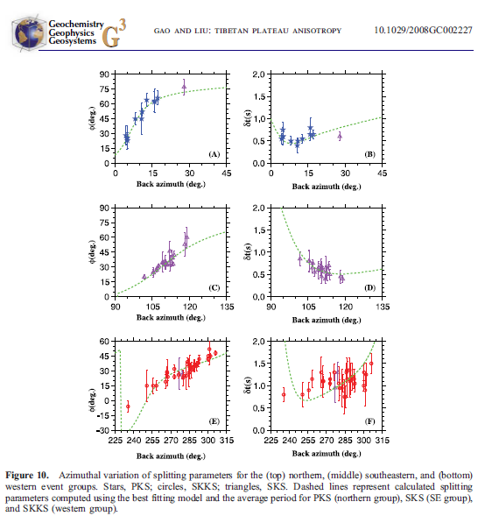
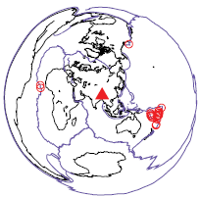
Most of the SKS events came from the ESE direction (middle panels), for which the specific two-layer anisotropic structure results in a very small splitting time of about 0.5 s.
This explains why previous studies, most of which only use the SKS phase, concluded insignificant anisotropy in southeastern Tibet.

Slide 46
A few suggestions on future shear-wave splitting research
Suggestion 1: Try to obtain and report both individual AND station-averaged splitting parameters.
Station-averaged splitting parameters are useful only for the not-so-common situation of simple anisotropy
Individual splitting parameters are way-more useful than station or regionally averaged ones in a number of aspects (see next slides).

Slide 47
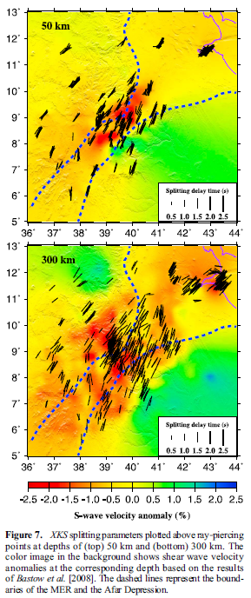
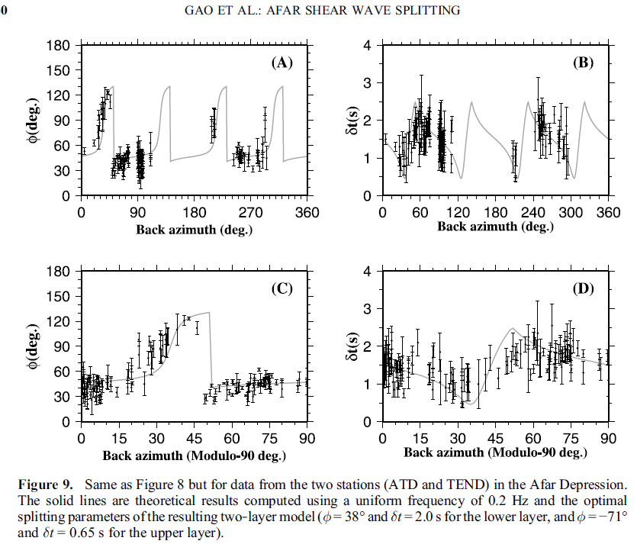
1). Complex anisotropy identification and characterization

Slide 48
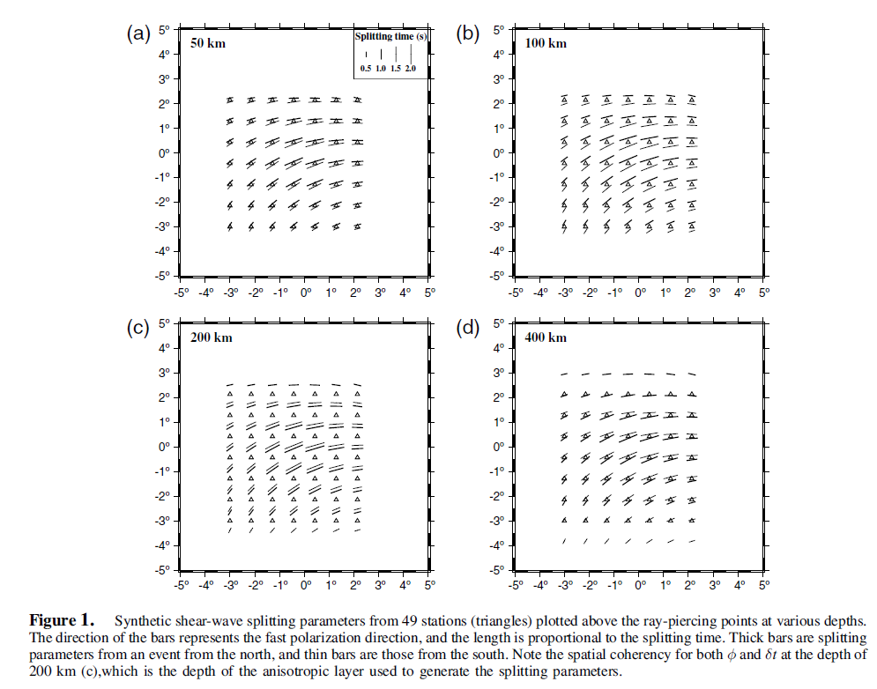
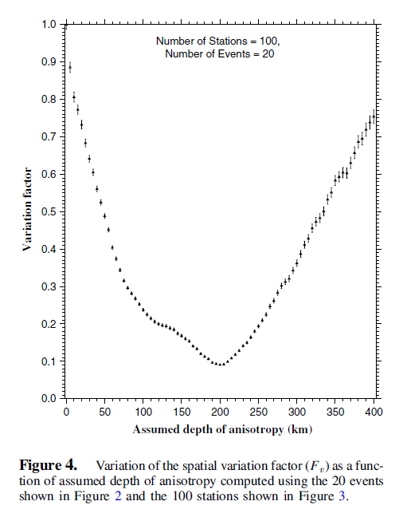
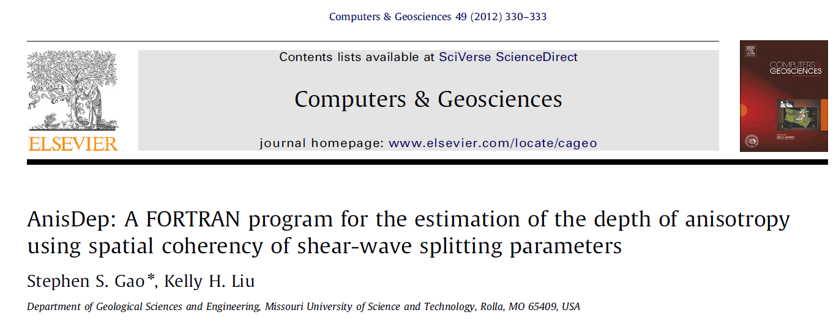
2). Estimating the depth of seismic anisotropy using spatial coherency of splitting parameters (Liu and Gao, 2011; Gao and Liu, 2012)
A Fortran code can be accessed from
http://www.mst.edu/~sgao/Anisdep/

Slide 49
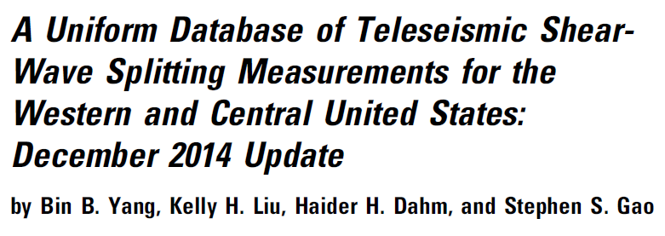
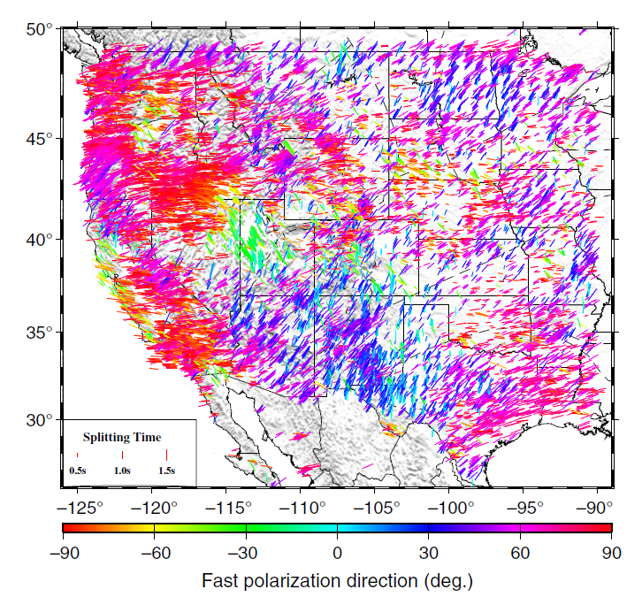
Suggestion 2: Producing a uniform database of shear-wave splitting parameters for the whole country using the same procedure and criteria, using not only the SKS, but also PKS and SKKS phases.
The figure below shows 23,488 pairs of splitting parameters at 2400 stations for the western and central United produced by the Missouri S&T group (Yang et al., 2016, Seismological Research Letters). Results for the remaining part of the US are being produced by the same group.

Slide 50
Suggestion 3: For the interpretation of XKS splitting results, the non-uniqueness reduces when crustal anisotropy is also measured. In areas with thick crust, contributions from the crust cannot be ignored.
Suggestion 4: Involving geodynamic modeling in the interpretation is helpful.

