Slide 1
青藏高原岩石圈结构研究
储日升
大地测量与地球动力学国家重点实验室
中国科学院测量与地球物理研究所
2016年6月27日 北京

Slide 2
致谢
朱露培
眭怡，吴庆举
孙道远，冷伟
周元泽
D. Helmberger，M. Gurnis
Shengji Wei
Brandon Schmandt

Slide 3
汇报提纲
地震波上地幔三重值
北美上地幔速度结构
青藏高原上地幔结构

Slide 4
汇报提纲
地震波上地幔三重值
北美上地幔速度结构
青藏高原上地幔结构

Slide 5
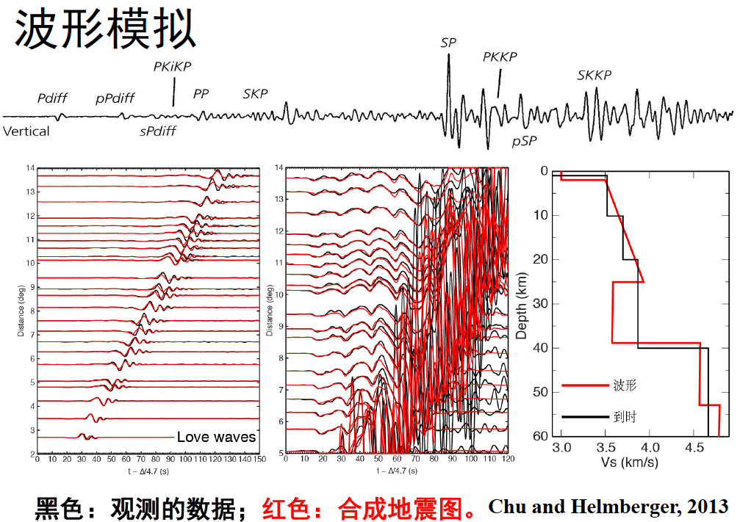
Notes:
单一数据结果，多重数据的结果。

Slide 6
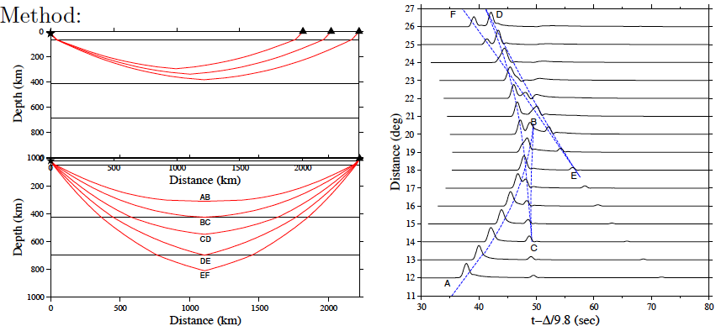

Slide 7
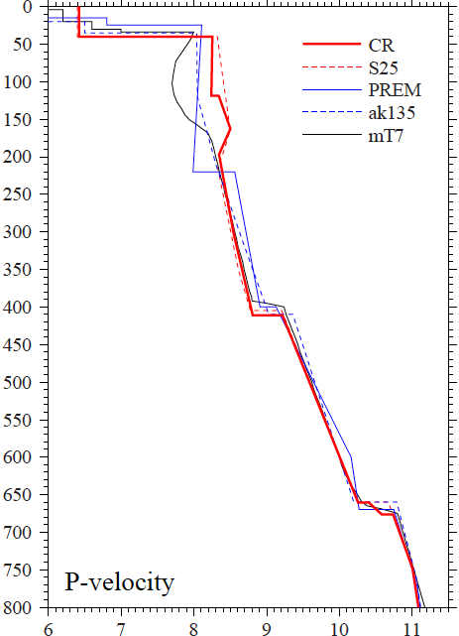
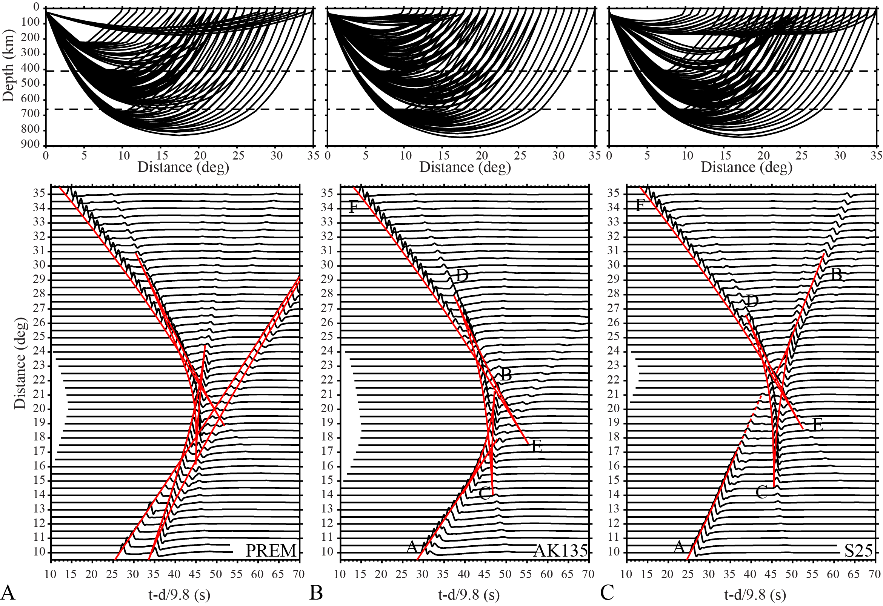
上地幔地震波三重值
Notes:
三重值的优点

Slide 8
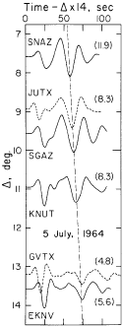
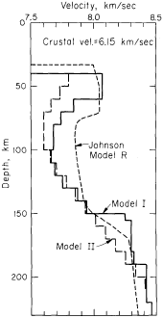
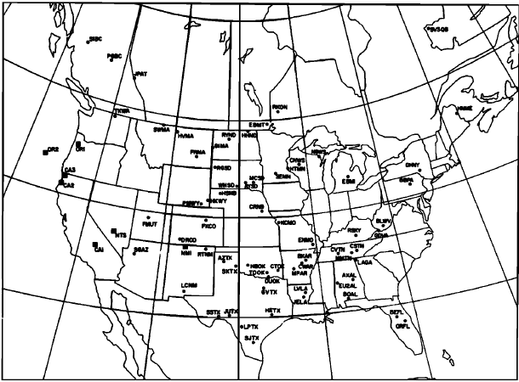
Helmberger, 1972
Wiggins and Helmberger, 1973

Slide 9
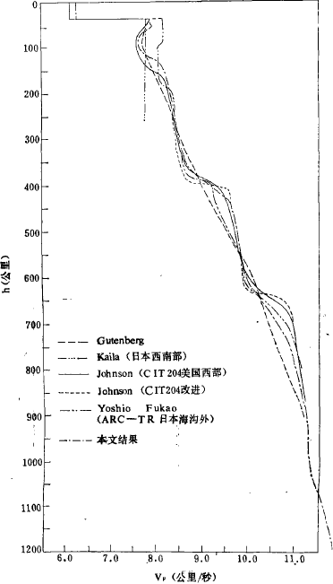
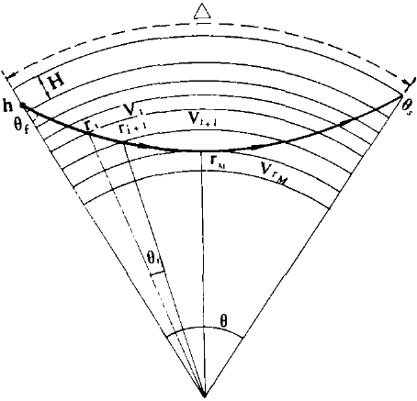
宋仲和等，1981

Slide 10
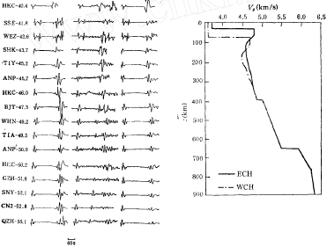
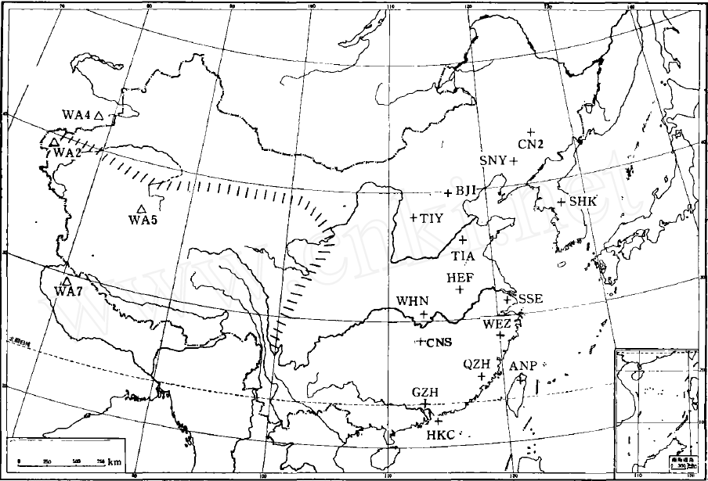
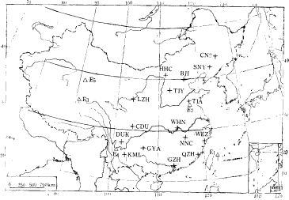
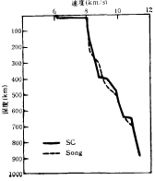
王凯等，1989；1991

Slide 11
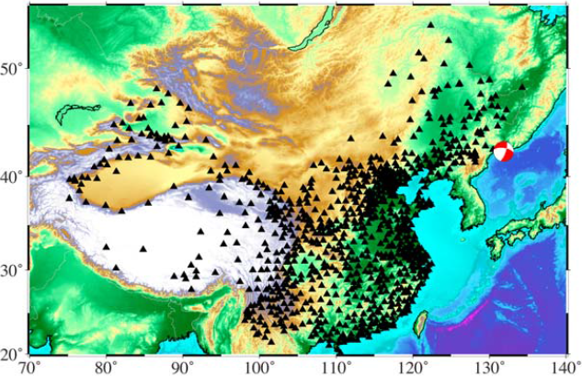

Slide 12
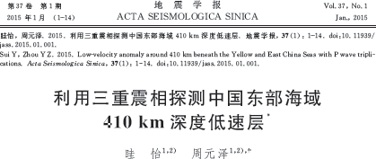
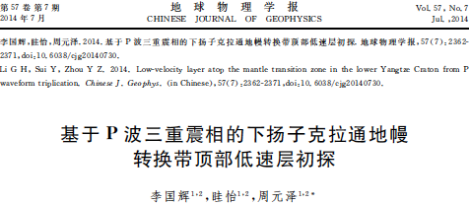
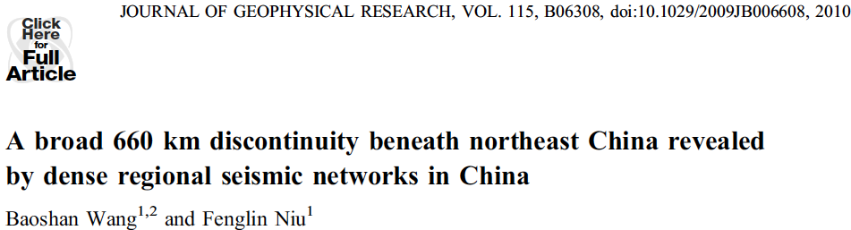
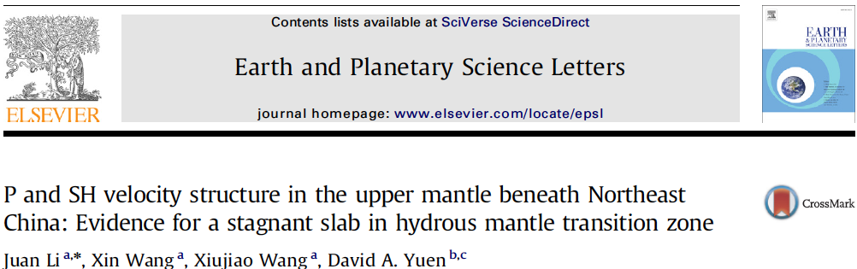
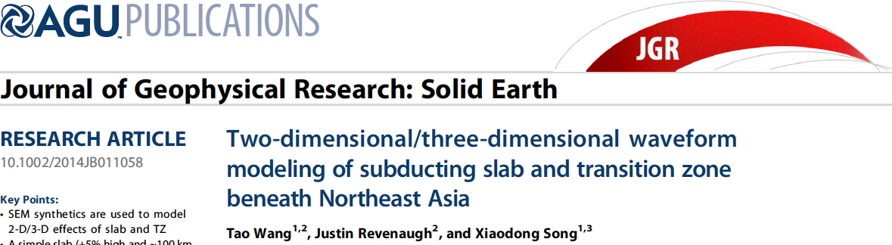
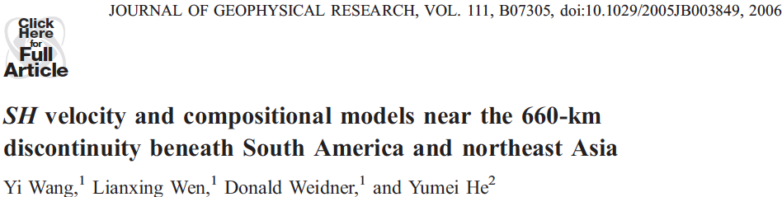
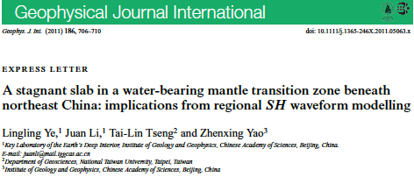
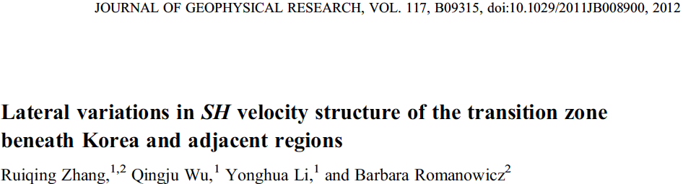

Slide 13
汇报提纲
地震波上地幔三重值
北美上地幔速度结构
青藏高原上地幔结构

Slide 14
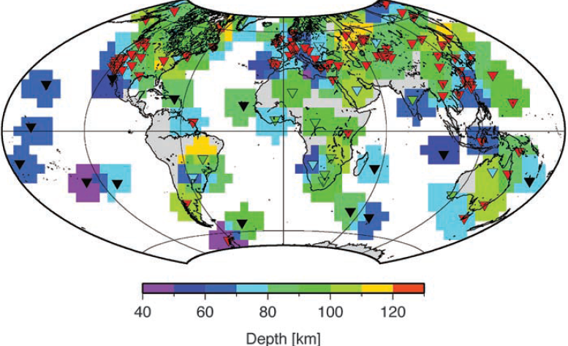
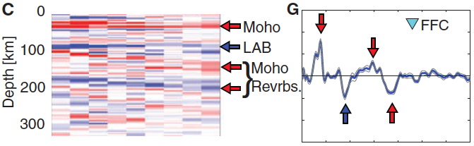
Rychert and Shearer, 2009
Notes:
接收函数的缺点，这些结果的不足（xenolith地化，其他的证据）

Slide 15
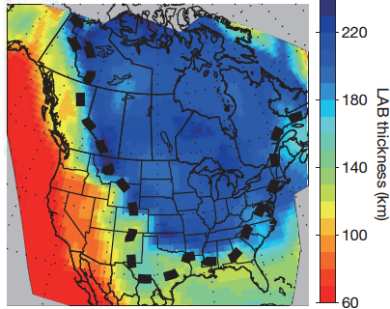
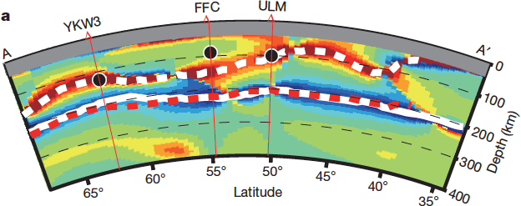
Yuan and Romanowicz, 2010

Slide 16
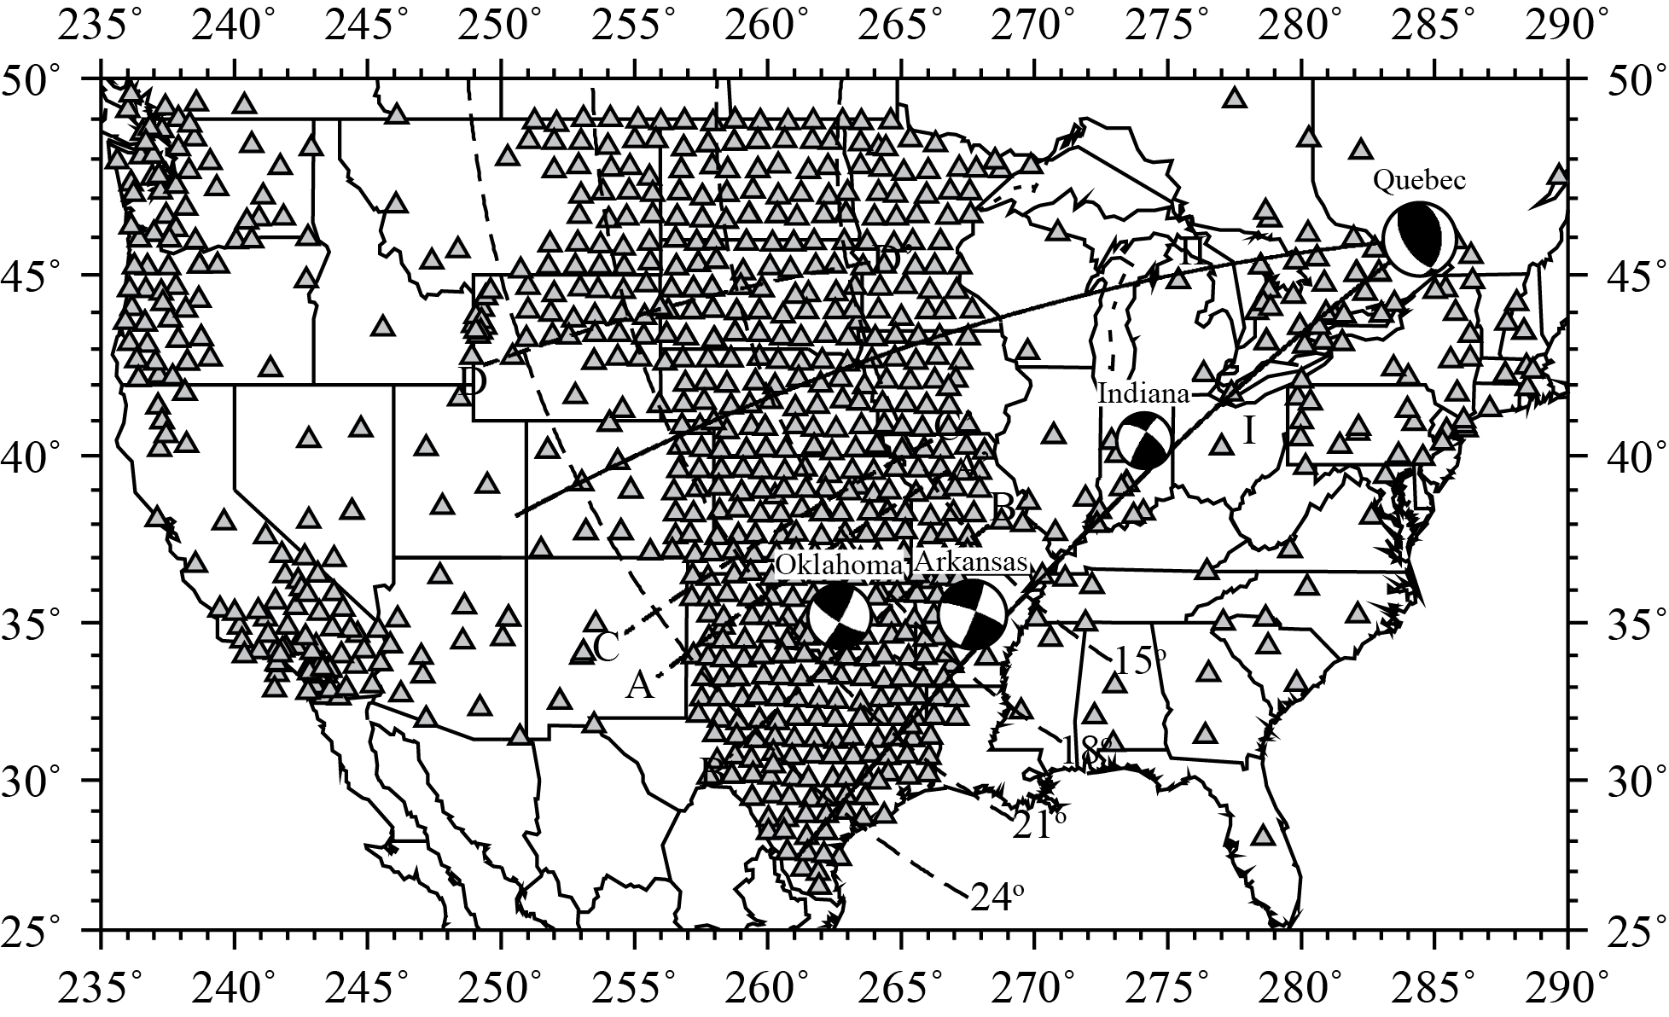
Chu et al., 2012

Slide 17
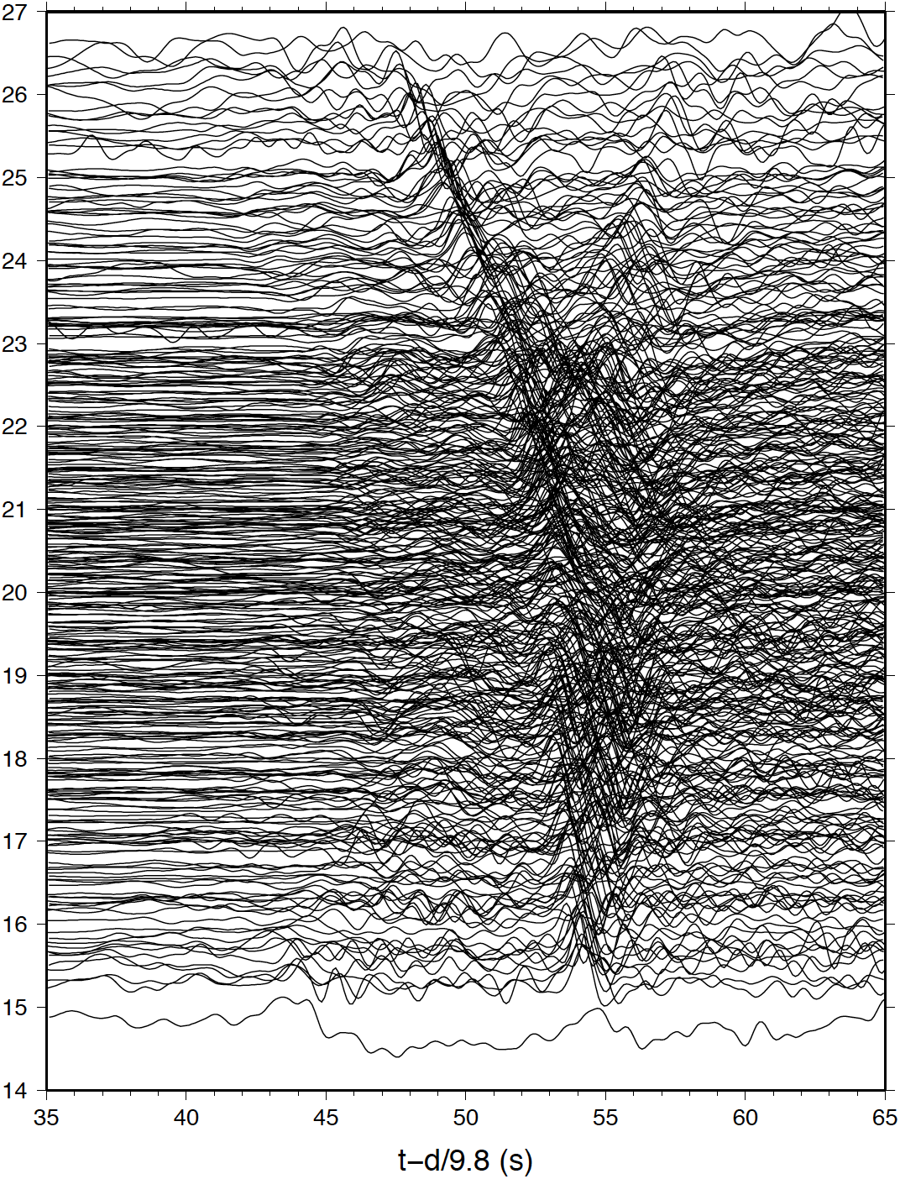
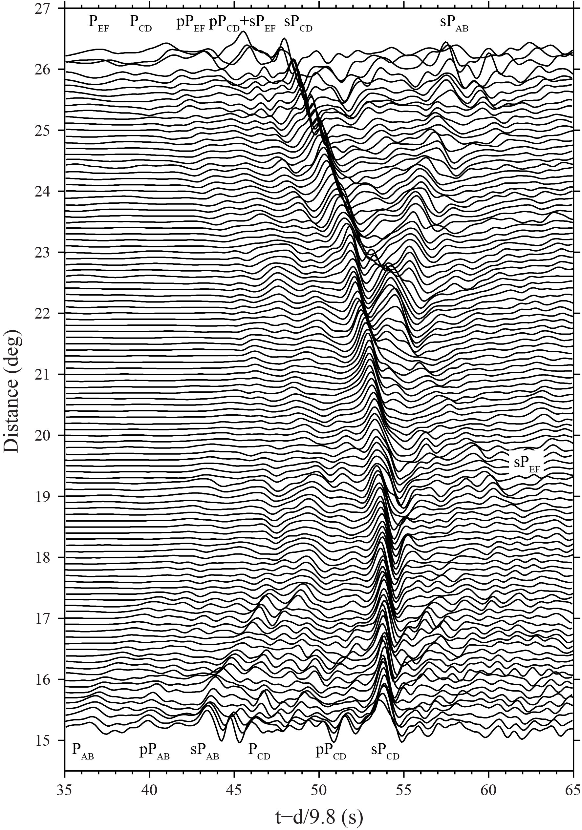
Notes:
This figure shows all the USArray data of the Quebec earthquake. The P and pP phases are more nodal, but the sP is very strong. The data is filtered 0.01 to 1 hz and plotted using a reduced velocity of 9.8 km/sec. This distance range is usually called triplication distances. This dataset samples the upper mantle between 150 amd 800 km. It is a messy plot, but we can still see the triplications patterns of sP.

Slide 18
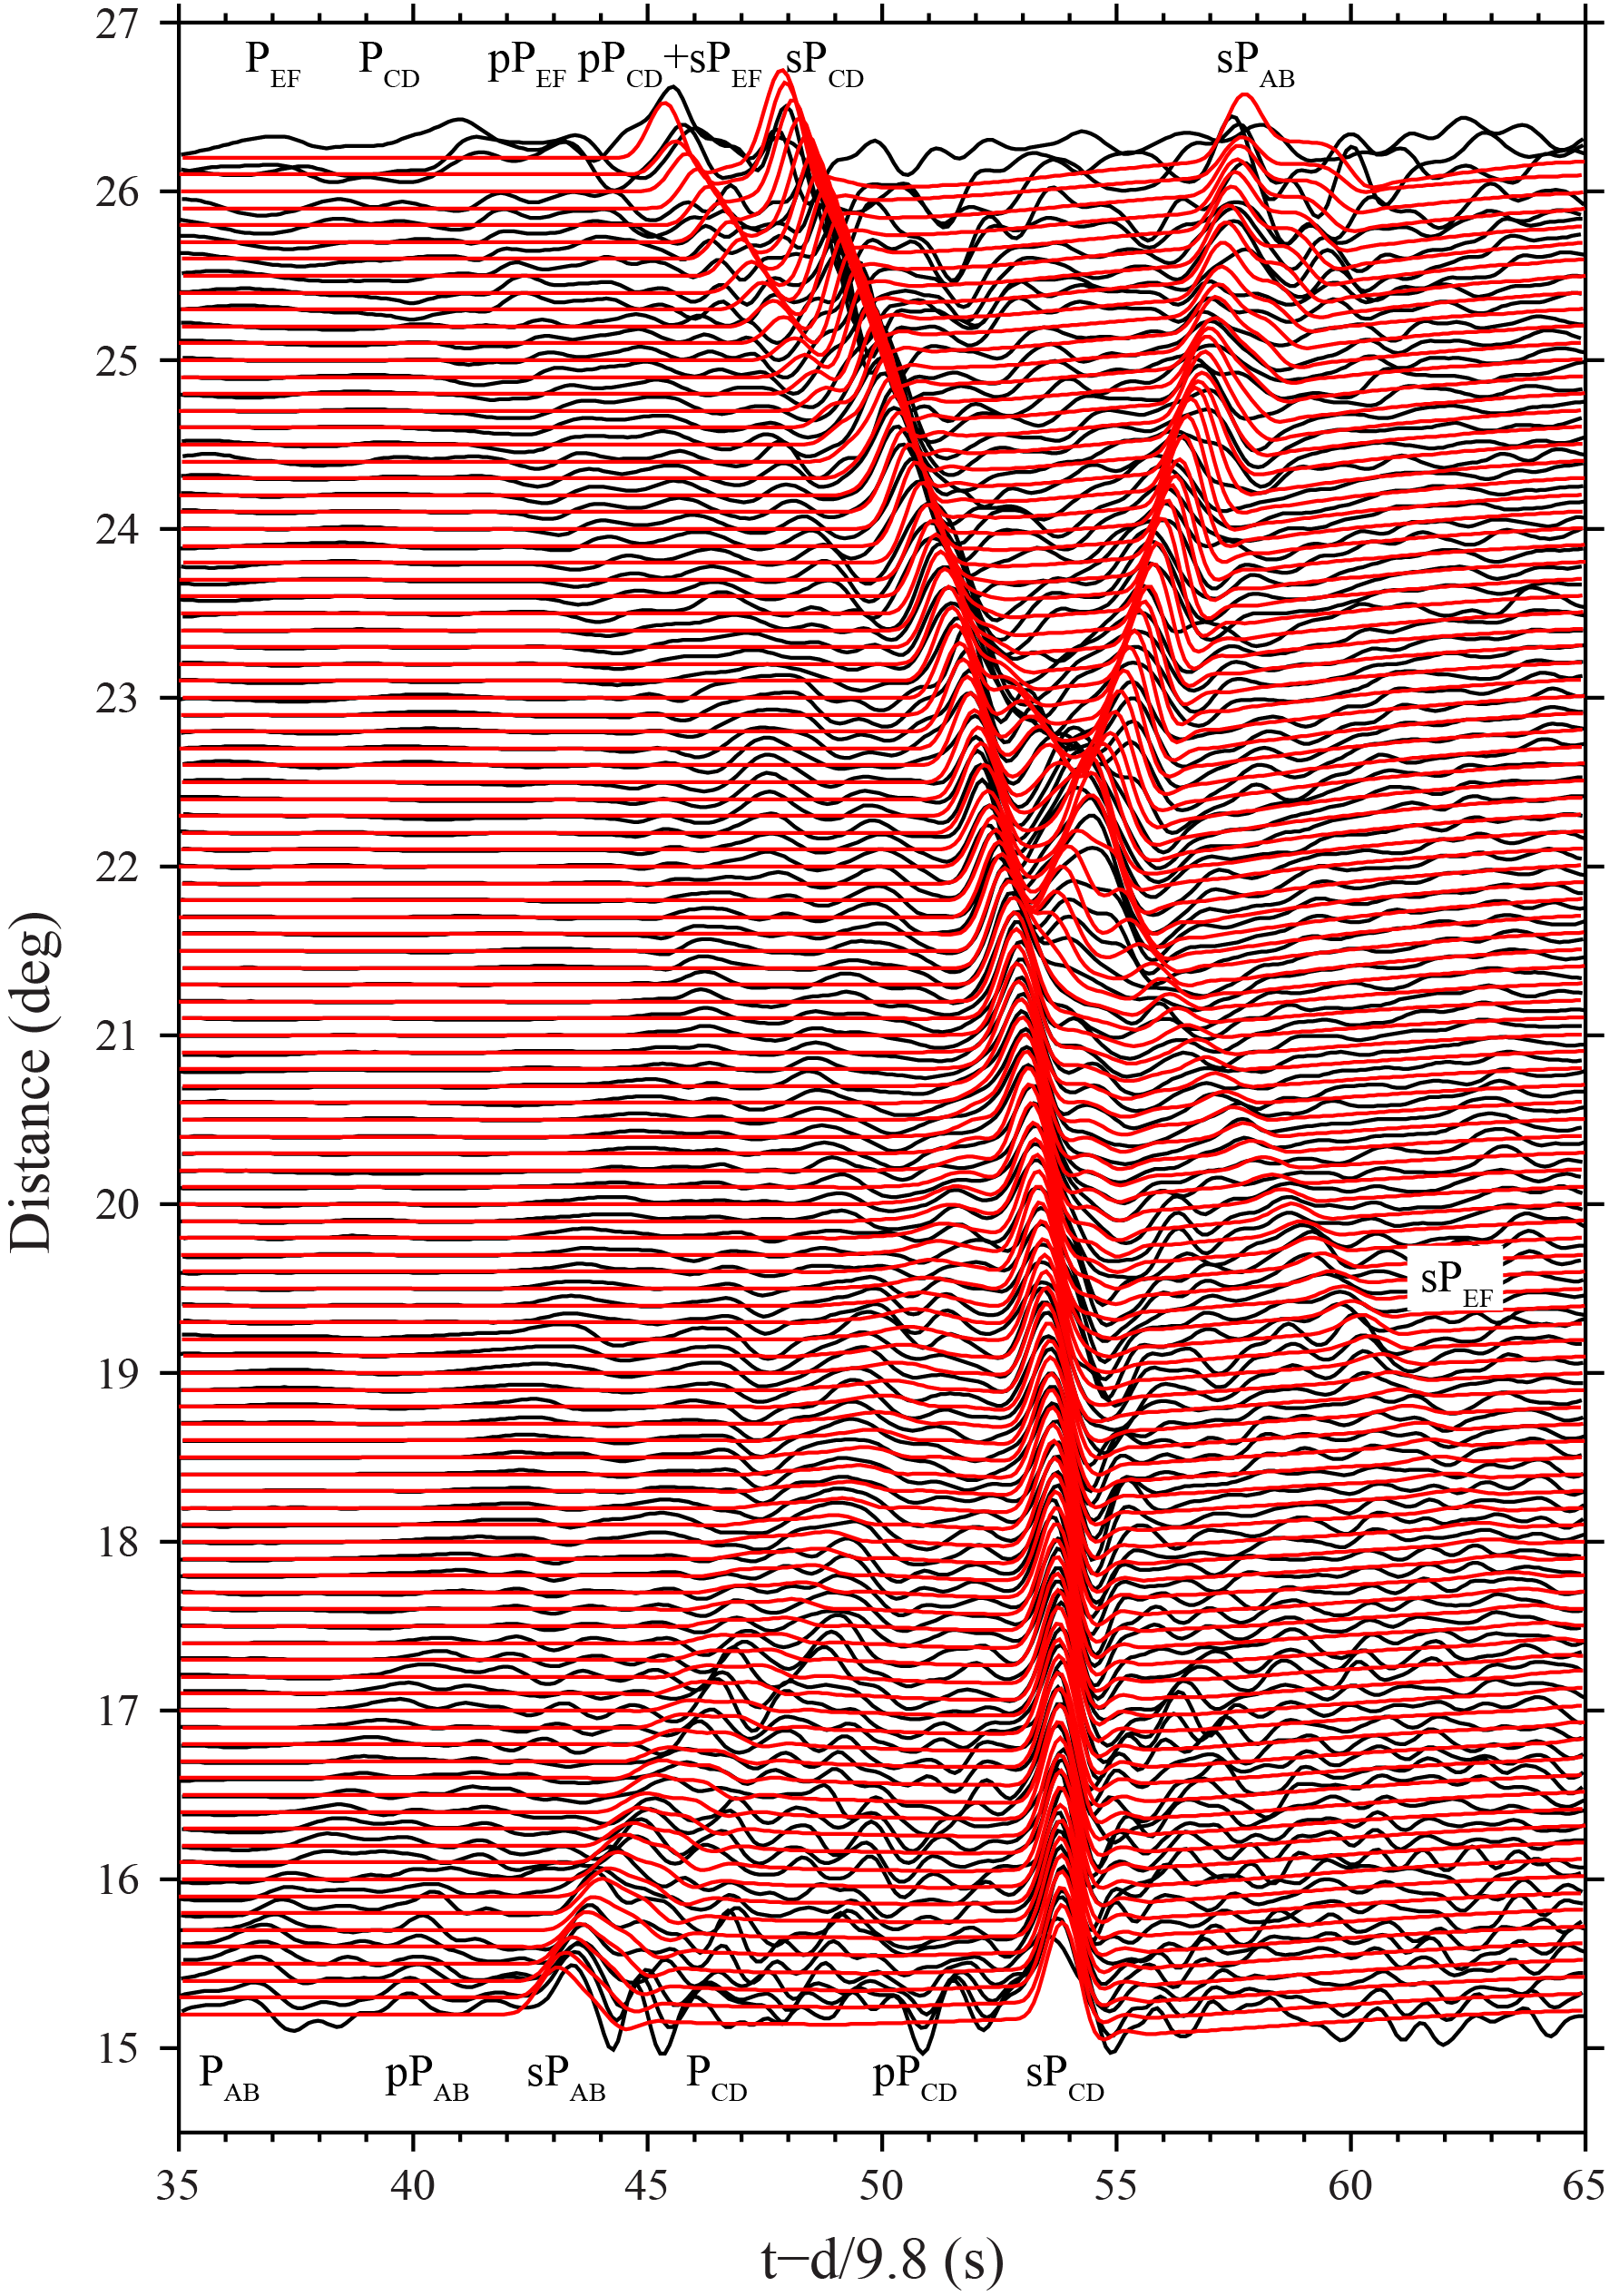
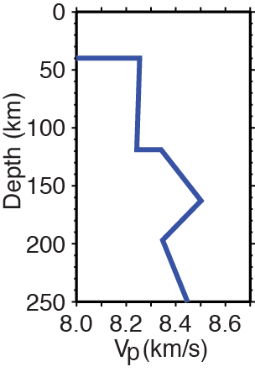
Chu et al., 2012

Slide 19
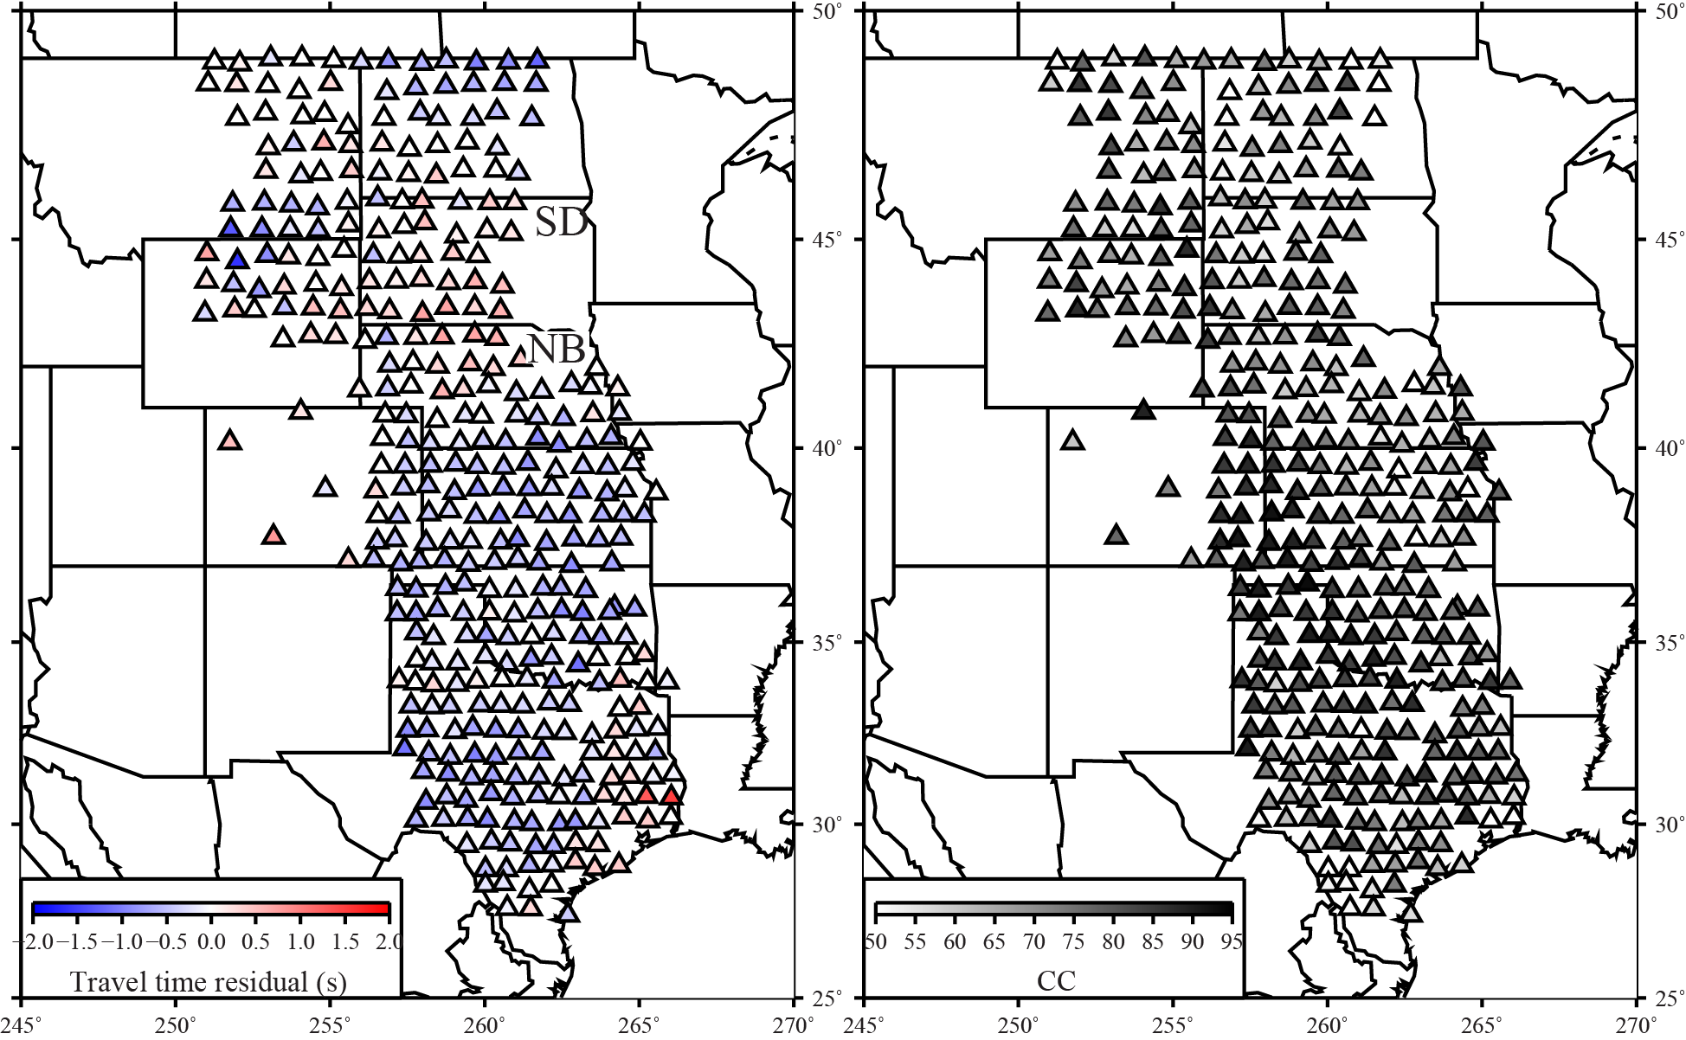
Notes:
另外几个小地震，岩石圈内部结构

Slide 20
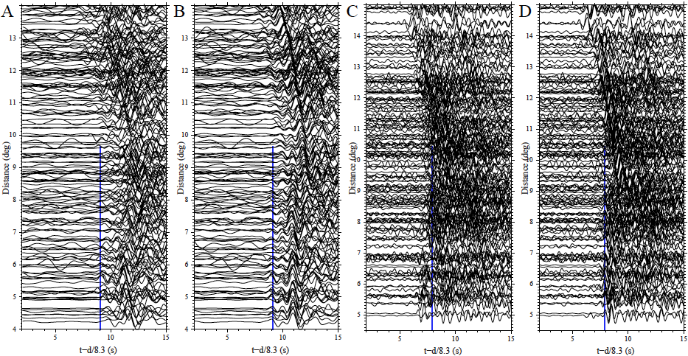

Slide 21
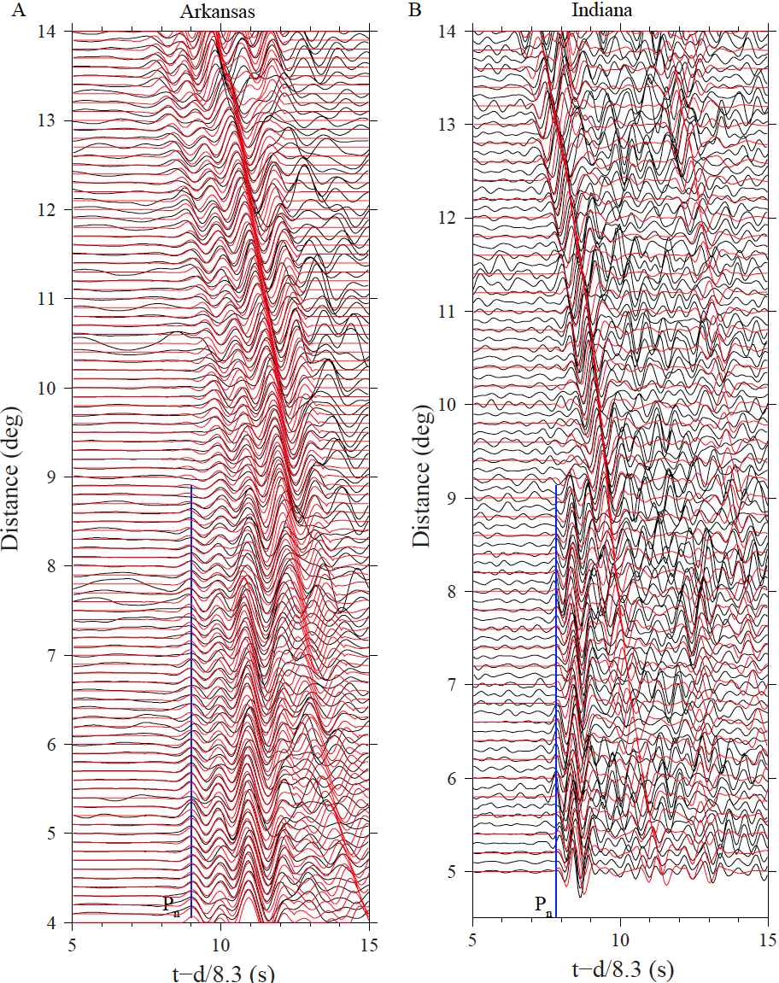

Slide 22
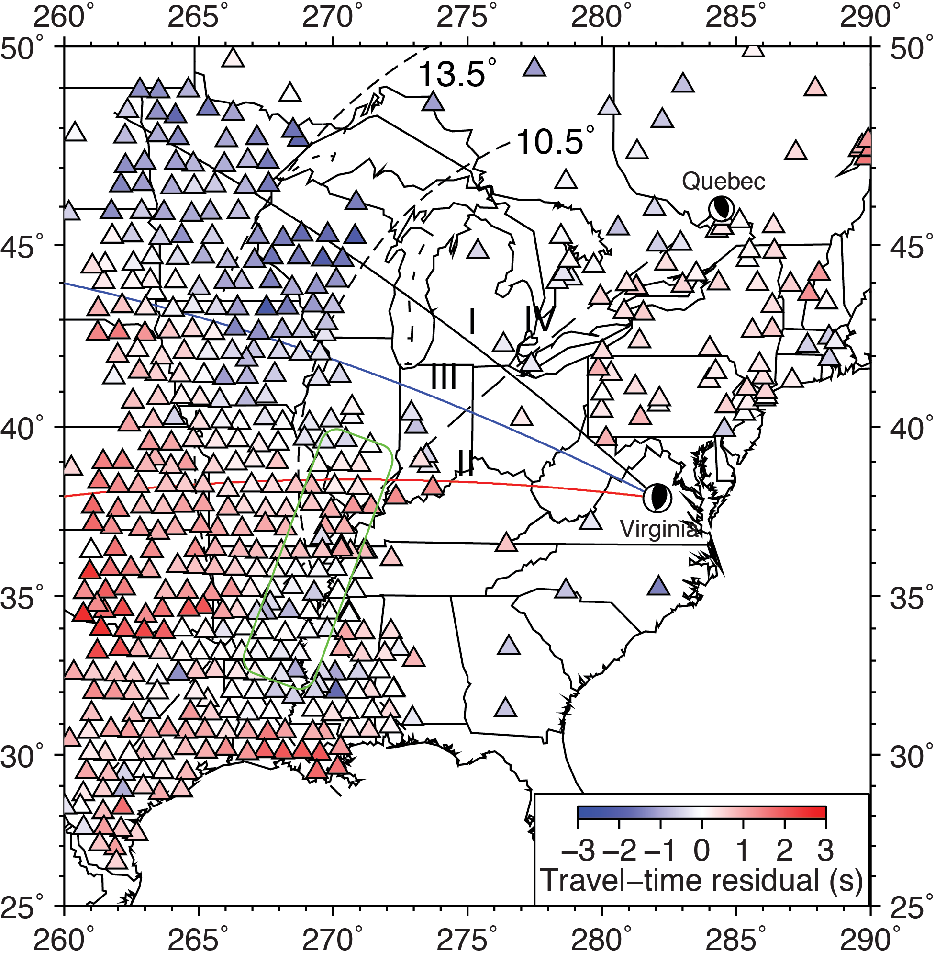
2. Lithospheric structures
Chu et al., 2012
Notes:
After the deployment of the USArray in the east of the rocky mountains, moderate earthquakes in eastern united states provide a great opportunity to study the upper-mantle structures of the north american craton. This map shows seismic stations recorded the 2011 Virginia earthquake. The distance range is 8~15 degrees, which samples the lithospheric structures. Colors denote the travel-time residuals. They have three regions, fast, slow, and a transition between them.

Slide 23
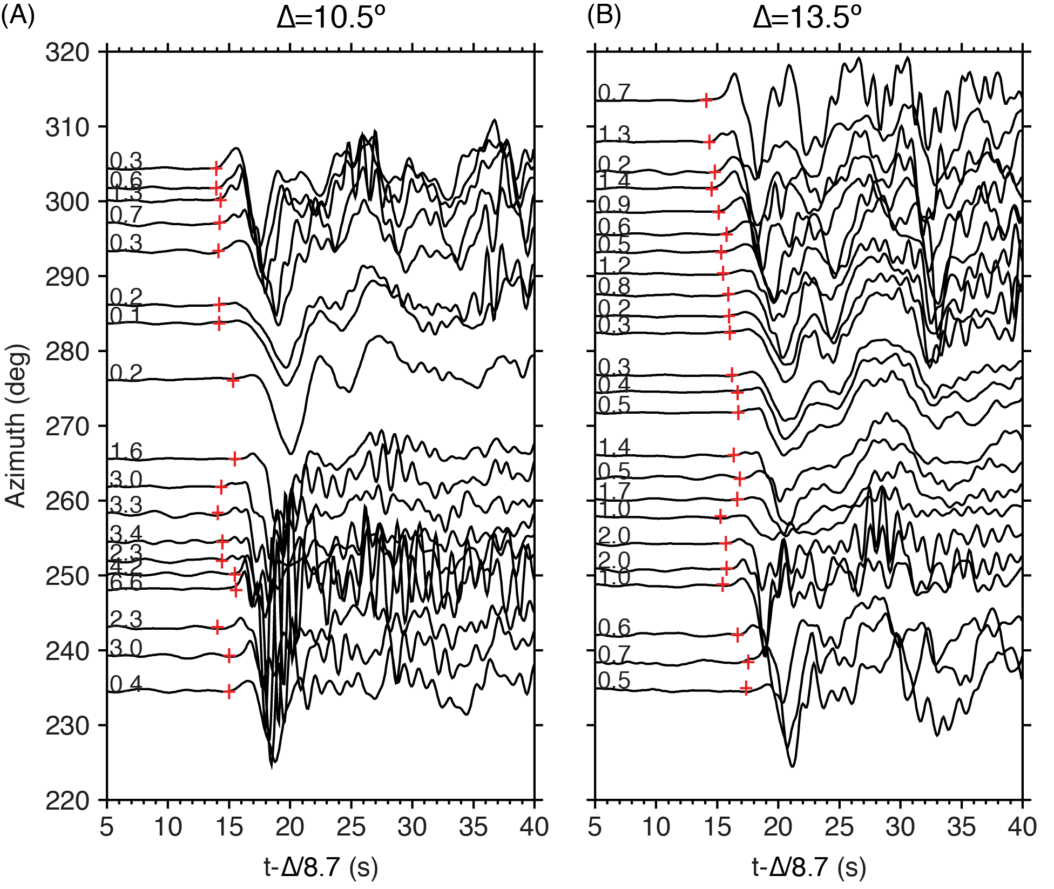
I
III
II
Notes:
The three regions are more obvious on azimuthal plots. This figures shows broadband recordings of the event at 10.5 and 13.5 degrees. We can see that between 260 and 290 degrees, the arrival times are late and waveforms are broadened. High-frequency energy along this corridor is depleted. So we will model the three profiles

Slide 24
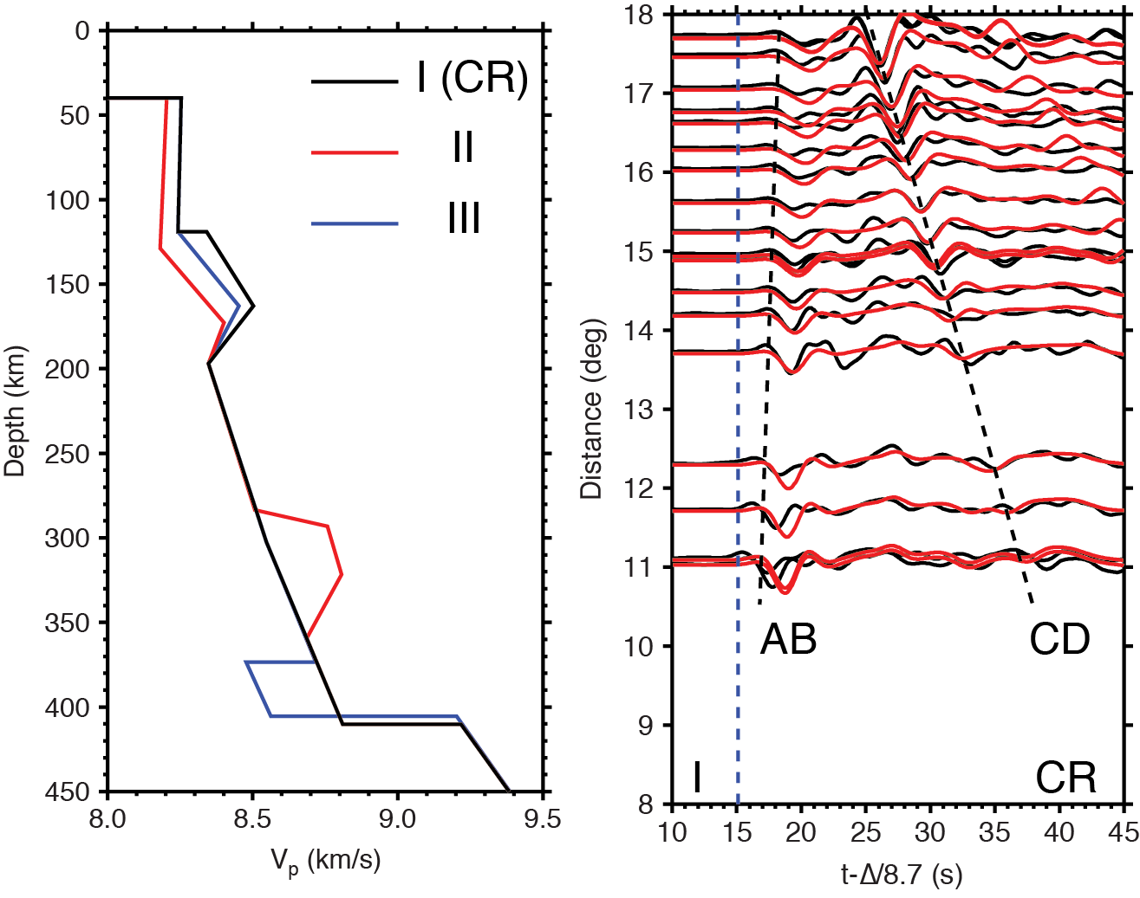
Notes:
This figures shows waveform fits along profile I. It clearly shows AB and CD branches. The synthetics are calculated using velocity model CR, which have a pretty good fits.

Slide 25
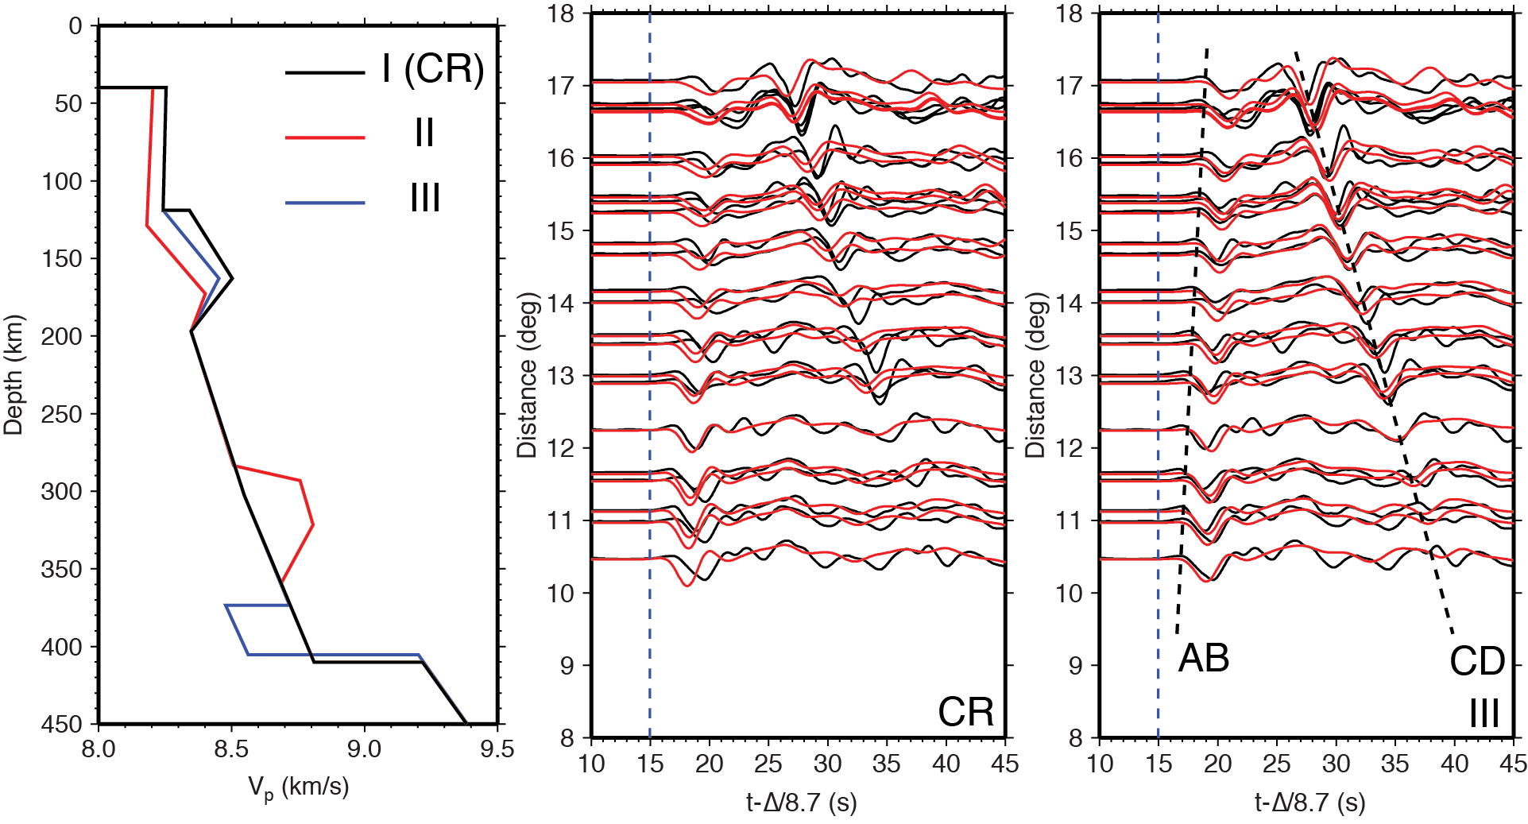
Notes:
When we move to profile III, the CR can not predict the observed waveforms. The central panel shows the predictions of CR. The observed waveforms are late for both AB and CD. The CD branch has bigger amplitude and goes as far as 10.5。 Because at this distance ranges, CD branch is pre critical reflections from the 410 discontinuity. In order to fit these waveforms, we need to put a low-velocity layer on top of the 410. The model is shown as blue in the left panel. The synthetics from the new model fit data much better.

Slide 26
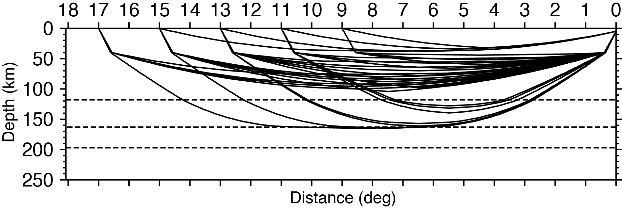
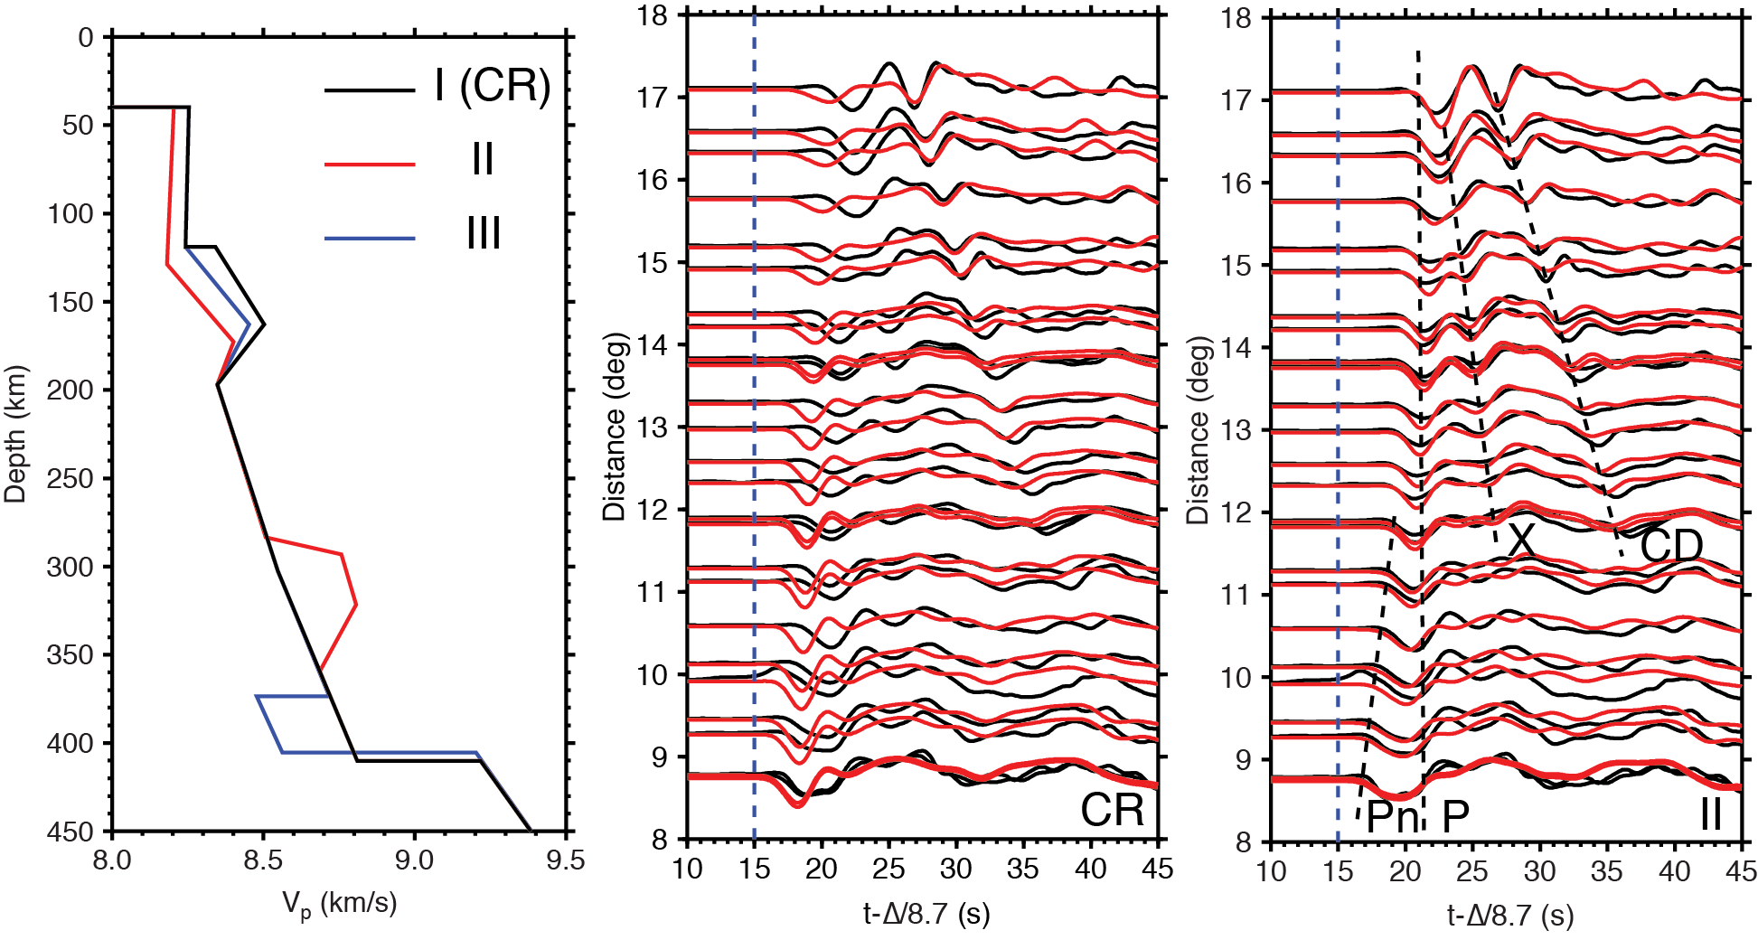
Notes:
Profile II shows a different story. Besides the usual AB and CD branch, a moderate triplication can be seen between 12 and 17 degrees, which suggest another discontinuity. For AB branch, the waveforms are twice broader than CR predictions, we think this is caused by the late P waves. For CR, arrivals of Pn and P are about the same, which looks like a single pulse. However, along this profile both Pn and P are delayed, but P is delayed more, thus the waveform gets broadened. The ray paths are shown in the top panel.

Slide 27
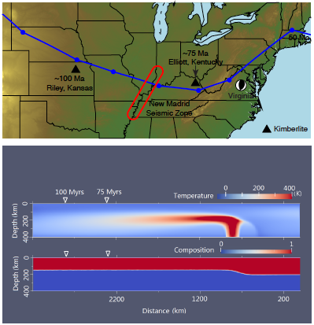

Slide 28
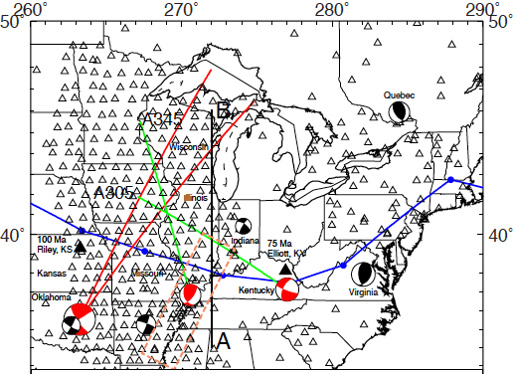
Chu and Helmberger, 2014

Slide 29
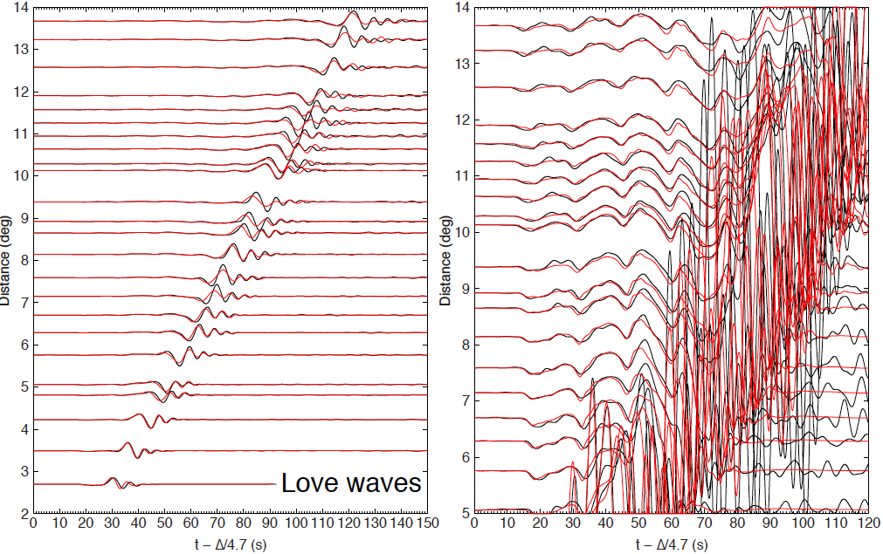
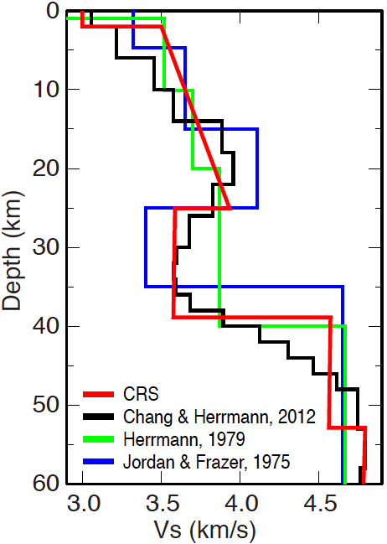
Notes:
模型构建的方法。策略

Slide 30
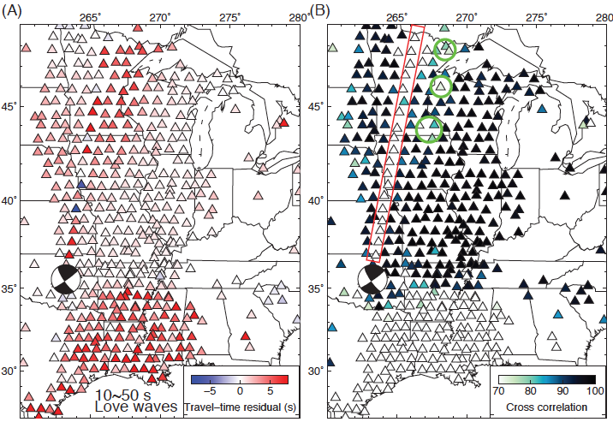
走时残差和互相关系数

Slide 31
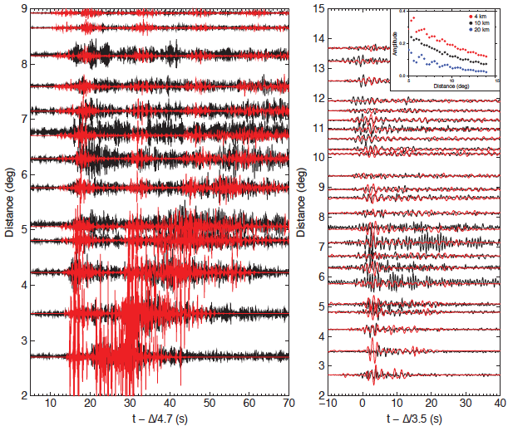
Chu and Helmberger, 2013

Slide 32
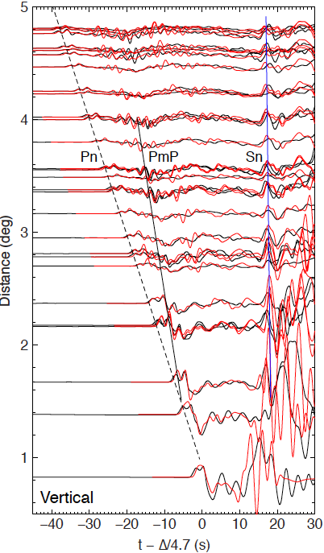
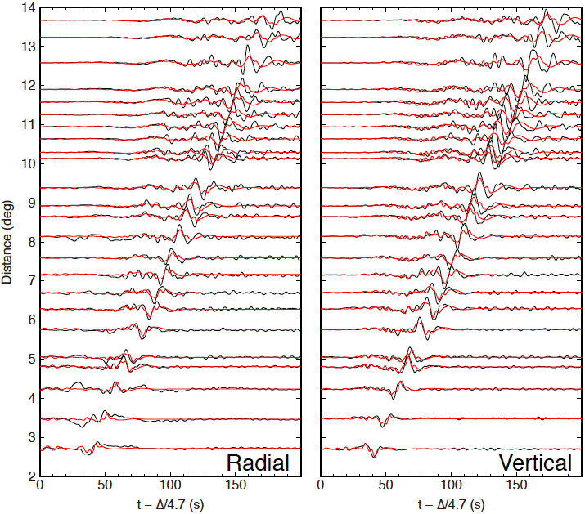
P波及瑞利波

Slide 33
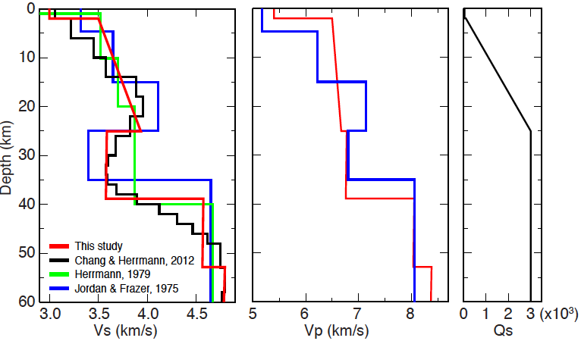
速度模型
Chu and Helmberger, 2014

Slide 34
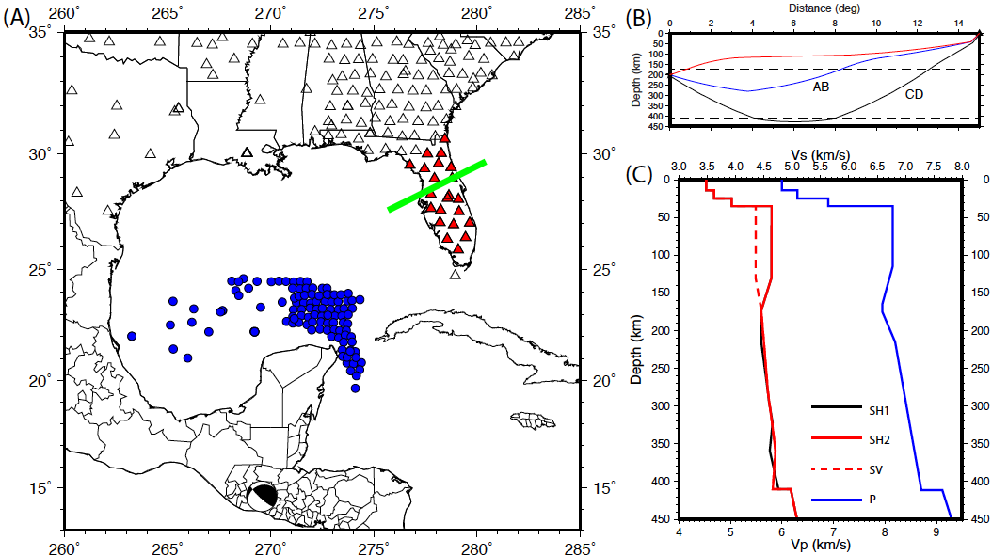
墨西哥湾上地幔速度结构

Slide 35


Grand and Helmberger, 1984

Slide 36


Zhao and Helmberger, 1993

Slide 37



Slide 38


Slide 39


Slide 40


Slide 41
汇报提纲
地震波上地幔三重值
北美上地幔速度结构
青藏高原上地幔结构

Slide 42


Multi-pathing effect
Simple
waveform.
Distance (º)
Distance increasing
slow
2D cross section
[Ni et al., 2002]
Time (sec)

Slide 43
Multi-pathing effect
Distance (º)
Distance increasing
Simple
waveform.
Fast
2D cross section
[Ni et al., 2002]
Time (sec)

Slide 44
Multi-pathing effect
Complicate
waveform.
Distance (º)
Distance increasing
slow
Fast
2D cross section
[Ni et al., 2002]
Time (sec)
Multi-pathing effect causes waveform distortions!

Slide 45


Multi-pathing effect
NW
SE
The preferred strong multi-pathing for the event from the SE suggests that the anomalies in the upper mantle dip to the south.
MPD is efficient to map the dipping anomaly.

Slide 46

多路径效应成像(Multi-pathing Detector)
[Sun and Helmberger, 2011]
∆_{T}: Time delay related to a reference model.
Like tomography travel-time measurement.
∆_{LR}: Describing how strong the effect of multi-pathing is.
Complex waveform means larger ∆_{LR} .

Slide 47

MPD patterns of western US
South American event (SE)
The preferred strong multi-pathing for the event from the South suggests that the anomalies in the upper mantle dip to the south.
Red: Large ∆_{LR} value, strong waveform distortion .
Red: small amplitude.
Amplitude has good correlation with the ∆_{LR} (large ∆_{LR} , small amplitdue).
The variation of amplitude is not caused by attenuation.
Multi-pathing effects are important.
[Sun and Helmberger, 2011]

Slide 48

MPD patterns of western US
South American event (SE)
Japan event (NW)
The anomalies in the upper mantle dip to the south (slab dipping direction).
[Sun and Helmberger, 2011]

Slide 49
MPD patterns of China
Eastern edge of
Tibet Plateau:
Strong Multi-pathing,
Low amplitude

Slide 50
MPD patterns of China
Shandong and Jiangsu:
Strong Multi-pathing,
Low amplitude.
Not obvious in
tomography model.
What’s this anomaly?

Slide 51



Zhao et al., 1991

Slide 52


Slide 53


Slide 54


Slide 55


Slide 56


Slide 57


P SH

Slide 58



Slide 59


Yao et al., 2008

Slide 60
小结
上地幔三重值是研究岩石圈和转换带速度结构的重要手段；
同时拟合P、S、面波等多震相可提高反演结果的不唯一性；

Slide 61
谢谢!

Slide 62
参考文献
Chu R., B. Schmandt, D. V. Helmberger (2012). Upper Mantle P- velocity structures beneath the Midwestern United States derived from triplicated waveforms, Geochem. Geophys. Geosyst., 13, Q0AK04, doi:10.1029/2011GC003818.
Chu R., W. Leng, D. V. Helmberger, M. Gurnis (2013). Hidden hotspot track beneath Eastern United States, Nature Geoscience, 6(11), 963-966.
Chu R., D. V. Helmberger, M. Gurnis (2014). Upper mantle surprises derived from the recent Virginia earthquake waveform data, Earth Planet. Sci. Lett., 402, 167-175, doi:10.1016/j.epsl.2012.10.023.
Chu R., Don V. Helmberger (2014), Lithospheric waveguide beneath the Midwestern United States; massive low-velocity zone in the lower crust, Geochem. Geophys. Geosyst., 15(4), 1348-1362.
Chu R., S. Wei, D. V. Helmberger (2016), Upper Mantle Structure beneath the Gulf of Mexico, to be submitted.
Chu R., Y. Sui, Q. Wu, Y. Zhou (2016), Lithospheric structure beneath the eastern edge of the Tibetan Plateau, in prep.

