Slide 1


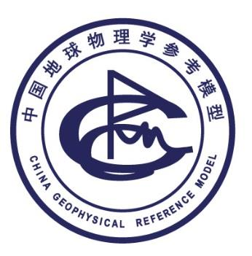
东北亚地区地幔过渡带结构研究、
进展及思考
李娟, 王新,郭广瑞
Institute of Geology and Geophysics, Chinese Academy of Sciences
(IGGCAS)
juanli@mail.iggcas.ac.cn
2016-06-28
首届“中国区域地震学参考模型”学术交流会

Slide 2
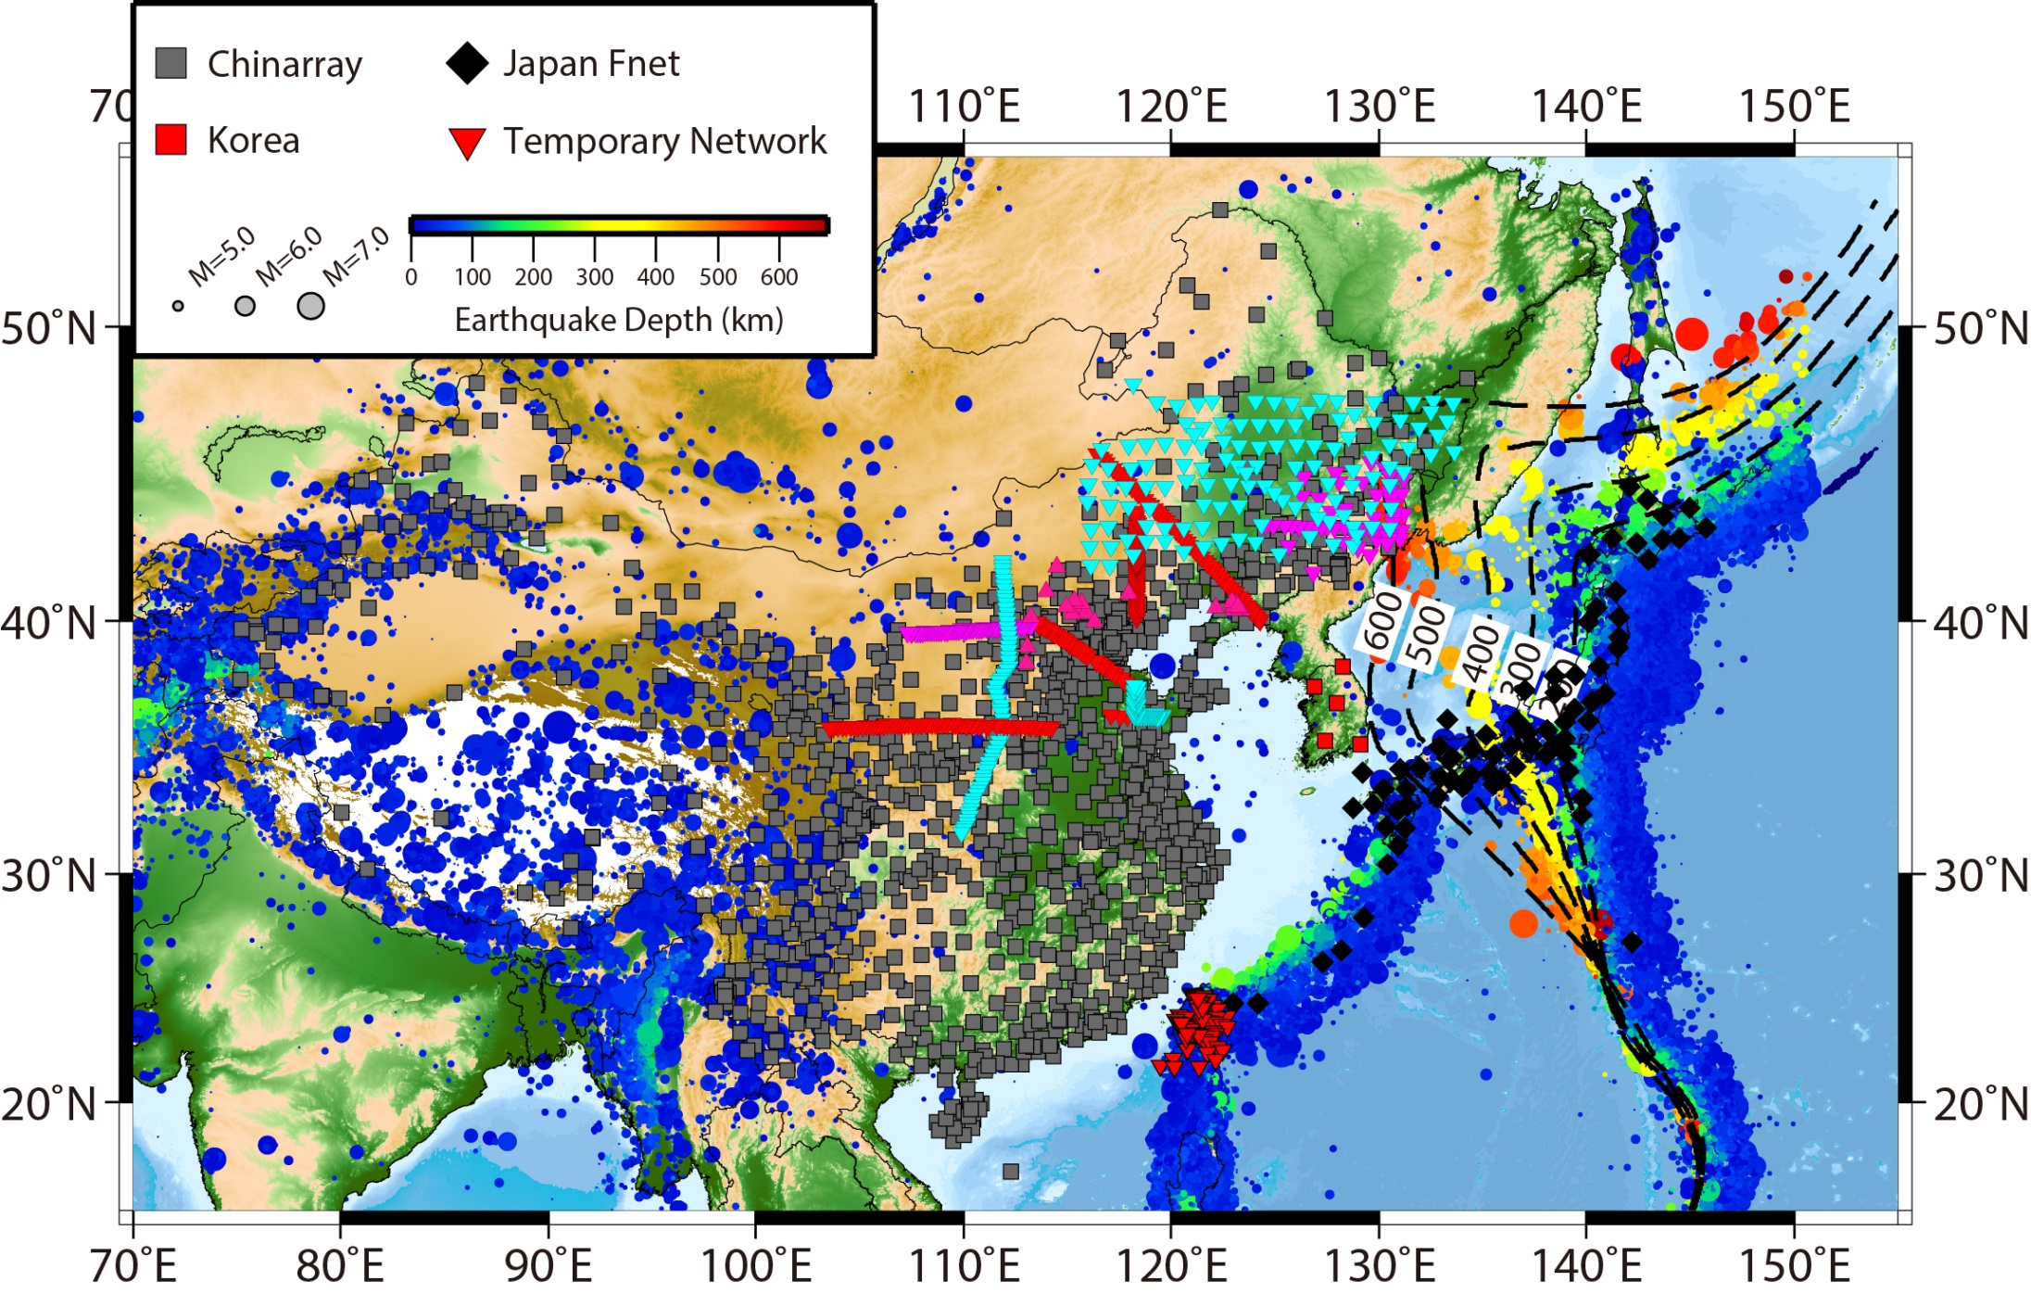

Slide 3
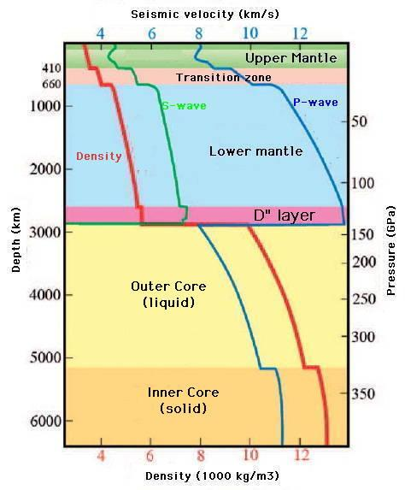

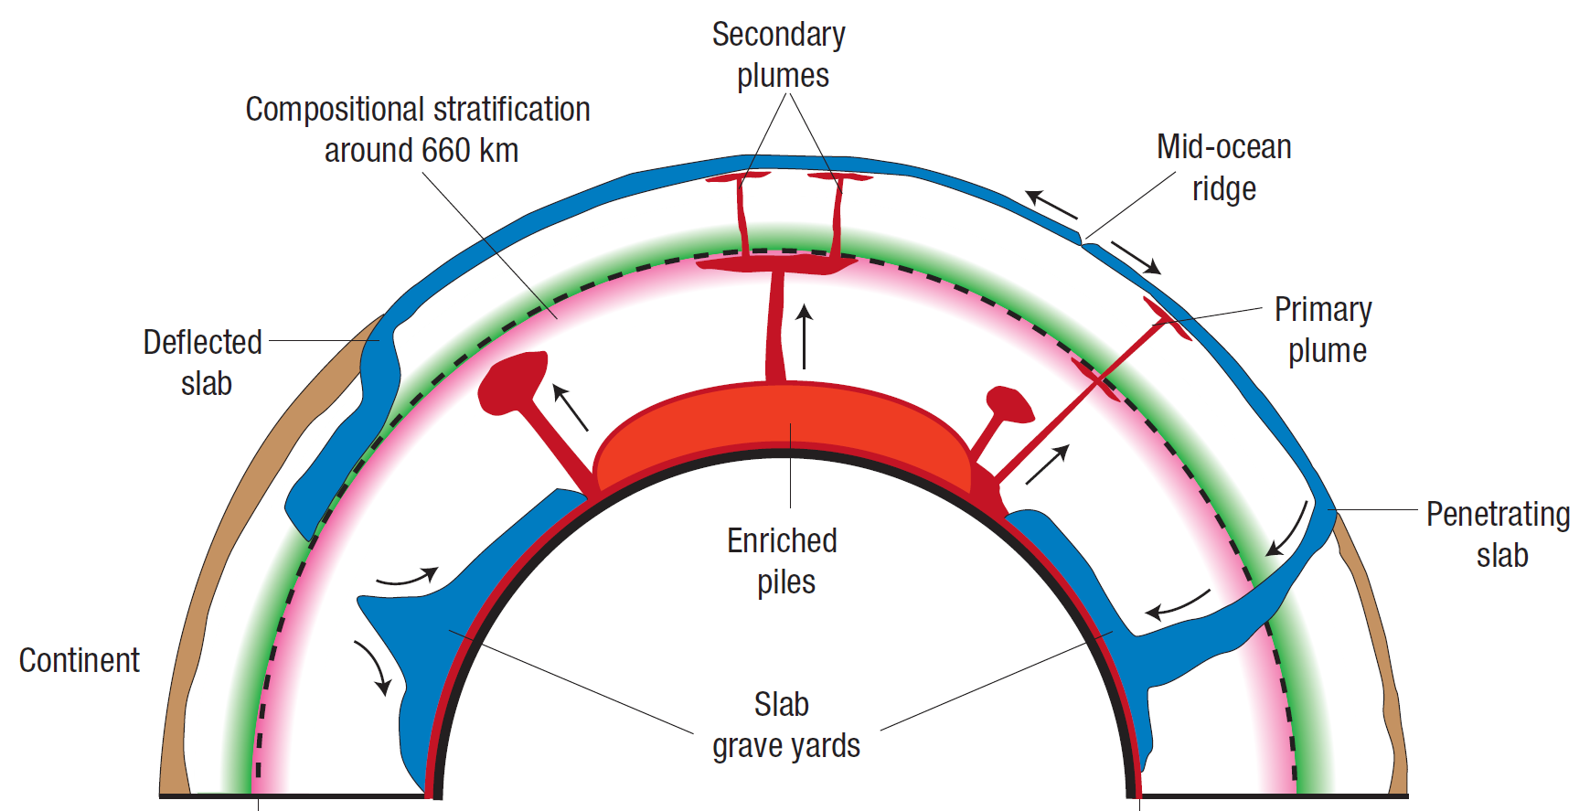
2008年 电影《地心游记》
(Tackley,2008)
？
？

Slide 4
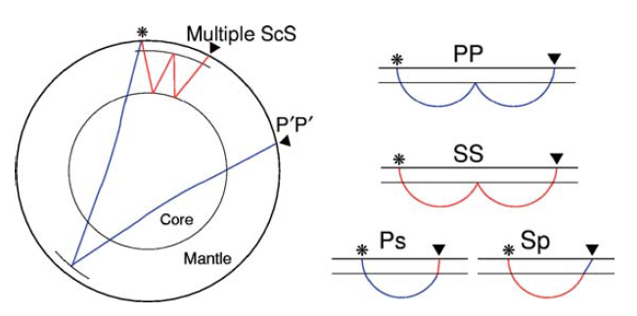
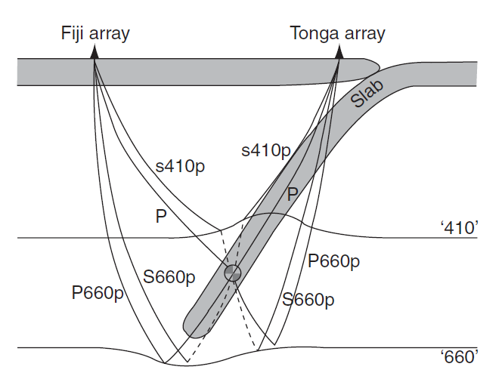
地震学探测方法
Seismic tomography
Scattered Wave
SS, PP， P′P ′(PKPPKP) precursors
Receiver Function
SdP etc.
ScS Multiple Reverberation
Waveform Modelling
e.g. Triplication
Ambient Noise

Slide 5
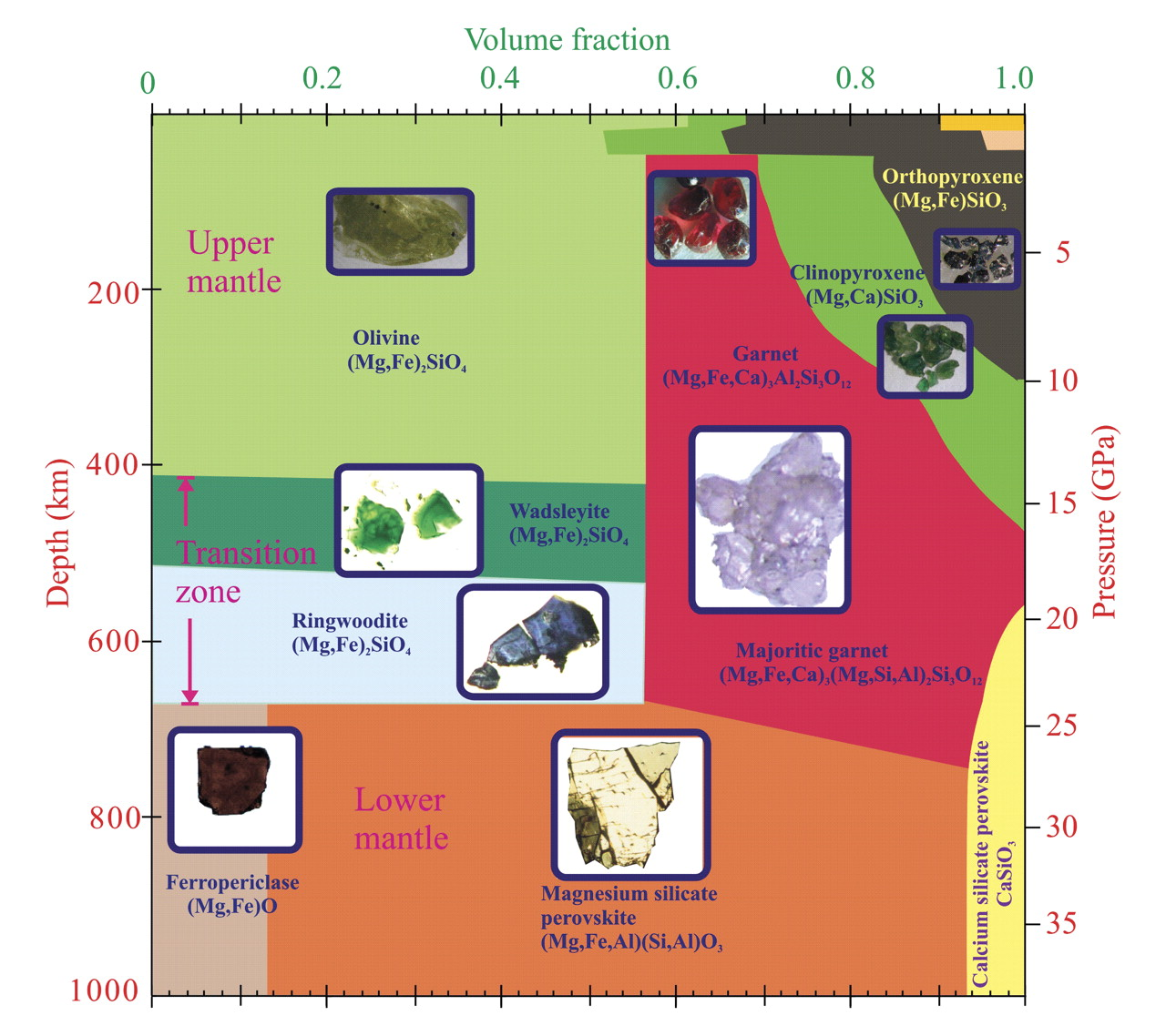
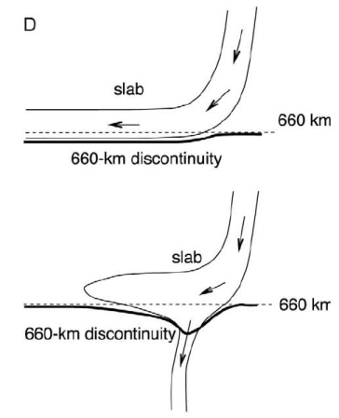
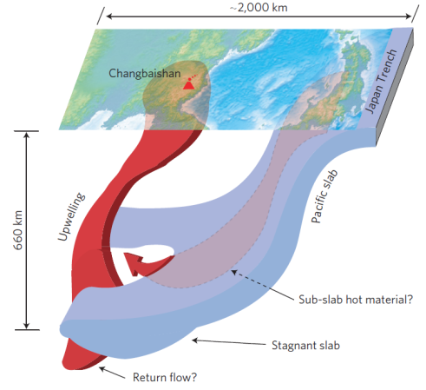
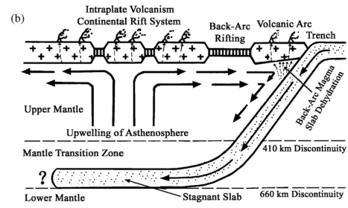
Why?
间断面附近
(MTZ)结构
速度/密度/
各向异性结构
Thermal anomaly
Compositional
anomaly
Seismic Tomography
Waveform Modeling
Scattered wave
Ambient Noise
Other
Mechanism
Existence (e.g. 520)
Topography?
Double/Multi Dis?
Sharpness?
……
间断面性质
Waveform Modeling
Scattered wave
e.g. RF, PP/SS precursors
SdP, ScS multiples
Frost, 2008
Li and Yuan, 2003
Tang et al, 2014
Lei and Zhao,2005
Notes:
Dehydration of stagnant slab

Slide 6
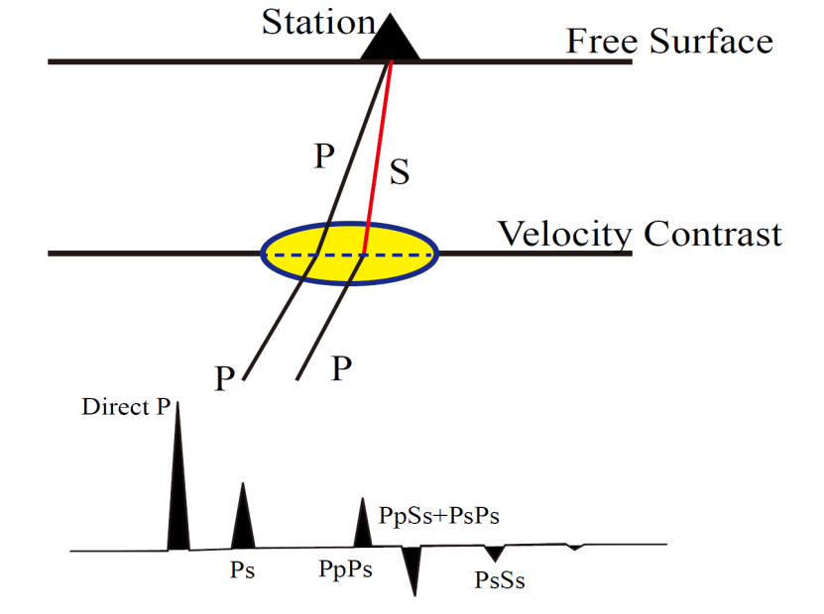
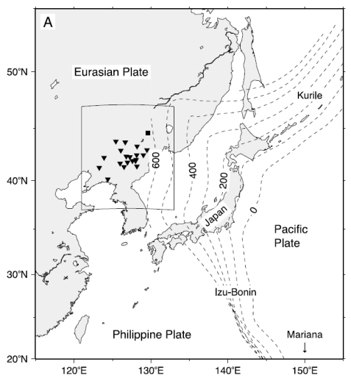
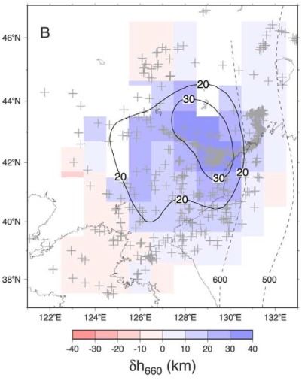
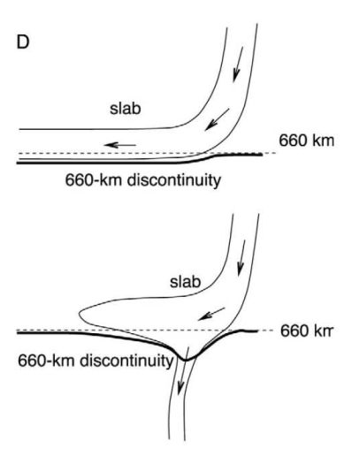
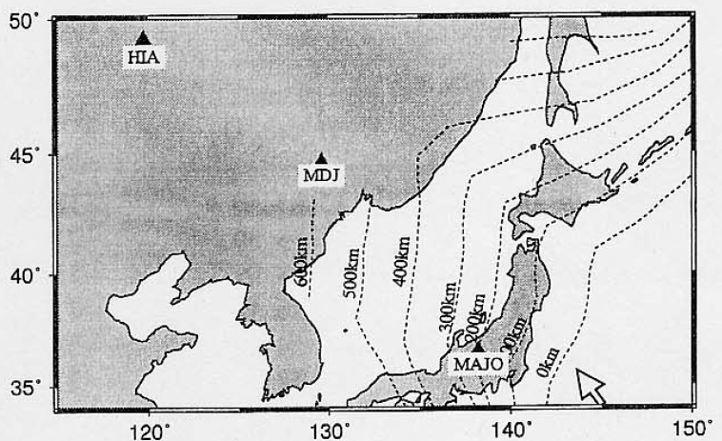
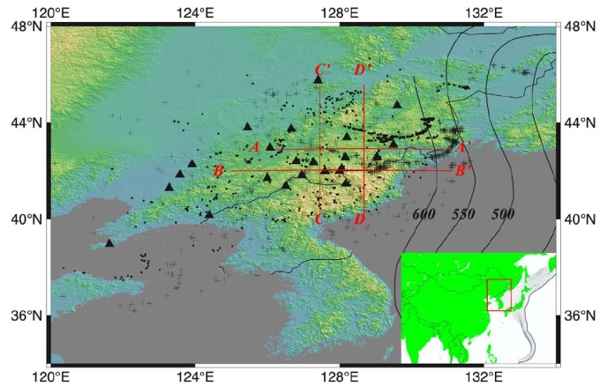
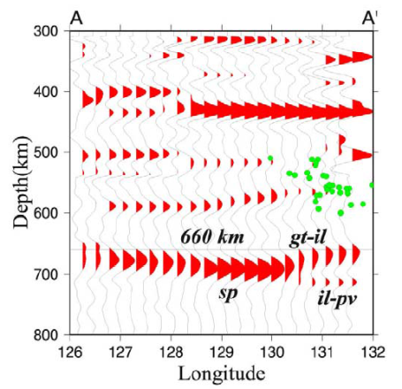
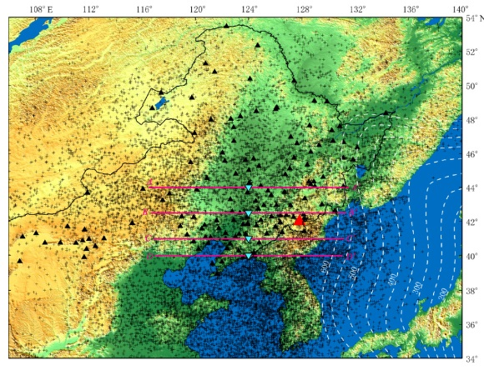
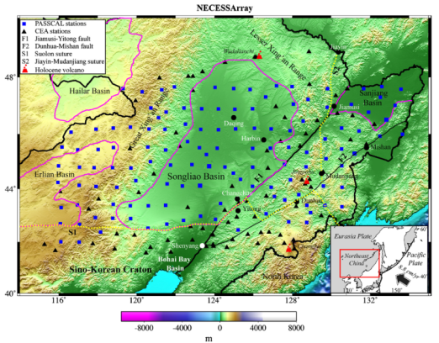
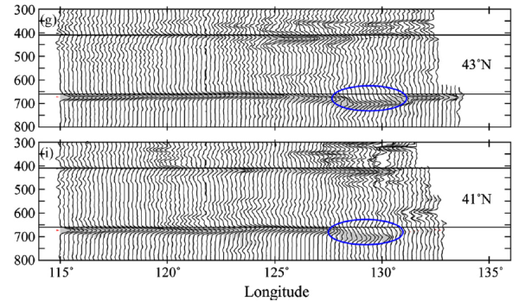
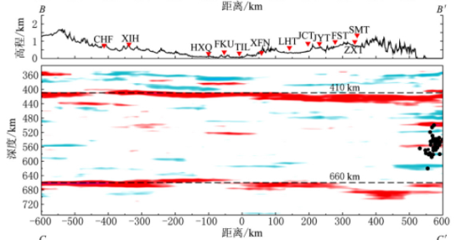
Receiver Function (RF) Studies
Li & Yuan, 2003, EPSL
……
Niu & Kawakatsu, 1996
Ai et al., 2003, EPSL
高占永等，地震学报，2015
Liu et al., 2015, EPSL

Slide 7
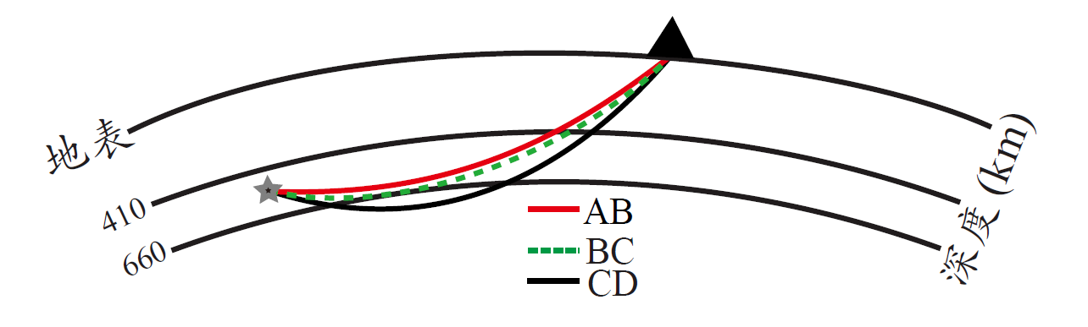
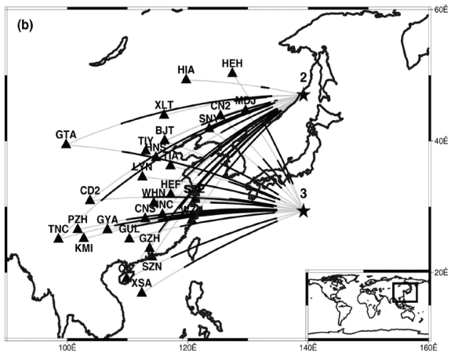
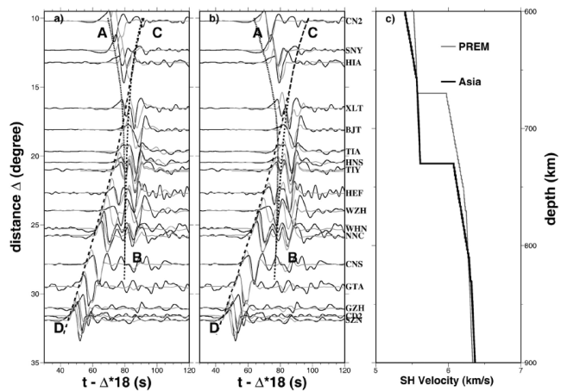
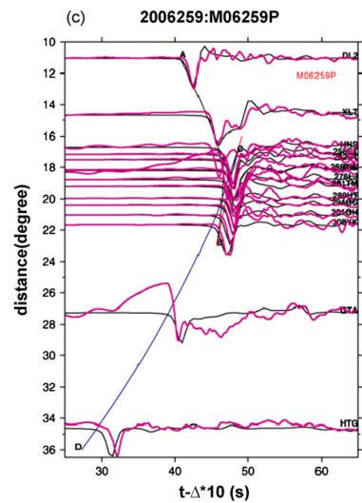
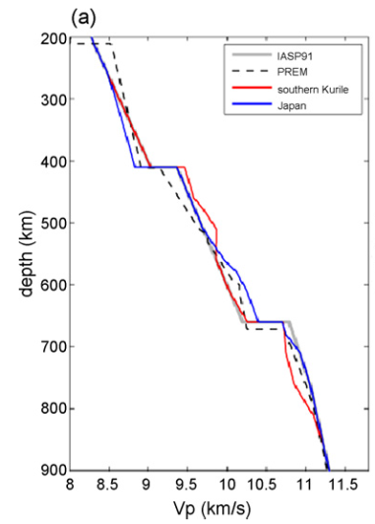
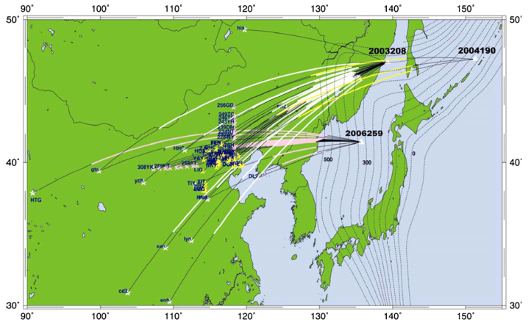
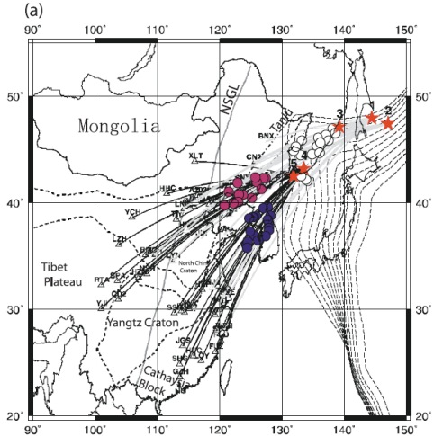
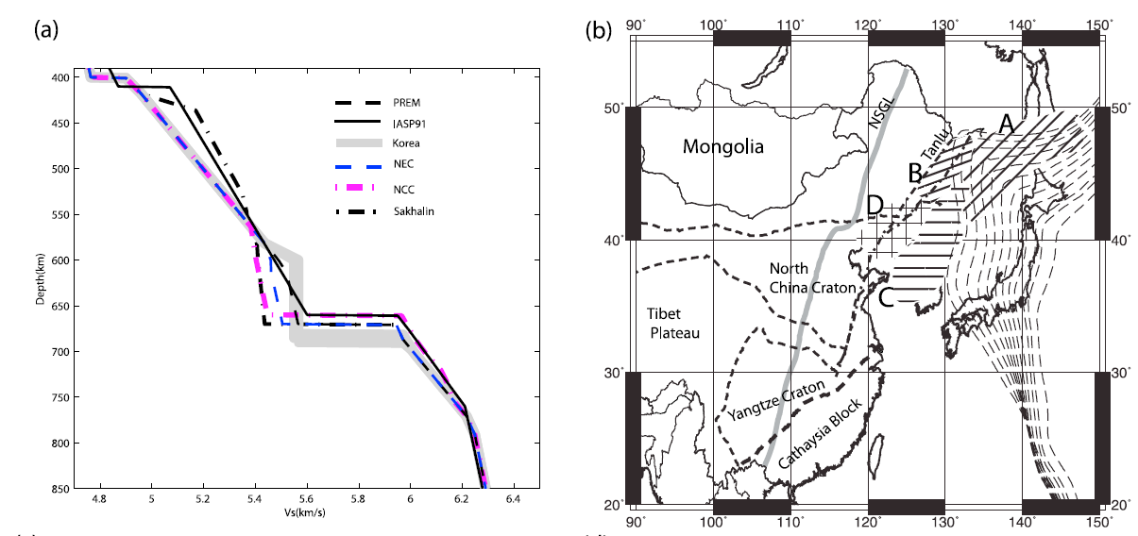
Triplication Waveform
Wang et al., JGR, 2006
Wang et al., PEPI, 2009
Zhang et al., JGR 2012

Slide 8
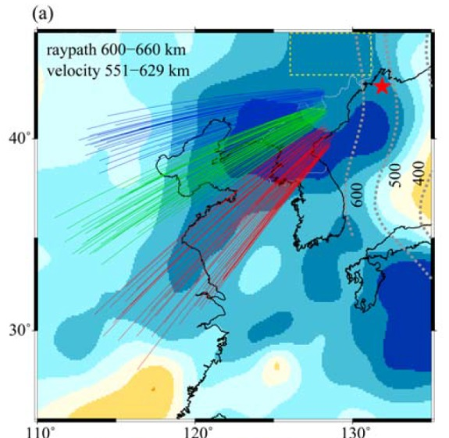
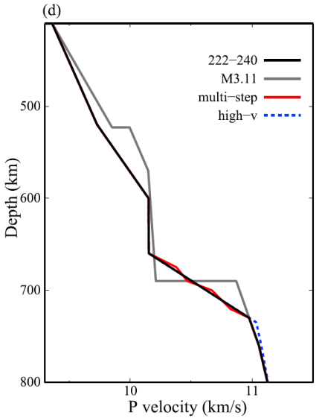
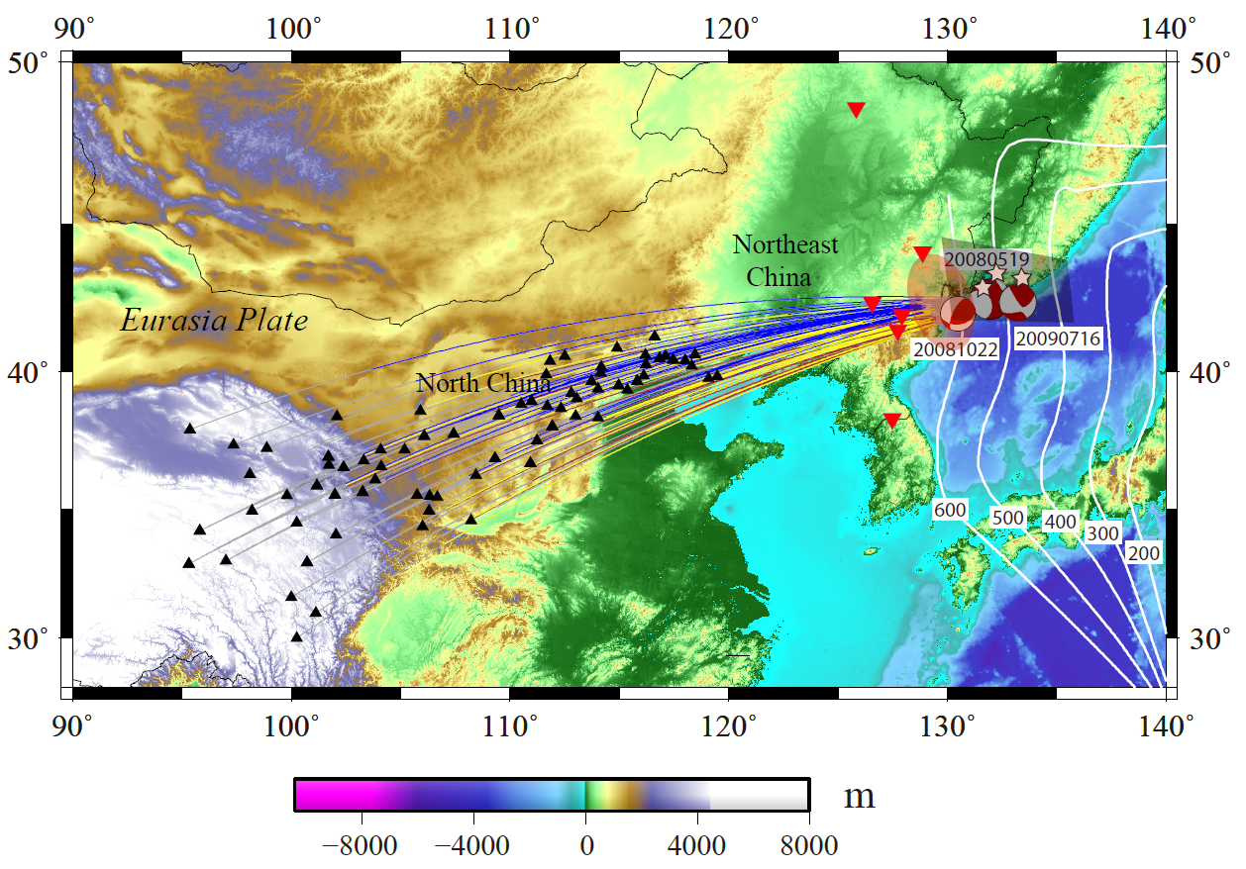
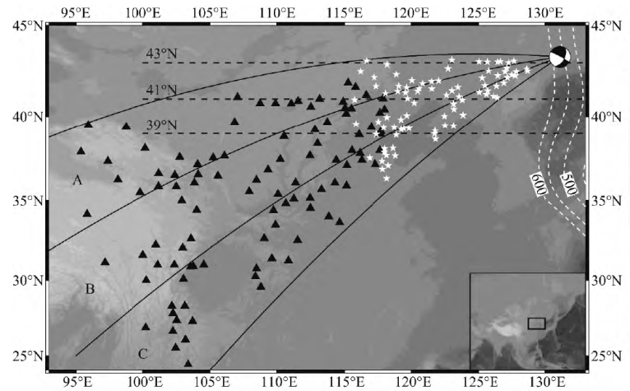
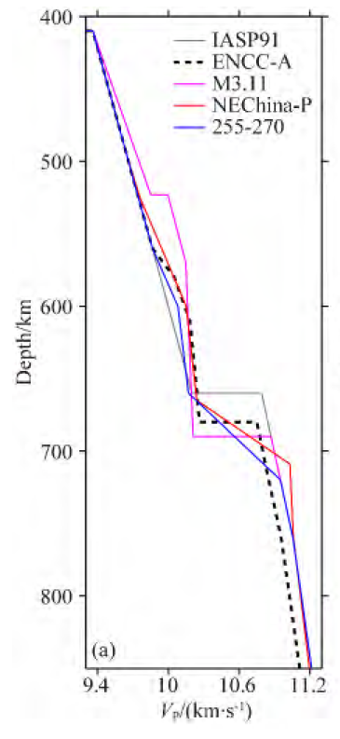
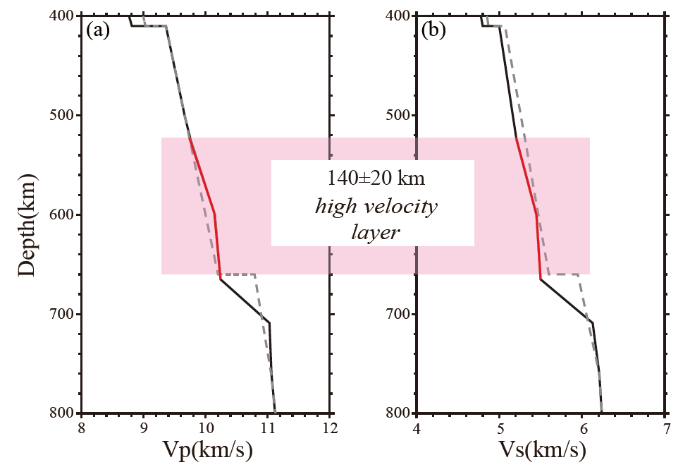
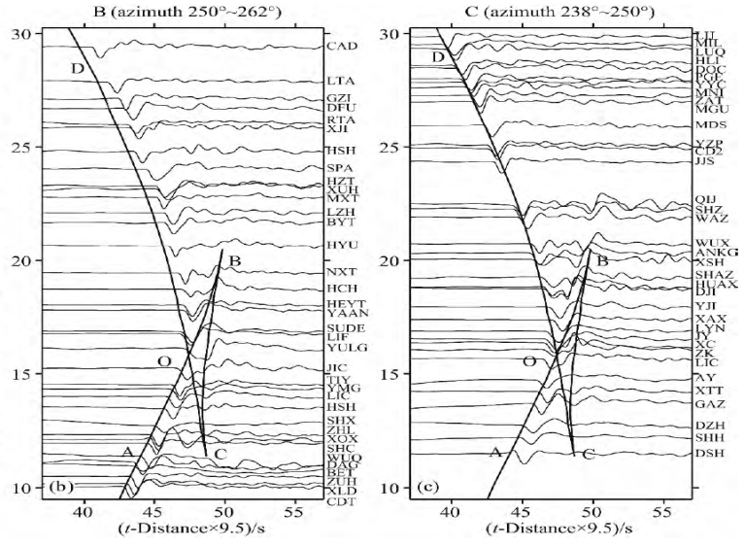
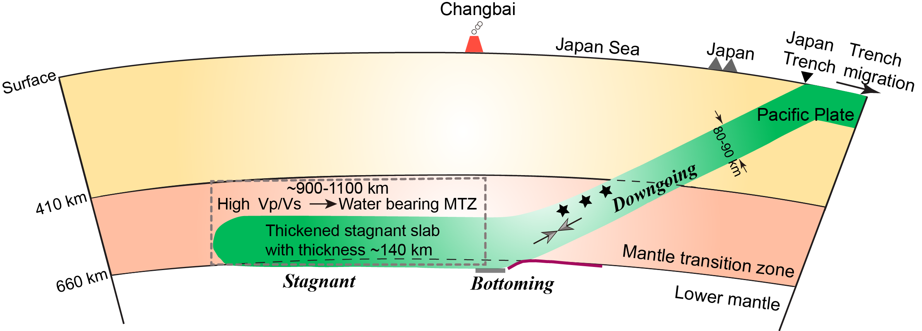
Wang & Niu, JGR, 2010
Li et al., EPSL, 2013
崔辉辉 等,地球物理学报， 2016

Slide 9
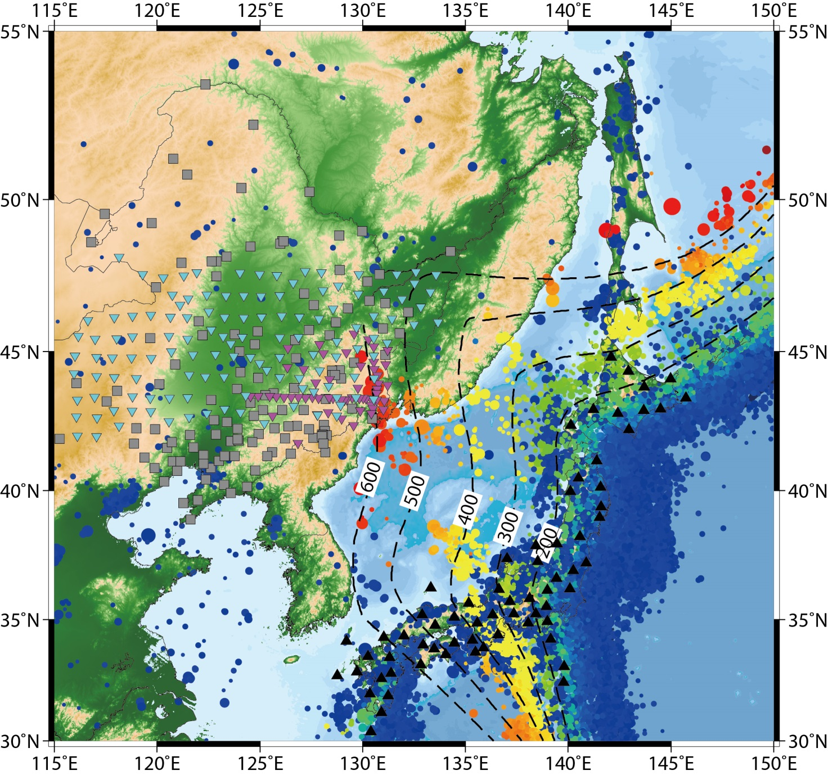
Study Region

Slide 10
Outline
ScS-Multiple Method & Data
Topography of the 410 & 660
Comparison with others
Discussion and Summary

Slide 11
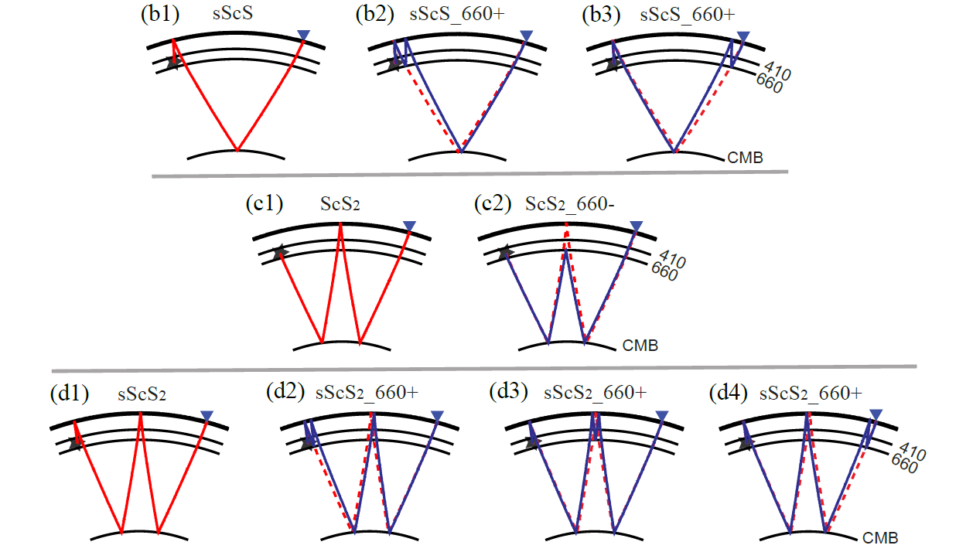
Multiple-ScS Reverberations
Main phase sScS, ScS2, sScS2, sScSn…
(From Wang et al., 2016,
in revision)
Reflected phase sScS_d+, sScS_d- … ScS2_d+, ScS2_d- … sScSn_d+, sScSn_d- …
d is the depth of the discontinuity, + and – represent the upper-side and under-side reflection

Slide 12
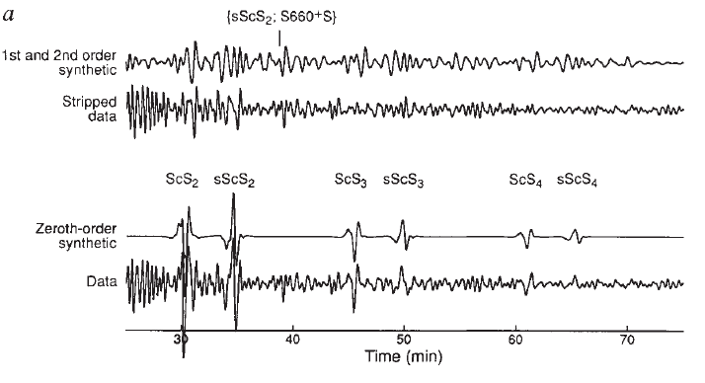
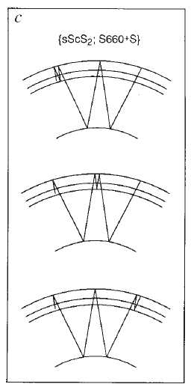
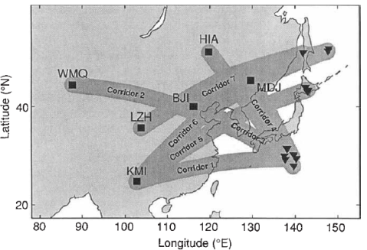
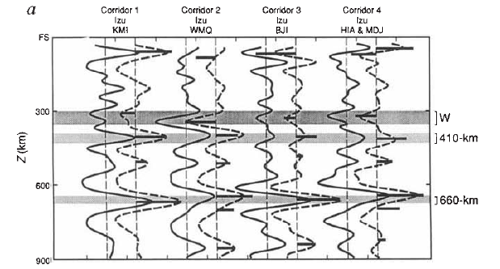
sScS2_660+
ScS多次反射波，多反射点问题
地震事件到台站之间，平均结构信息！
Revenaugh & Sipkin, Nature, 1994

Slide 13
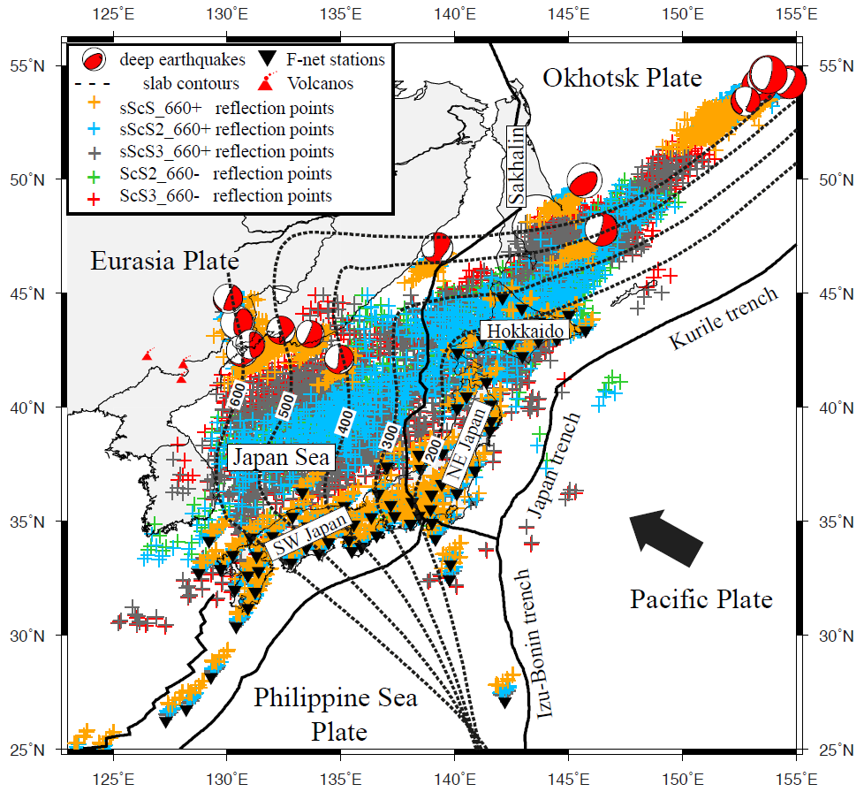
Data & Stations
Deep Events: 16
F-Net Stations
多地震，多台站叠加→反射点下方结构
Notes:
说明采用共反射点叠加

Slide 14
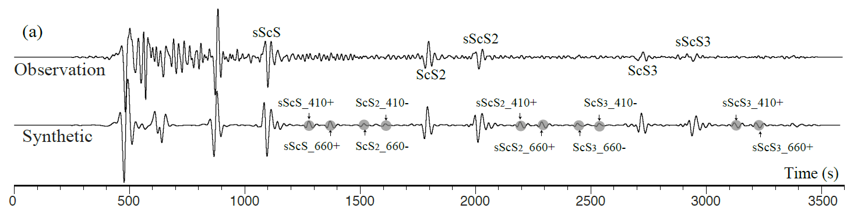
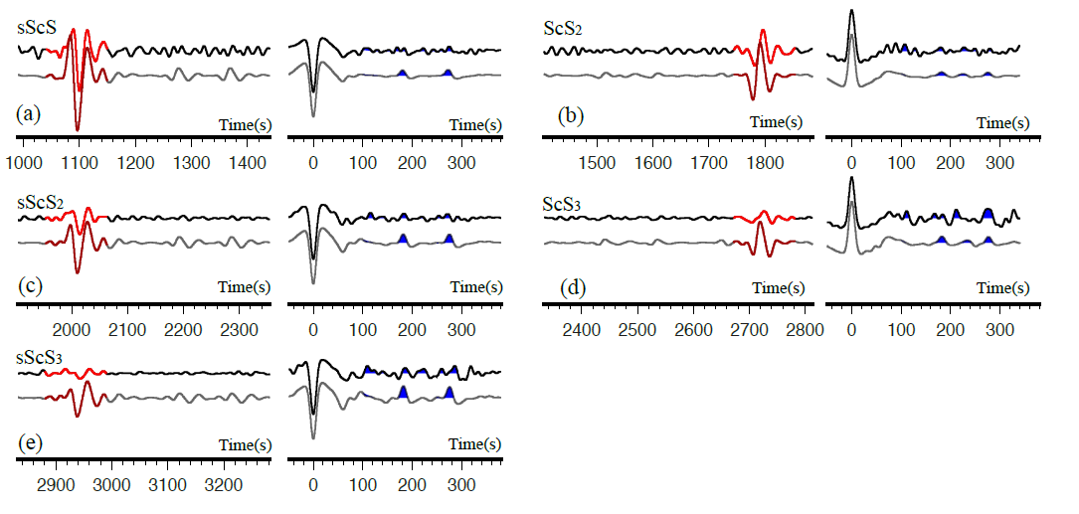
Multi Events – CRP Stacking
Data Processing:
Deconvolution, Moveout correction, Common-reflection-point stacking

Slide 15
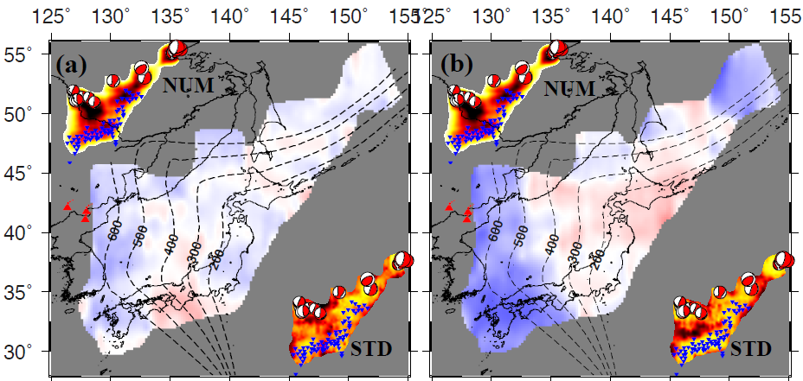
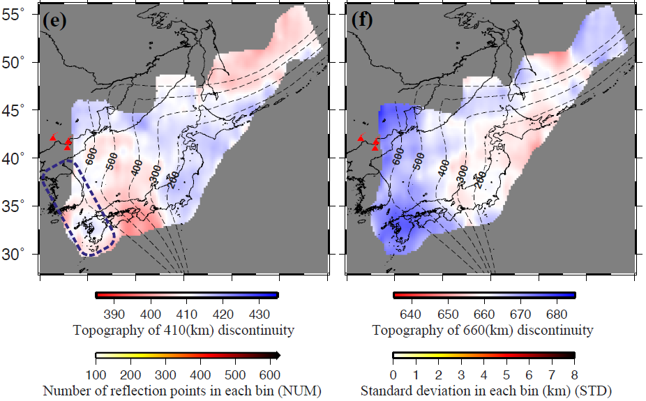
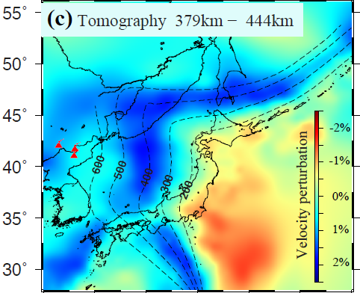
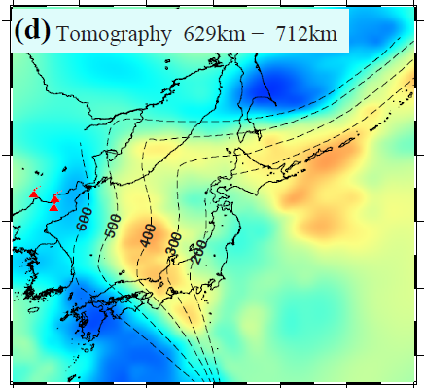
Results
“Apparent Depth”
After 3D Velocity
Correction (GAP_P4)
Wang et al.,in Revision, 2016

Slide 16

Synthetic Experiments & Resolution Test
2D Synthetic tests:
AxiSEM
(Nissen-Meyer et al., 2014)

Slide 17


Slide 18



Slide 19
Results
“Apparent Depth”
After 3D Velocity
Correction (GAP_P4)
Wang et al.,in Revision, 2016

Slide 20

CRP Cross Sections

Slide 21





Comparison-1 ScS & SdP
Method: ScS
A Sharp change
(Li et al., GRL, 2008)
Method: SdP

Slide 22

Comparison -2: ScS & RF
(Niu, et al., EPSL, 2005)
RF: Hi-Net (High Frequency )
ScS: ~10 s

Slide 23





Discussion: 660-km Discontinuity
(Fukao & Obayashi, JGR, 2013)
Topography of the 660
3D corrected by GAP_P4 →

Slide 24





ScS
ScS
Topography
of the 660
(Tono. et al., JGR, 2005)
(Yamada, et al, Gondwana, 2009)
RF
RF
RF
(Tomegawa. et al., EPS, 2005)
(Niu. et al., EPSL, 2005)
(Lee et al., JGR, 2014)

Slide 25

660-km discontinuity
SW of Japan Sea & South of Okhotsk Sea
Depression of the 660, 15-20 km
Subduction related temperature anomaly
East of Japan
660 is Shallower 5-15 km
Hot material
Clapeyron slope: -2.0MPa/K for post-spinel transformation
Maximum 20km depression (southwest Japan) → -300 K
15km elevation (east Japan) correspond to lateral temperature variations of +220 K
(Fukao & Obayashi, JGR, 2013)

Slide 26



410-km discontinuity
(Fukao & Obayashi, JGR, 2013)
An obvious elevation of the 410 in the SW part of Japan Island, elevated ~8-20 km；
East part of Japan Island: the 410 depressed ~5-10 km
West part of study region, the 410 depressed 10-15 km；

Slide 27



RF
RF
(Tonegawa. et al., EPS, 2005)
(Niu. et al., EPSL, 2005)
1. SW of Japan Island: 410 uplift ~ 15 km
maximum ~20km Lee et al., 2014:
~15-20km Tonegawa et al., 2005:
~10-20km Niu et al., 2005:
~20km Tono et al., 2005:
RF
Average 15km uplift 410-km discontinuity, a colder temperature of about 150 K than normal mantle can be inferred by using the Clapeyron slope of +3MPa/K.
(Lee et al., JGR, 2014)

Slide 28





East of Japan
the 410 depressed ~5-10 km
Temperature anomaly
(a hotter region) ~50-100 K
3D Corrected
(Obayashi et al, EPSL, 2006)
(Tomography data from Fukao & Obayashi, JGR, 2013)

Slide 29


3. SW Japan: the 410 depressed ~ 10-15km
our RF study
Our RF study
Go Further West
RF Data: NECESSArray
+ NECSaids Array
RF
Depression of the 410:
Robust Feature
(Lee. et al., JGR, 2014)

Slide 30



Large-scale subsidence (~10-15km) west part of Japan Sea
? Temperature anomaly: a hotter region?

Slide 31


Water or chemical composition
(Schmerr & Garnero, Science, 2007)
water related boundary, which might represent a hydrated Wadsleyite boundary.
Notes:
Using high-resolution stacks of precursors to the seismic phase SS, we investigated seismic discontinuities associated with mineralogical phase changes approximately 410 and 660 kilometers (km) deep within Earth beneath South America and the surrounding oceans. Detailed maps of phase boundary topography revealed deep 410- and 660-km discontinuities in the down-dip direction of subduction, inconsistent with purely isochemical olivine phase transformation in response to lowered temperatures. Mechanisms invoking chemical heterogeneity within the mantle transition zone were explored to explain this feature. In some regions, multiple reflections from the discontinuities were detected, consistent with partial melt near 410-km depth and/or additional phase changes near 660-km depth. Thus, the origin of upper mantle heterogeneity has both chemical and thermal contributions and is associated with deeply rooted tectonic processes.

Slide 32

MTZ Thickness
Thickened MTZ:
SW Japan ~ 270 km; West Japan Sea + Ohkotsk Sea ~ 260 km;
Thinned MTZ:
NE Japan Islands + East Japan Sea ~ 235 km

Slide 33
Summary
ScS Multiples can be used as a good way to obtain the topography of the 410 and 660. A complimentary to RF and other methods.
We obtain the structure of mantle transition zone beneath Japan Sea and adjacent regions using ScS multiple-waves.
  The 660
  Beneath SW Japan and south of Okhotsk Sea, the 660 depressed 15-20 km
  East part of Japan, the 660 is uplifted slightly (5-12 km)
  Subduction related thermal anomaly
  The 410: Complex behavior of the 410
  Observed local uplift of the 410 around the 400 km iso-depth line
  Depression of the 410 to the east of Japan Island
  Related with subduction
  West of the 400 km iso-depth line, the 410 is depressed.
  We interpret it to be water related boundary, which might represent a hydrated Wadsleyite boundary.

Slide 34
（热点）问题 & 思考
间断面性质（地震学上的观测）
Topography (410-, 520-, 660-km Dis)
Sharpness
Velocity/Density contrast
Double/Multi Discontinuity
Anisotropy of MTZ
MTZ中水的存在
410-km 间断面上覆低速层（LVZ）

Slide 35

About Double-660 Discontinuity
A complex 660-km dis
Beneath NEChina
(Ai et al., 2003, EPSL)
• 华北克拉通东北边界台阵
(121-122°)
Double 660：660km,690km
(王炳瑜等，2013，地球物理学报)
• CEArray
黄海 Double 660
(Wang Xinlin and Niu F.L.,
2011, Eq. Sci.)
• National Seismograph Network, Eqs 2004-2006
Beneath eastern China
部分台站下方，690-750 km
(Gao Y. et al., PEPI, 2010)
华北固体台网
660-670km； 690-710 km
（刘震等，2016，地球物理学报）

Slide 36

地球内部的海绵层
(The Earth’s Sponge Layer)
(Hirschmann, 2006)
矿物物理实验：
  MTZ之上的上地幔和下地幔储水能力弱，0.1-0.2wt%
  MTZ矿物，可以达到3wt%，10-30倍
Notes:
Figure 1
Possible regions of hydrous melting in the mantle. Shaded regions show possible loci of
hydrous melting in the mantle discussed in the text (a) melting in mantle wedges above
subduction zones, (b) melting in the deeper portions of OIB source regions, (c) melting in the
deeper portions of MORB source regions, (d ) pervasive melting above the 410 km
discontinuity, (e) melting in localized upwellings above the 410 km discontinuity, and ( f )
melting in downwellings below the 670 km discontinuity. Residues from melting in regions
(a), (b), and (d ) have been suggested as possible principal sources of the upper mantle (see text).
At right is a schematic view of the H2O storage capacity as a function of depth.
630

Slide 37


地幔过渡带中的“水”
(Nature，2014)
地点： Juina(茹伊纳）,巴西
发现： 金刚石里包的ringwoodite
第一个尖晶橄榄石地球样本

Slide 38


含有ringwoodite 包体的金刚石，Juína, Brazil.
最长边直径：5 mm
X-ray 衍射 + 拉曼红外光谱 +
FTIR Spectroscopy
(Nature, 2014, March 13, Hans Keppler)
(Nature, 2014, Pearson et al.)
→ 地幔转换带(MTZ)含水 1wt%

Slide 39


Study Area
Eurasian Plate
Atlantic
Mediterranean
African Plate
Method: Receiver Function Study
  18 Temporary stations + 6 permanent stations
  About 500 seismograms
  Frequency: High-pass filtered (0.05HZ)
      Multiple low-pass filtered (0.15-0.75HZ)

Slide 40


通常关注“Ps到时”
关注Ps振幅
P-s phase Amplitude varying with Frequency (Synthetic test)
20km
6km
0.15HZ
0.75HZ
410 thickness: 20 km thick
6 km thick

Slide 41


Low T vs. Water
Observed 20- 35 km thickness
If only T anomaly decrease 300K → 10 km thickness
0.75hz → 0.15hz
0.75hz → 0.15hz
0.75hz → 0.15hz

Slide 42

太平洋地区地幔转换带水含量: ~0.1-0.2 wt.%
电导率观测
Electric conductivity in the upper and lower transition zone of the Pacific
Wadsleyite
Ringwoodite
(Huang et al. ,2005, Nature)
Notes:
Figure 2 The influence of temperature and water content on electrical conductivity.
a, Wadsleyite; b, ringwoodite. The experimental results summarized in Table 1 are
corrected for oxygen fugacity effects (see text for details). The numbers on the curves
represent electrical conductivity (in Sm21). The light green shaded areas represent
temperatures of 1,850^100 K; the yellow shaded areas represent the electrical
conductivity ranges in a the upper, and b the lower, transition zone in the Pacific4; the dark
green areas represent the range of temperature and water content that is consistent with
the observations. The water content in the transition zone in the Pacific is ,0.1–0.2 wt%
inferred from both wadsleyite and ringwoodite.

Slide 43



High Electricity Conductivity
Geochemistry
water rich
(Ichiki etal, 2006; Karato, 2011)
(Kuritani, 2011)
Electrical conductivity
(Kelbert, et al, Nature, 2009)
(Li et al., EPSL, 2013;
Li et al., AGU Monograph, 2016 )
MTZ: Vp正常, Vs低速
高Vp/Vs

Slide 44

410-km上覆低速层(LVZ)
日本海,黄海和亚洲东部410-km间断面上方约330km深度处存在一个低速带，波阻抗降低～5.8%
Revenaugh & Sipkin, Nature, 1994

Slide 45


美国西部
410-km间断面之上存在一层20-90km厚的低速层，波速降低幅度～5%；
解释为组分异常，可能是较重的部分熔融层，与古老的Farallon板块俯冲及弧后扩张有关
T.-R. Song et al., 2004, Nature

Slide 46






我国东部
李国辉 等，地球物理学报，2014
眭怡 & 周元泽，地震学报，2015
王秀姣，博士论文，2015

Slide 47

地幔过渡带顶部低速层结构特征
周晓亚等，地球物理学进展，2014

Slide 48
有关建立参考模型的思考
比较？
看到了相同，也看到了不同，如何认识？
相同的方法 + 不同的方法
数据的差异，处理方法的差异
frequency不同，分辨率的不同
采用模型的不同
共享？
原始数据：波形 + 发现的问题
结果：最终结果 + 间接结果
（e.g. processed waveform in time domain)

Slide 49

谢谢聆听,
请指正 ！

Slide 50


Slide 51


Slide 52


Slide 53


Hit Densities for 660-km and 410-km

Slide 54

Helffrich & Wood, Nature, 2001
 | 410-km (13-14GPa) Olivine -> Wadsleyite |  | 520-km (18GPa) Wadsleyite -> Ringwoodite |  | 660-km (23GPa) Ringwoodite -> Perovskite + Magnesiowustite
 | Depth | Thickness | Depth | Thickness | Depth | Thickness
Temperature ↑ | 下沉 | 变薄 | 下沉 | Unknown | 上隆 | ---
Water ↑ | 上隆 | 变厚 | Unknown | 变薄 | 下沉 | 变薄
Mg/Fe ↑ | 下沉 | 变薄 | Unknown | Unknown | Unknown | Unknown
Al ↑ | 下沉 | 变薄 | Unknown | Unknown | Double 660km | 变厚
Unknown 表示没有查到相关资料
--- 表示影响很小，可忽略不计
Temperature & Water 仅在Olivine相变下适应
Notes:
在含水条件下，橄榄石-瓦兹利石相变界面会向低压方向便宜
Mg-Fe元素在橄榄石、瓦兹利石和石榴石的再分配作用，将会导致橄榄石-瓦兹利石的相变区间变小，使不连续面变薄。在1400无水条件下，Mg-Fe分配作用会使橄榄石-瓦兹利石的相变压力区间仅为0.2GPa，相当于6km。
Al在橄榄石体系中含量较低，主要富集在辉石-石榴子石体系中，体系中的Al含量会直接影响石榴子石稳定域，由于辉石-石榴子石反应，进一步影响体系中橄榄石-瓦兹利石的Fe含量及辉石含量。高Al会导致Fe减少

Slide 55
Earthquake information
Event | Origin Date (YYYYMMDD_HHMM) | Lat. (ºN) | Lon. (ºE) | Magnitude (Mw) | Depth (km) | Phase
1 | 19990408_1310 | 43.66 | 130.47 | 7.1 | 575.4 | sScS sScS2 sScS3
2 | 20020628_1719 | 43.74 | 130.45 | 7.3 | 581.5 | sScS sScS2 sScS3
3 | 20020915_0839 | 44.77 | 130.04 | 6.4 | 589.4 | sScS sScS2 sScS3
4 | 20021117_0453 | 47.81 | 146.45 | 7.3 | 479.8 | sScS sScS2 sScS3
5 | 20030727_0625 | 46.99 | 139.23 | 6.7 | 477.2 | sScS sScS2 sScS3
6 | 20030831_2307 | 43.38 | 132.37 | 6.1 | 493.0 | sScS sScS2 sScS3
7 | 20070309_0322 | 43.22 | 133.65 | 6.0 | 451.1 | sScS sScS2
8 | 20080705_0212 | 54.12 | 153.37 | 7.7 | 610.8 | sScS sScS2 sScS3
9 | 20081124_0903 | 54.27 | 154.71 | 7.3 | 502.3 | sScS sScS2 sScS3
10 | 20091210_0230 | 53.44 | 152.77 | 6.3 | 655.7 | sScS sScS2
11 | 20091224_0023 | 42.12 | 134.93 | 6.3 | 390.4 | sScS sScS2 sScS3
12 | 20100218_0113 | 42.48 | 130.66 | 6.9 | 578.7 | sScS sScS2 sScS3
13 | 20120814_0259 | 49.97 | 145.70 | 7.7 | 598.2 | sScS sScS2
14 | 20130405_1300 | 42.77 | 131.02 | 6.3 | 571.9 | sScS sScS2 sScS3
15 | 20130524_0544 | 54.61 | 153.77 | 8.3 | 611.0 | sScS sScS2 sScS3
16 | 20131001_0338 | 53.20 | 152.81 | 6.7 | 585.5 | sScS sScS2 sScS3

Slide 56


Slowness stack (A) PP (B) Synthetic based on iasp91
(C) SS (D) Stack of PP wave synthetic from model EK1
P410P ~1s earlier than in IASP91, P410P/PP is ~2%, about 60% of the ratio calculated for IASP91; No P660P
Lame constant λ at 660-km dis
→ ΔVp = 2%
ΔVS, Δρ
(Science,1996, C. Estabrook and R. Kind) The nature of the 660-km Upper-mante Sciemic Discontinuity from Precursors to the PP Phase

Slide 57


Stacking 70 seismograms that recorded P′₄₁₀P ′ & P ′ ₆₆₀P ′ phase
High frequency:
410- and 660-dis are sharp, at least locally !
No clear 520-dis
Nature,1993,Benz & Vadale
Notes:
High-frequency observations and synthetic seismograms clearly show that the 410-km discontinuity is, at least locally, too sharp for its current phase boundary explanation.

Slide 58







Slowness-time Stacking
Ambient Seismic Noise
42 stations
Northern Finland
Cross-correlation
(Poli et al., Science, 2012)

Slide 59

Data fit and final 1D model obtained from forward modeling
(Poli et al., Science, 2012)

Slide 60

(Kelbert et al., 2009, Nature)
Inversioin of long period geomagnetic response functions →
3D model of electrical conductivity (Data: 59 Observatories)
Support the view that at least some of the water in the transition zone has been carried into that region by cold subducting slabs.

